Slide 1
Simple Machine Test Bed Investigation

Slide 2
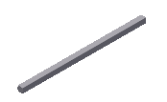
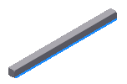
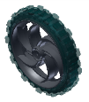
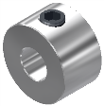
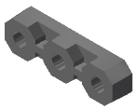
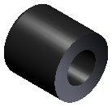
Resistance Force – We will be using a mass made of the following components.
Part | Name | Quantity
 | 3” Drive Shaft | 2
 | 2” Drive Shaft | 1
 | Large Wheel | 2
 | Shaft Collar | 8
 | Bearing Flat, Delrin | 2
 | Large Spacer | 4
 | Square Plate 5x5 | 2
 | Plus Gusset | 3

Slide 3
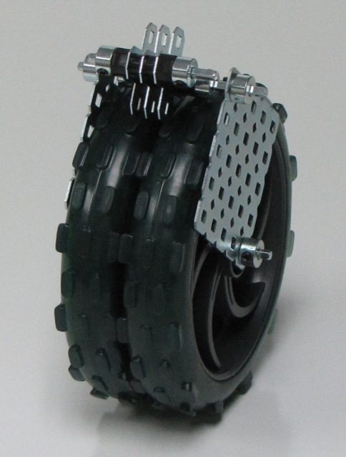
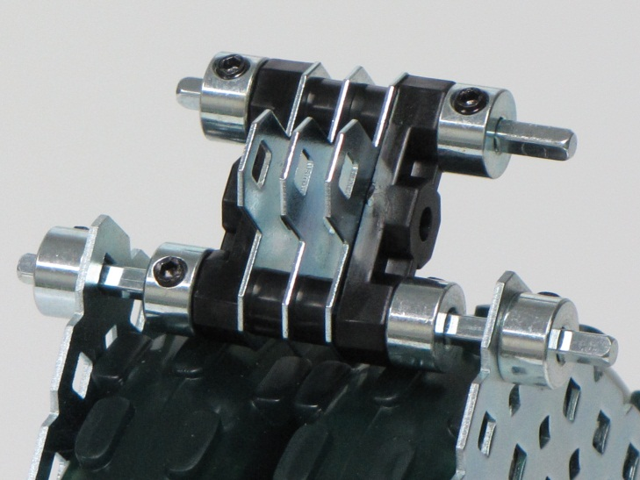
Step 2: Assemble the resistance force
Use the force meter to measure the value of the resistance force

Slide 4
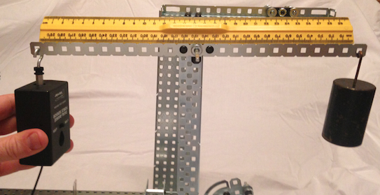
1st Class Lever
1.) Using your Simple Machines Test Bed (SMTB) set up a first class lever and create a scaled annotated drawing, measuring and labeling your D_{E} and D_{R}.
2.) Calculate the IMA.
3.) Measure the F_{E}.
4.) Calculate the AMA.
5.) Calculate the efficiency.
6.) Depending on where you
put the fulcrum what are
possible IMAs of a
1st class lever?

Slide 5
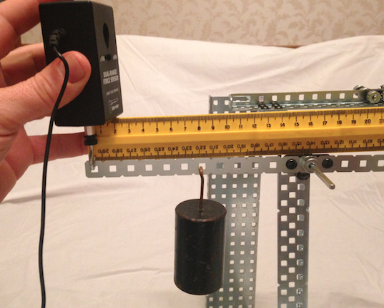
2nd Class Lever
1.) Using your SMTB set up a second class lever and create a scaled annotated drawing, measuring and labeling your D_{E} and D_{R}.
2.) Calculate the IMA.
3.) Measure the F_{E}.
4.) Calculate the AMA.
5.) Calculate the efficiency.
6.) What are possible IMAs
of a 2nd class lever?

Slide 6
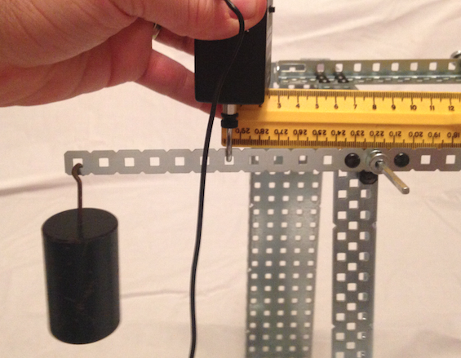
3rd Class Lever
1.) Using your SMTB set up a third class lever and create a scaled annotated drawing, measuring and labeling your D_{E} and D_{R}.
2.) Calculate the IMA.
3.) Measure the F_{E}.
4.) Calculate the AMA.
5.) Calculate the efficiency.
6.) What are possible IMAs
of a 3rd class lever?

Slide 7
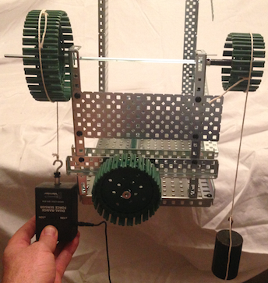
Wheel and Axle
1.) Using your SMTB create a scaled annotated drawing of your wheel and axle, measuring and labeling your Diameter_{wheel} and Diameter_{axle} and calculating their circumferences.
Calculate and measure the following assuming the effort force is applied to the wheel:
2.) Calculate the IMA.
3.) Measure the F_{E}.
4.) Calculate the AMA.
5.) Calculate the efficiency.
6.) What happens to the answers
above if the effort force is
applied to the axle and why
might we want to do that?

Slide 8
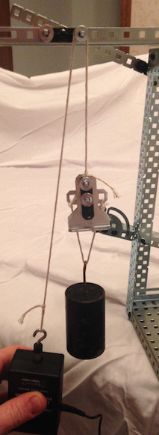
Fixed Pulley
(Measure the weight of the pulley apparatus to add to the resistance force)
1.) Using your SMTB create a scaled
annotated drawing of your fixed pulley system.
2.) Calculate the IMA.
3.) Measure the F_{E}.
4.) Calculate the AMA.
5.) Calculate the efficiency.

Slide 9
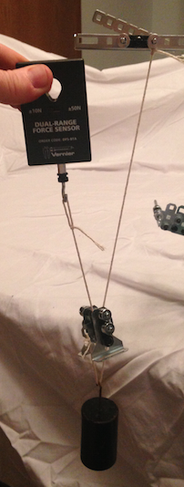
Movable Pulley
1.) Using your SMTB create a scaled annotated drawing of your movable pulley system.
2.) Calculate the IMA.
3.) Measure the F_{E}.
4.) Calculate the AMA.
5.) Calculate the efficiency.

Slide 10
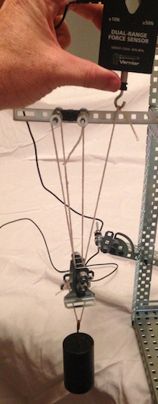
Block and Tackle
1.) Using your SMTB create a scaled annotated drawing of your block and tackle system.
2.) Calculate the IMA.
3.) Measure the F_{E}.
4.) Calculate the AMA.
5.) Calculate the efficiency.
6.) How does the mechanical
advantage relate to the
number of strands?

Slide 11
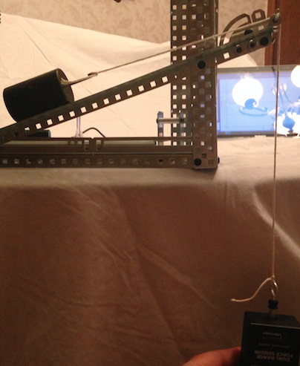
Inclined Plane
1.) Using your SMTB create a scaled annotated drawing of the inclined plane, measuring and labeling your D_{E} and D_{R}.
2.) Calculate the IMA.
3.) Measure the F_{E}.
4.) Calculate the AMA.
5.) Calculate the efficiency.

Slide 12
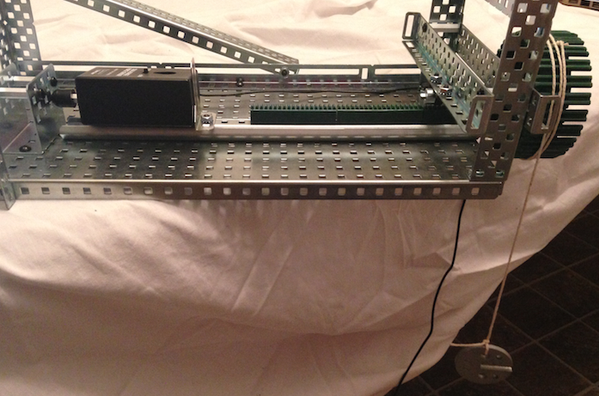
The Screw
(Replace the hook with the bumper on the Force Meter and use the 50.0 g mass as the F_{E})
1.) Measure the diameter and calculate the circumference of the “head” of the screw.
2.) Measure the distance the screw moves forward with one turn of the “head” of the screw.
3.) Measure the distance between
threads (pitch) on the worm gear
and compare to #2.
4.) Calculate the IMA.
5.) Measure the F_{R}.
6.) Calculate the AMA.
7.) Calculate the efficiency.

