Slide 1
Simple Machines
Test Bed Construction
Principles Of Engineering

Slide 2
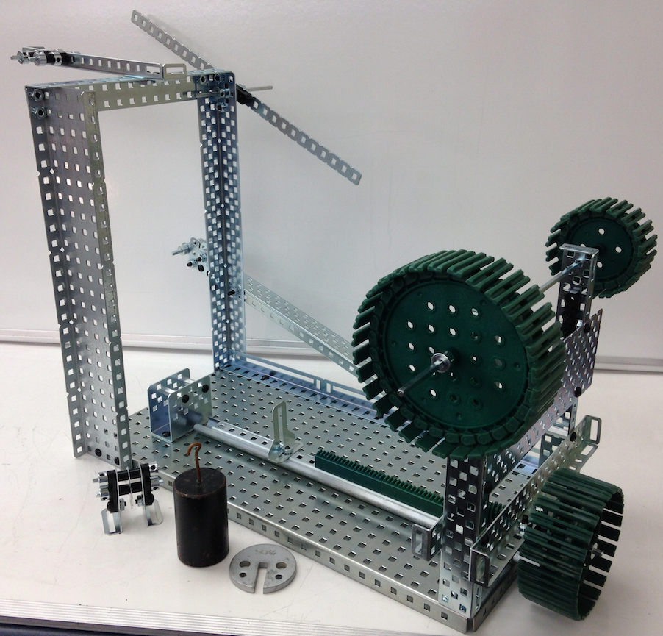

Slide 3
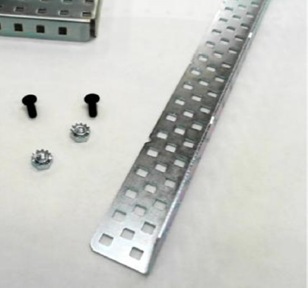
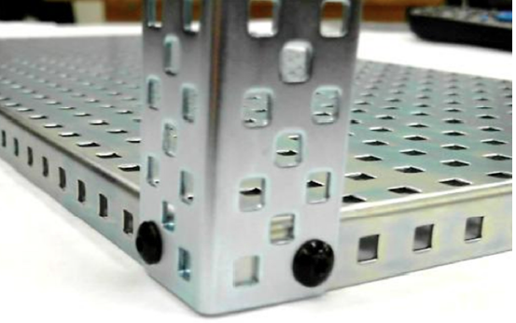
Lever
Collect a base plate and these parts to build the lever support tower.
Attach the tower to the corner of the base plate.

Slide 4
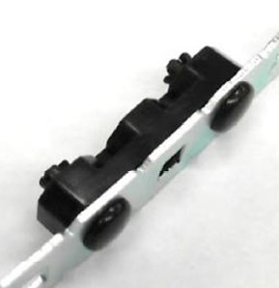
Lever
Collect the parts for the fulcrum and the lever arm
Attach bearing to lever arm with pop rivets.

Slide 5
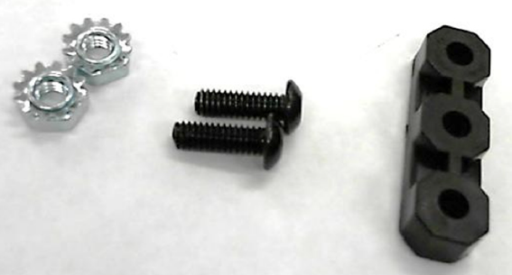
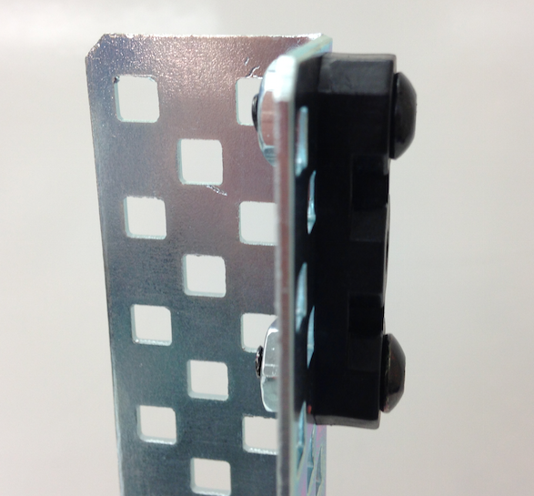
Lever
Collect the parts of the other half of the fulcrum.
Attach to the top of the tower.

Slide 6
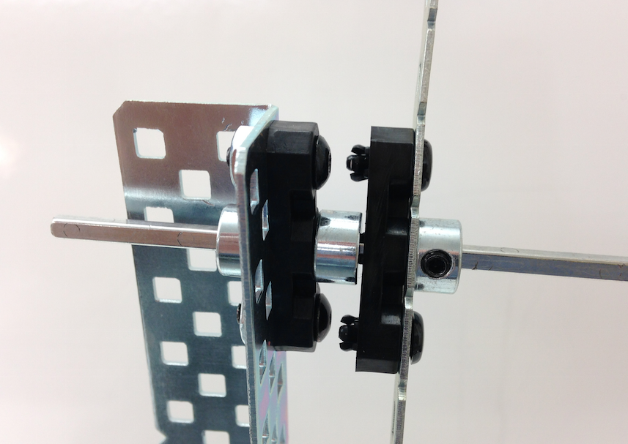
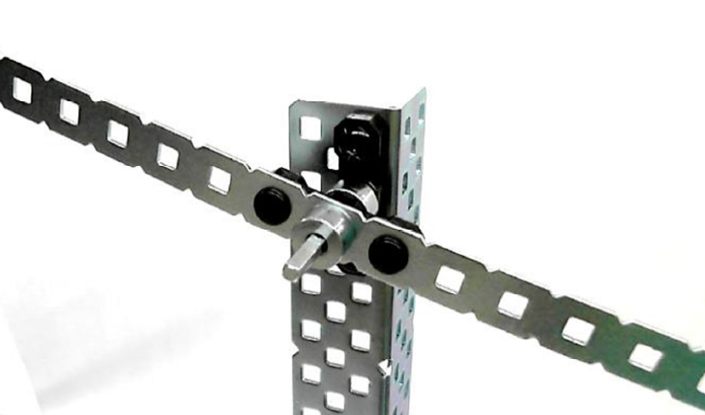
Lever
Attach the lever to the top of the tower as seen in this picture.
Your lever is now complete.

Slide 7
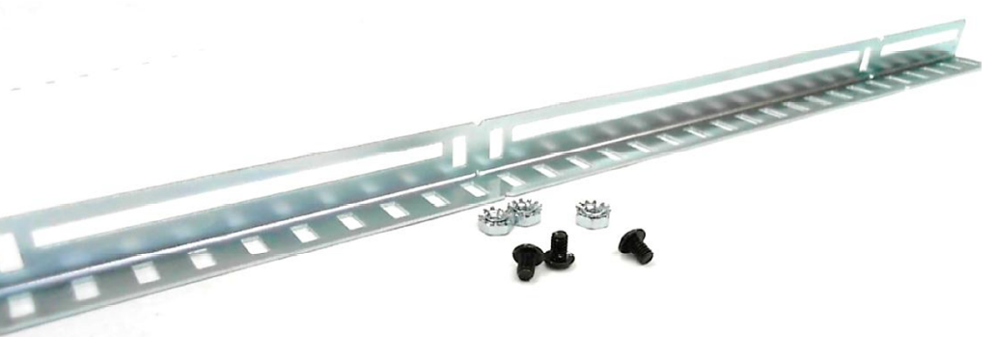
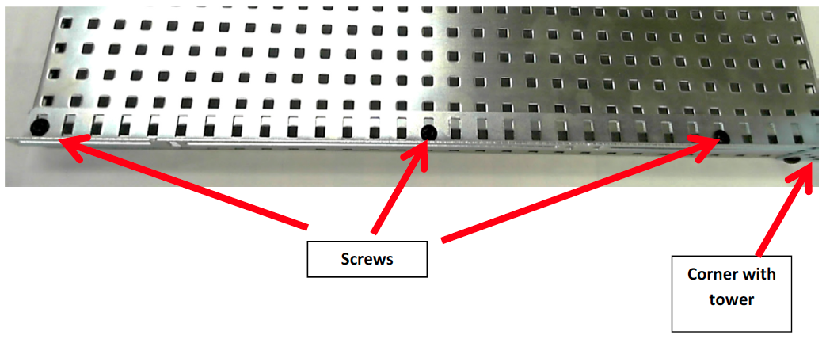
Inclined Plane
Collect the following parts: inverse slotted angle 1x28, 3 nut 8-32 Keps, 3 screws 8-32 x 0.25”
(lengths may vary)
Attach the rail to the base plate with the slotted side facing outward.

Slide 8
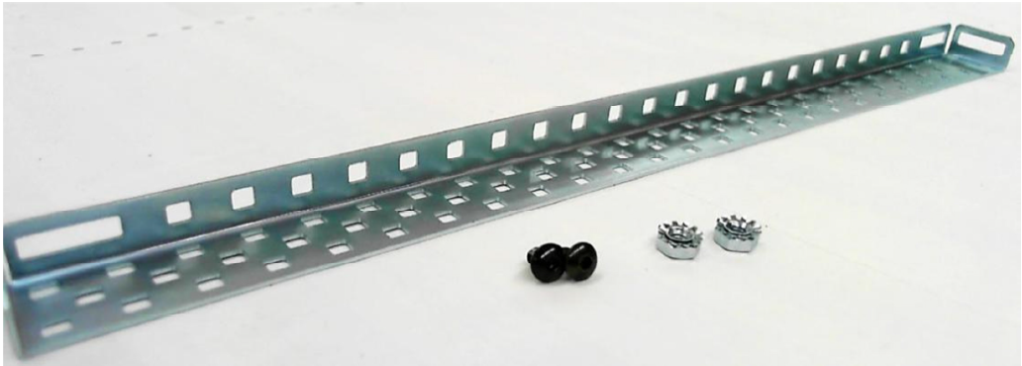
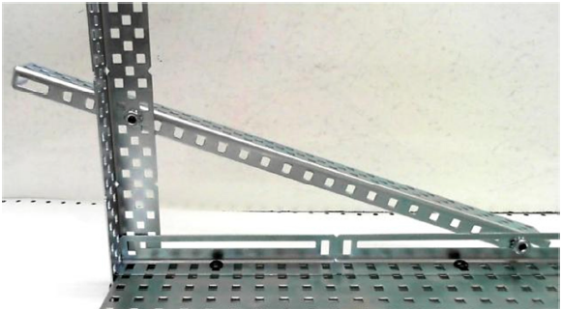
Inclined Plane
Collect the following parts:
Chassis Rail 1 x 25, 2 nuts 8-32 Keps, 2 screws 8-32 x 0.25”
Attach Rail: The rail is your inclined plane. You must have at least 2 inches extending beyond the edge of the tower and base plate.

Slide 9
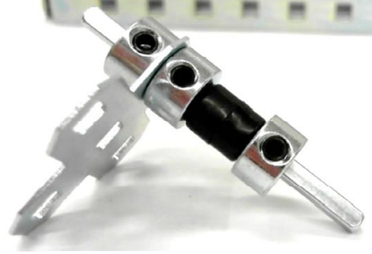
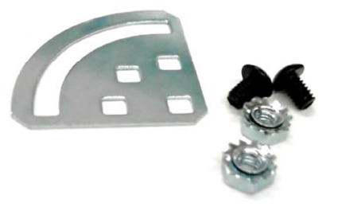
Inclined Plane
Collect parts and assemble pulley that will be attached at the top of the inclined plane. Parts—2” drive shaft, 3 shaft collars, 1 plus gusset, 2 thin spacers,
Collect parts that will be used to attach pulley assembly to the top of the inclined plane.

Slide 10
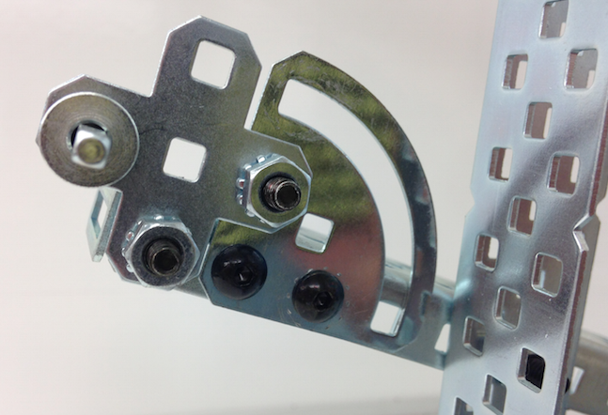
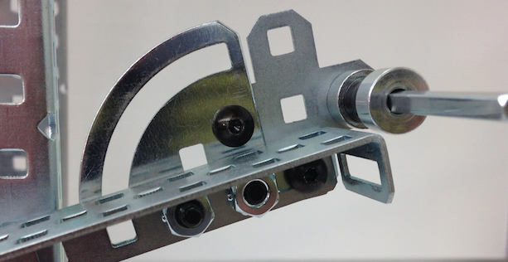
Inclined Plane
Attach gusset and the pulley assembly to the end of the inclined plane as shown in the pictures. Your incline plane is now complete.

Slide 11
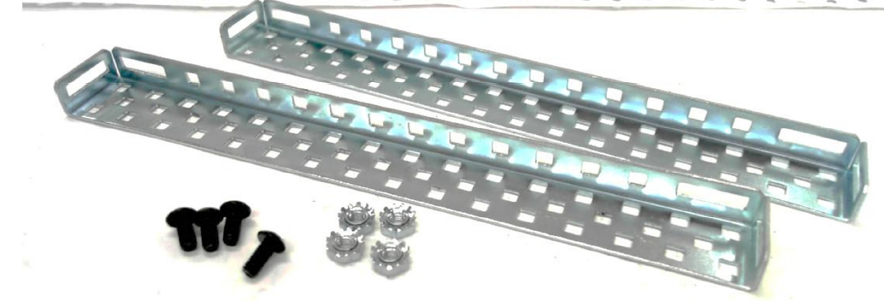
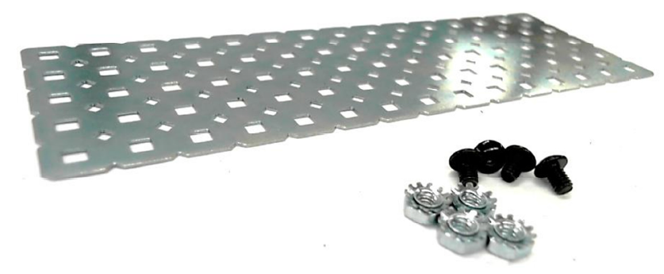
Wheel & Axle
Collect the following parts:

Slide 12
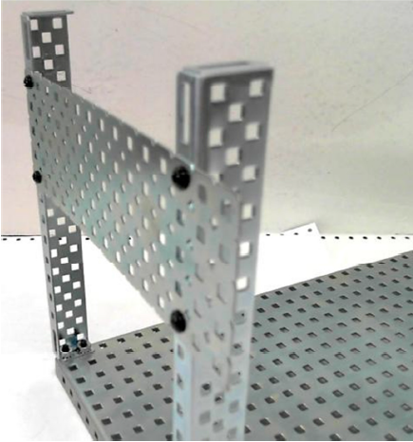
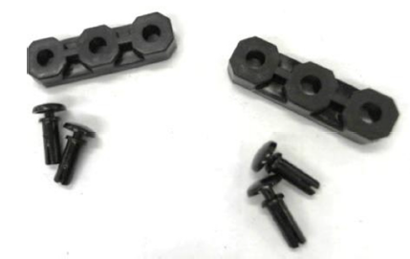
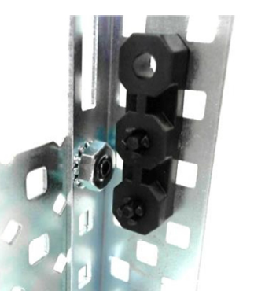
Wheel & Axle
Construct the uprights and the brace.
Collect these parts.
Attach bearings to uprights with the pop rivets.

Slide 13
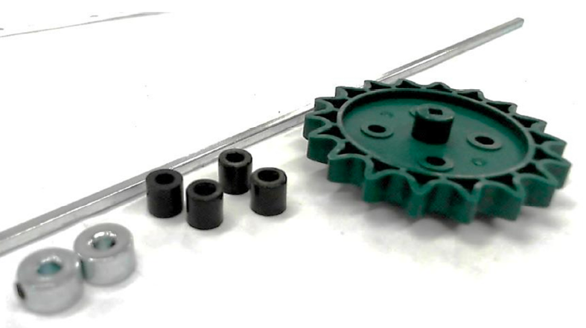
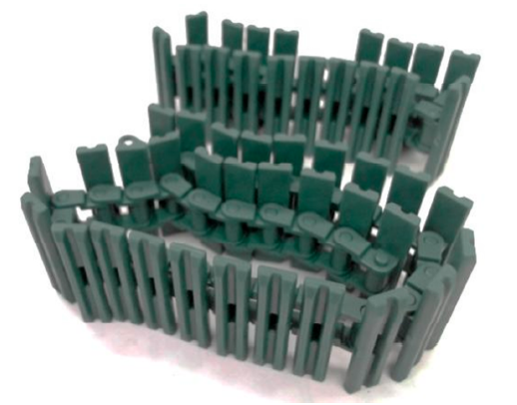
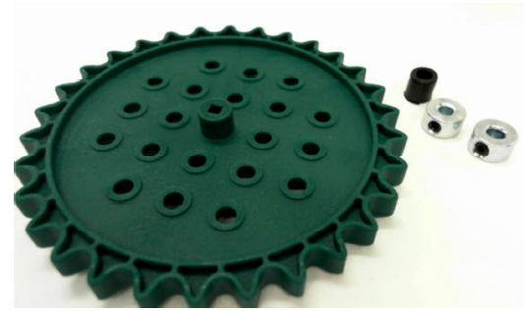
Wheel & Axle
Collect these parts.

Slide 14
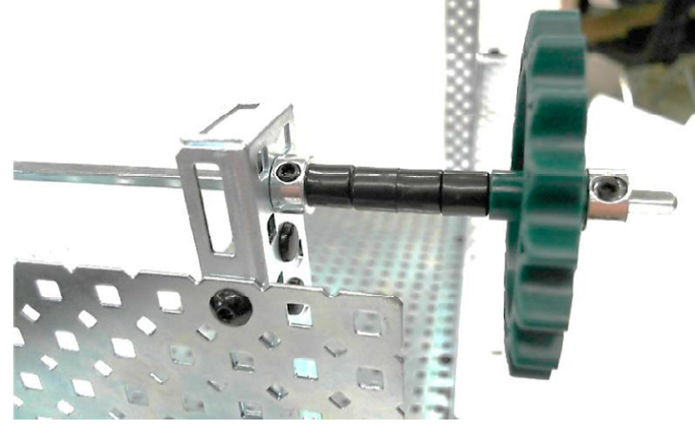
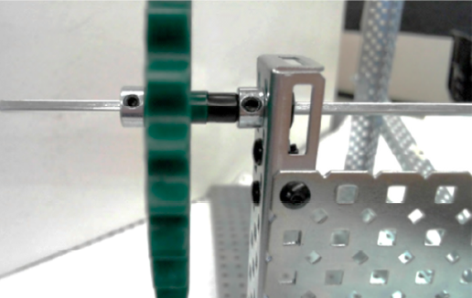
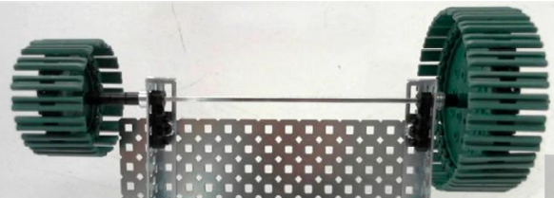
Wheel & Axle
Construct the Wheel & Axle.

Slide 15
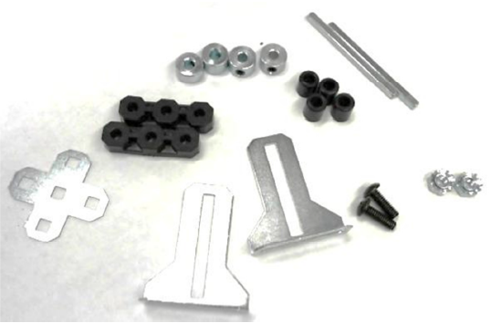
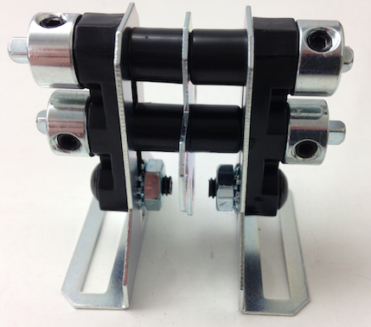
Pulley System
Collect these parts.
Assemble the movable pulley system.

Slide 16
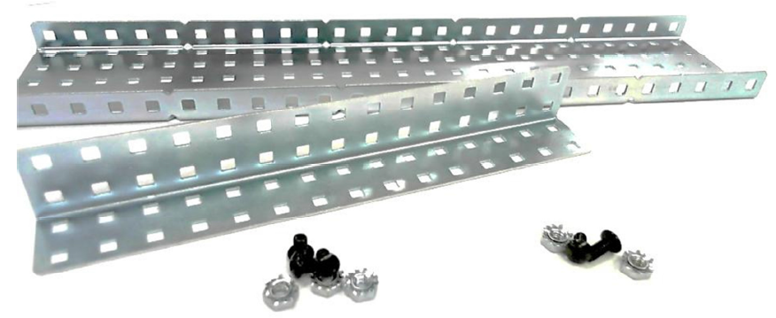
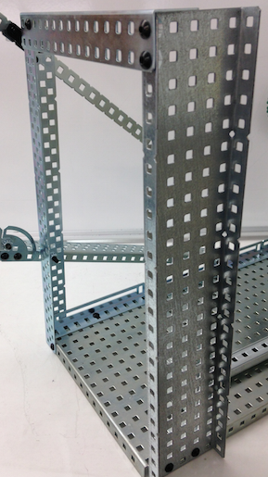
Pulley System
Collect these parts.
Assemble the pulley support system.

Slide 17
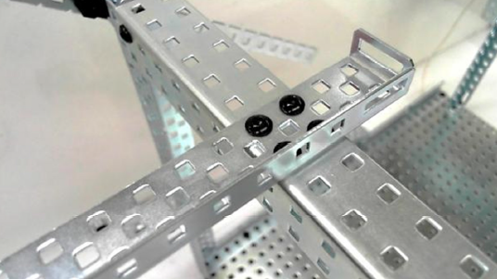
Pulley System
Collect these parts.
Assemble the pulley crossbeam support.

Slide 18
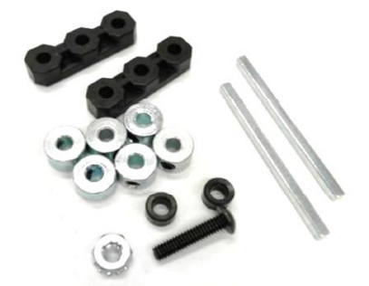
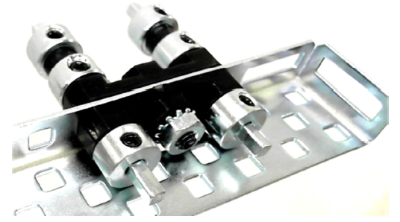
Pulley System
Collect these parts.
Assemble the fixed pulley at the end of the crossbeam support.

Slide 19
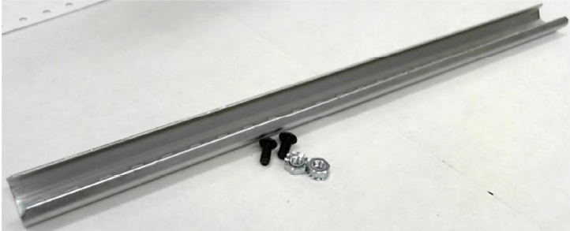
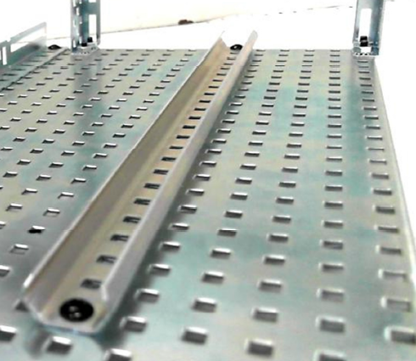
Screw Assembly
Collect these parts.
Attach to the base plate.

Slide 20
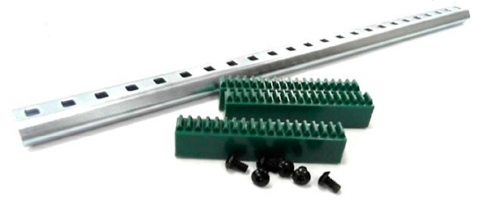
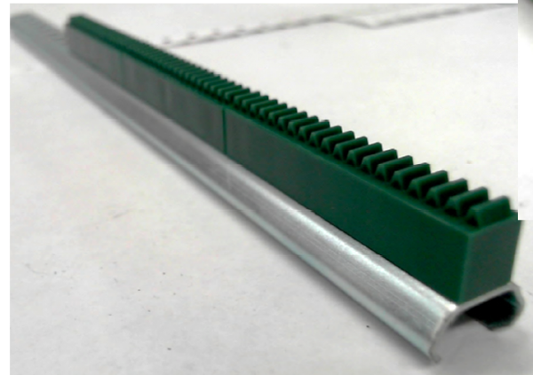
Screw Assembly
Collect these parts.
(These screws are the small 6-32 screws, not the normal 8-32)
Assemble.

Slide 21
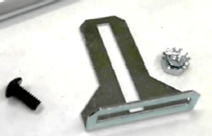
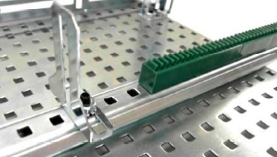
Screw Assembly
Collect these parts.
Attach to the slider and insert into the track.

Slide 22
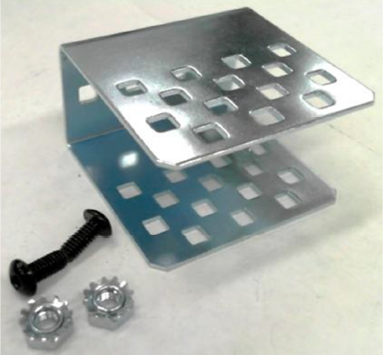
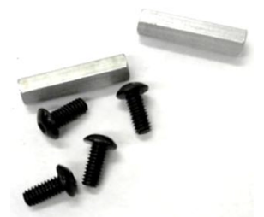
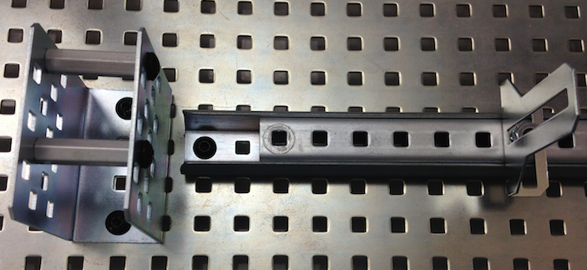
Screw Assembly
Collect these parts.
Assemble as shown.

Slide 23
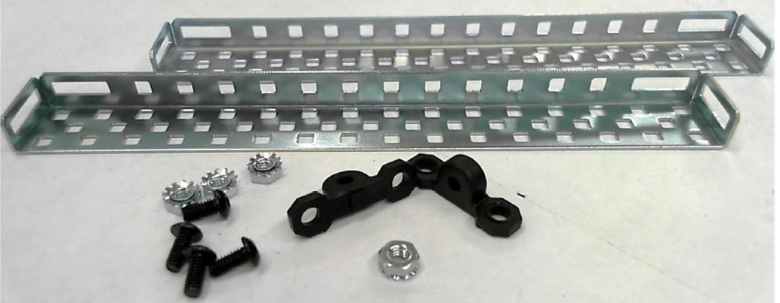
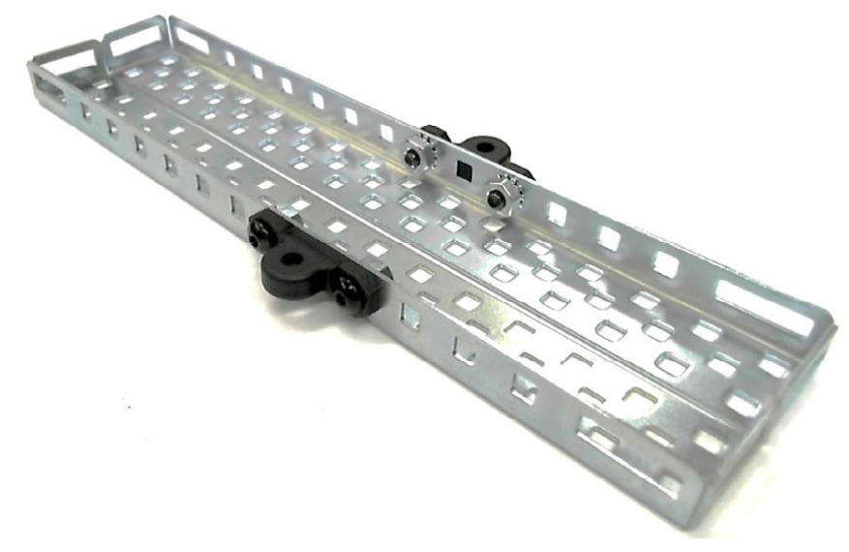
Screw Assembly
Collect these parts.
Assemble as shown.

Slide 24
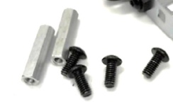
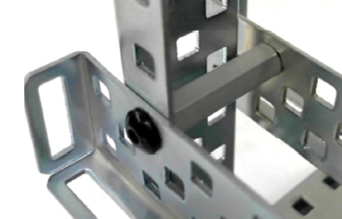
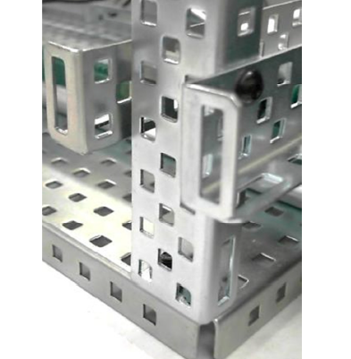
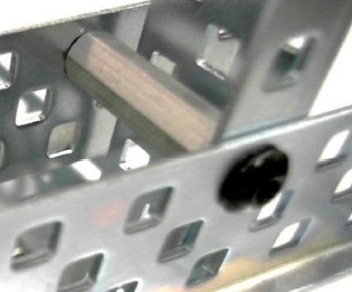
Screw Assembly
Collect these parts.
Assemble as shown.

Slide 25
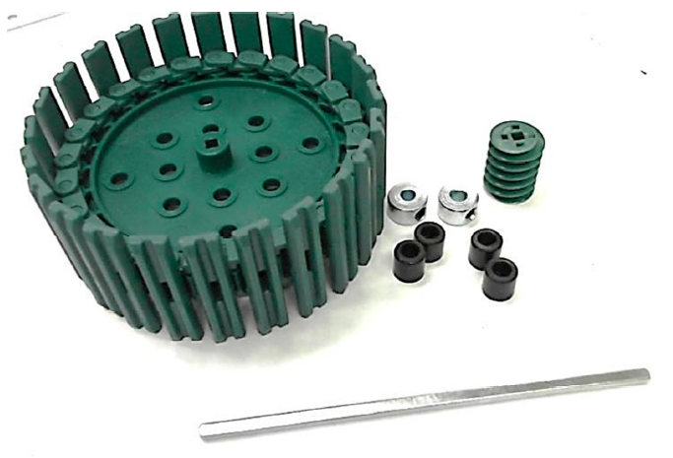
Screw Assembly
Collect these parts.
Assemble the worm gear assembly as shown.

Slide 26
Screw Assembly

Slide 27
Congratulations!
You have completed your Simple Machines
Test Bed Construction
Principles Of Engineering

