Slide 1
Flight Navigation and Planning
Radio Navigation
Aerospace Engineering
© 2011 Project Lead The Way, Inc.

Slide 2
Radio Navigation
ILS
Instrument Landing System
VOR
Very High Frequency Omni-Directional Range

Slide 3
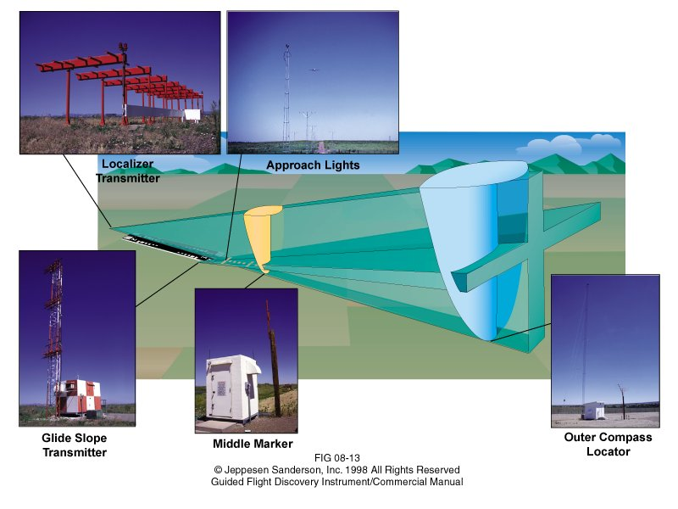
ILS – Instrument Landing System
Navigation aid to guide aircraft to runway
Notes:
Outer marker is location of start of descent (approaching at ILS inbound altitude). Middle marker is location of decision altitude (on glide slope).

Slide 4
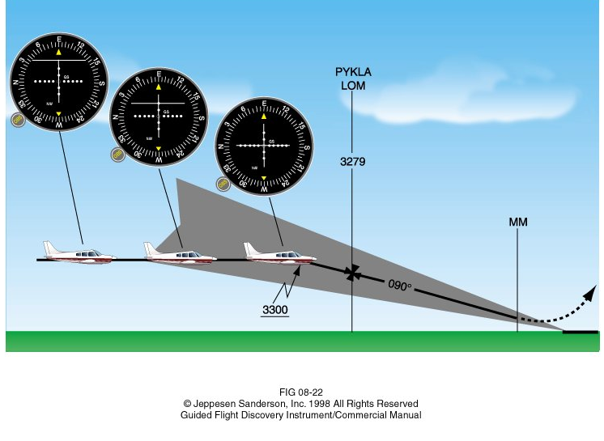
ILS – Instrument Landing System
Aligns aircraft along runway’s extended centerline (angle viewed from above)
Aligns aircraft on proper glide slope (angle viewed from side)

Slide 5
ILS Instrument

Slide 6
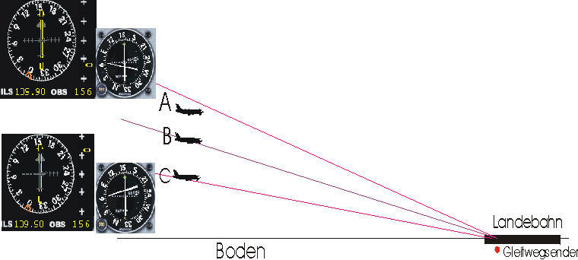
ILS Instrument Indications
Glideslope indication

Slide 7
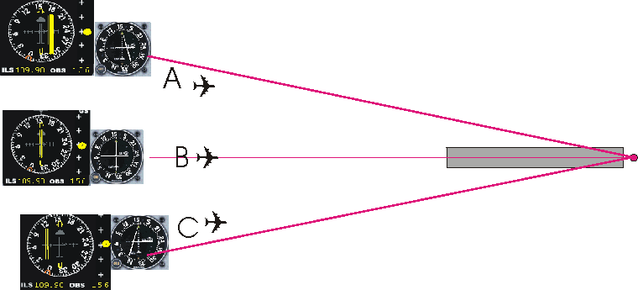
ILS Instrument Indications
Localizer indication

Slide 8
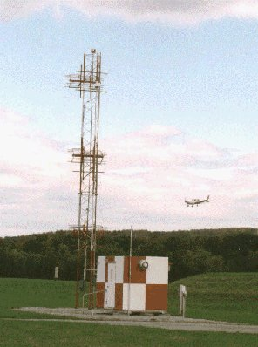
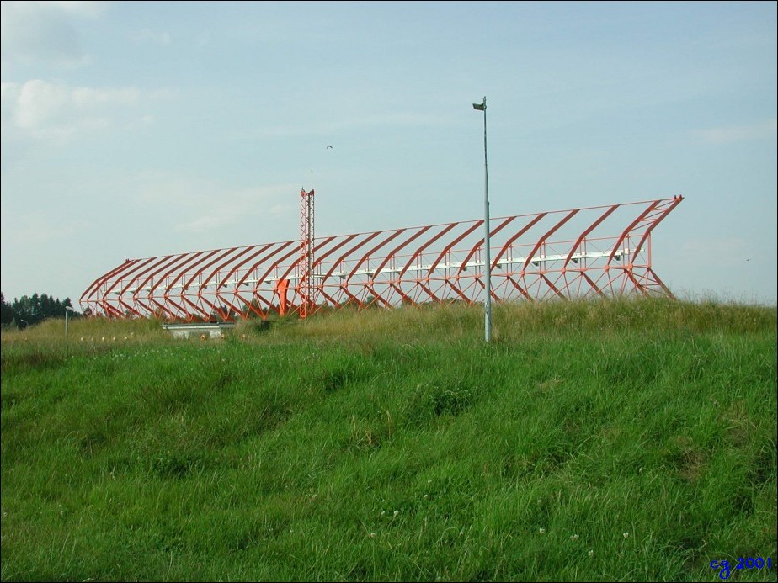
ILS Ground Equipment
Localizer (Centerline) Antenna
ILS Glide Slope Antenna

Slide 9
ILS Approach Plate Example
NAV2 VOR Approach
108.60 MHz
Radial 182
Morse _ _ … _.
NAV1 ILS Approach
110.10 MHz for R18
Morse .. _.. … _ _..
Maintain 2700 until the OUTER Marker
Normal Descent to MM

Slide 10
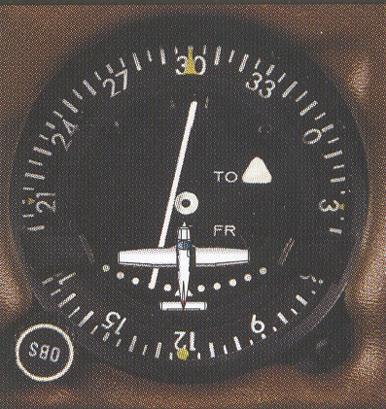
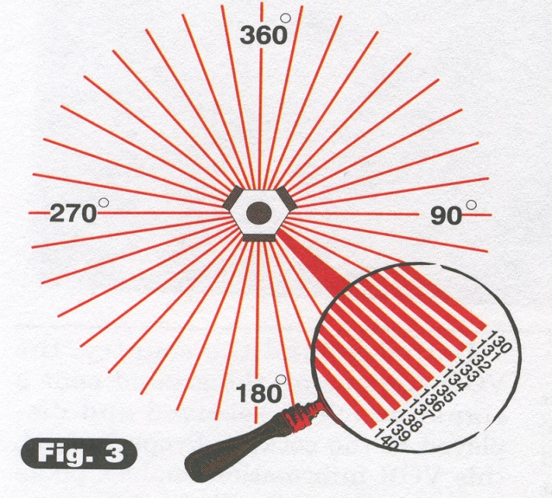
VOR - Very High Frequency Omni-Directional Range
Shows aircraft’s position relative to VOR radial
Very commonly used in aircraft

Slide 11
VOR Direction
Magnetic north is the basis for all navigation
Only reference direction is determined with the vacuum system
Magnetic north is accurate during an electrical failure
True North
Magnetic North
West
East
South

Slide 12
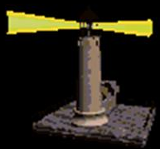
VOR Analogy
Imagine constant-rate rotating light beacon
Omni-Directional (all directions) strobe every time the beacon points north
Delay between strobe flash and sweeping beacon time is the number of degrees from north at which you are located

Slide 13
VOR Radials
VOR transmitter on ground
VOR radials transmit
direction information

Slide 14
VOR Radials
Radial is a specific beam transmitted by a VOR station
360 radials (one per degree)
Accurate navigation to 1° of precision
Radials named based on clockwise bearing from magnetic north
90° radial points to magnetic east from VOR station
Effective at 1000 ft AGL (above ground level)

Slide 15
VOR Benefits and Limitations
Benefits
Multiple stations, so multiple cross checks
Very little interference from lightning
Straight line courses
Automatic wind drift correction
Works regardless of aircraft orientation
Limitations
Ground-based transmitters
Line of sight (VHF) frequencies
Limited range at low altitude
Limited range at higher altitudes (not a global solution)

Slide 16
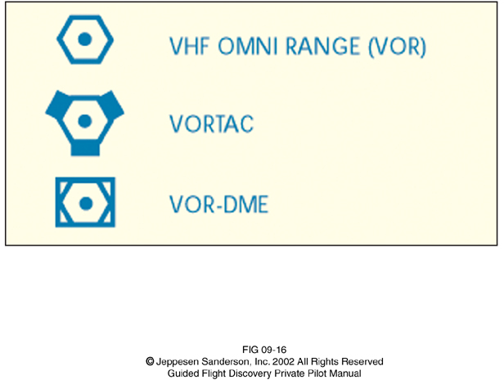
VOR Sectional Chart Symbols
VOR co-situated with a
TACAN (TACtical Air Navigation)
(Military Navigation)
Distance Measuring Equipment

Slide 17
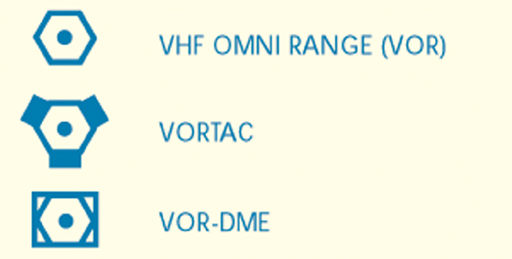
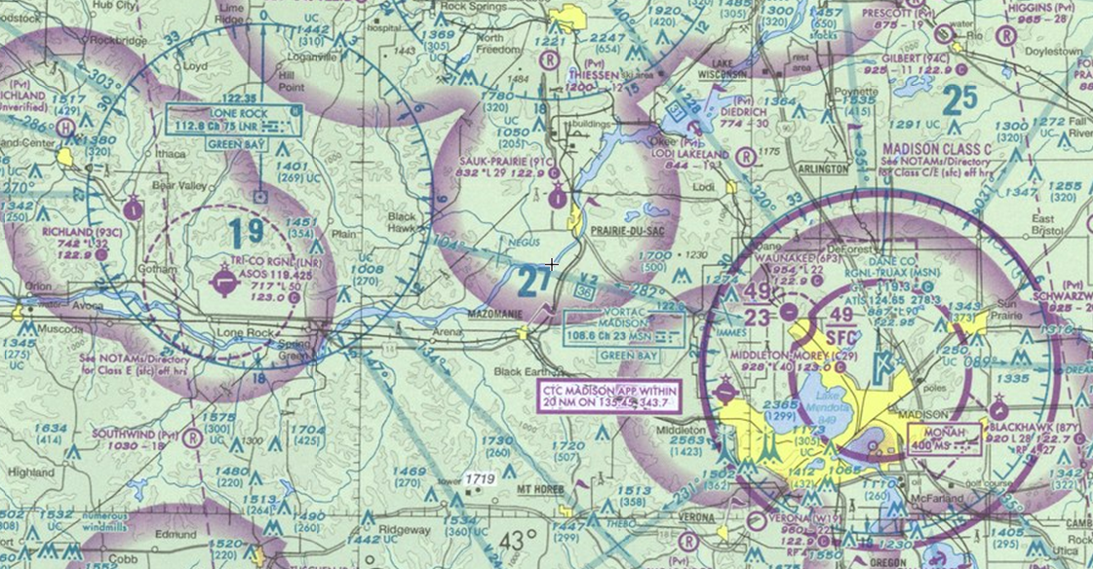
VOR Sectional Chart
VOR has blue-colored compass rose showing magnetic direction of radials transmitted
VOR-DME
Click image above to view sectional map in your area
Notes:
Go to http://skyvector.com/ to see a sectional chart in your area. Enter your local airport code or click the airport icon at the top of the page to search.

Slide 18
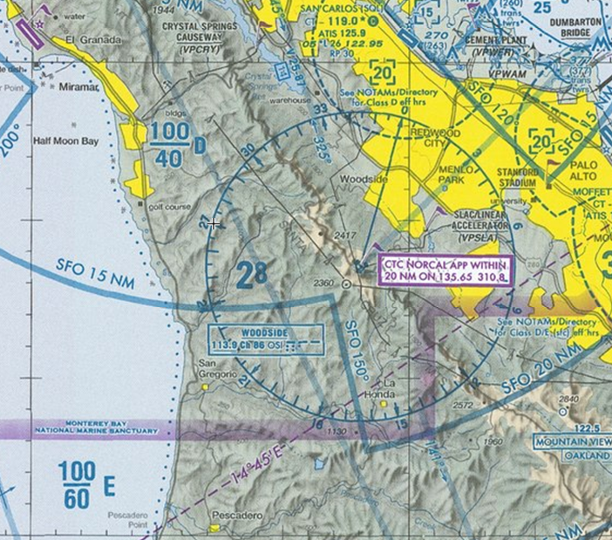
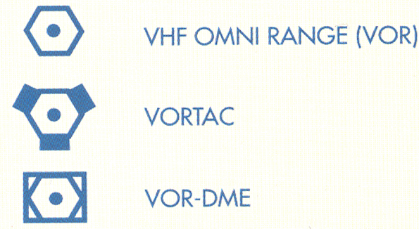
VOR Sectional Chart
VORTAC
VOR has blue-colored compass rose showing magnetic direction of radials transmitted
Note alignment of Victor Airway (V 25-87)
Click the image above to view a sectional map in your area
Notes:
Go to http://skyvector.com/ to see a sectional chart in your area. Enter your local airport code or click the airport icon at the top of the page to search.

Slide 19
VOR Compass Rose
VOR includes a blue-colored compass rose showing magnetic direction of radials transmitted
Note alignment of Victor Airway (V 228)
Wisconsin aero on sectional charts

Slide 20
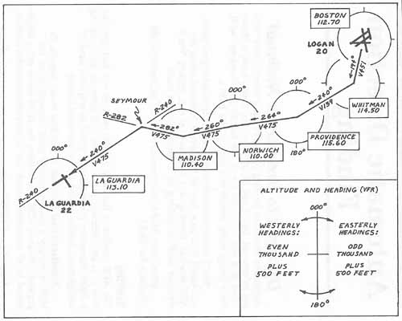
On this flight, from Boston to New York

Slide 21
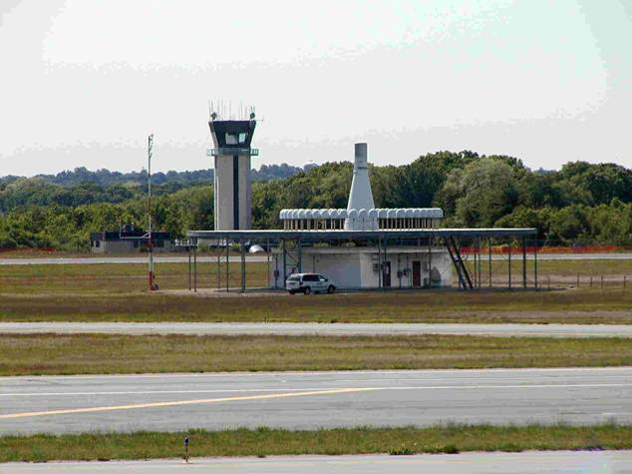
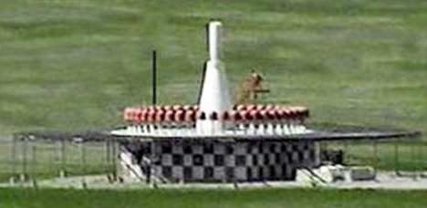
VOR Ground Equipment

Slide 22
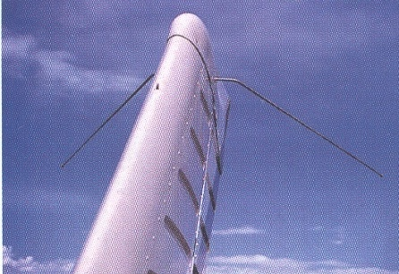
VOR Airborne Equipment
External antennae that are V shaped
Typically on vertical stabilizer

Slide 23
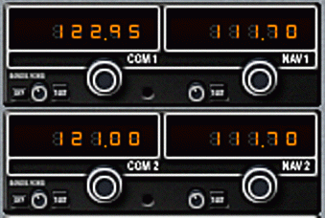
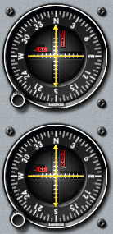
VOR Airborne Equipment
VOR instruments operate when tuned to station frequency
Typically tuned to two different VOR stations for cross-checking
Most GA (General Aviation) aircraft have two VOR receivers (NAV1 and NAV2)
NAV1
NAV2

Slide 24
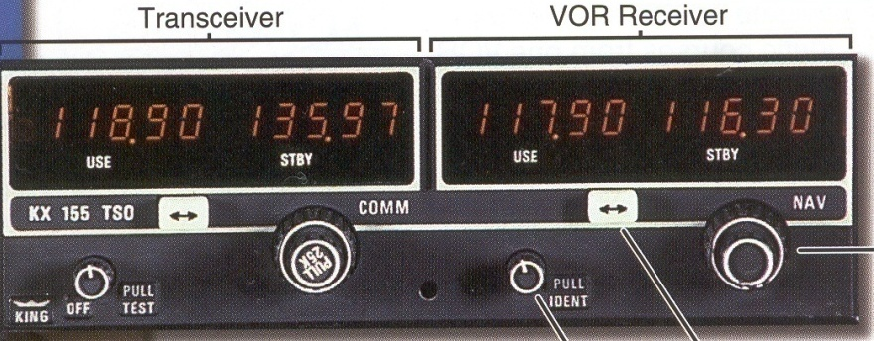
VOR Instrument Components
VOR Frequency Selector
Switch Standby (STBY) to Active (USE) Frequency
Volume Control/Indent

Slide 25
VOR Instrument Operation
Set VOR Omni Bearing Selector (OBS) to radial (0-359 degrees)
Sky divided into To and From sections
Sky divided into Left and Right of station
To section
From section
OBS tuned to
90 degree radial
Left of station
Left of station
Right of station
Right of station
To section
From section

Slide 26
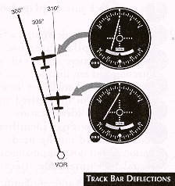
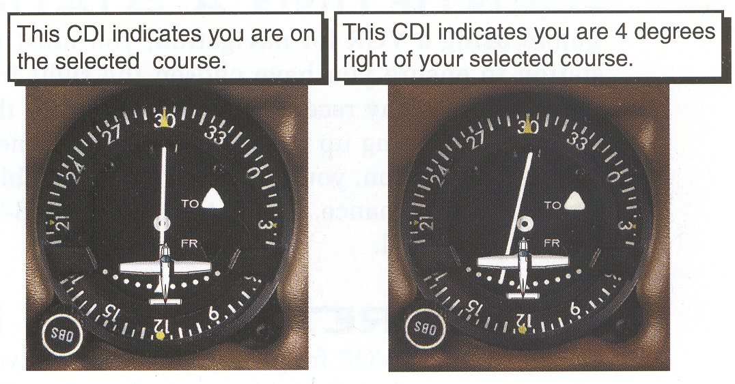
VOR Instrument Operation
Course Deviation Indicator (CDI) indicates angular deviation of aircraft position relative to VOR radial
Greater CDI deflection means greater angle

Slide 27
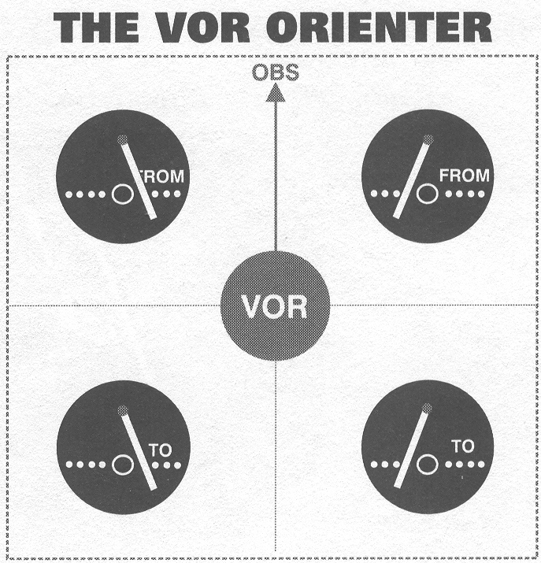
VOR Instrument Examples

Slide 28
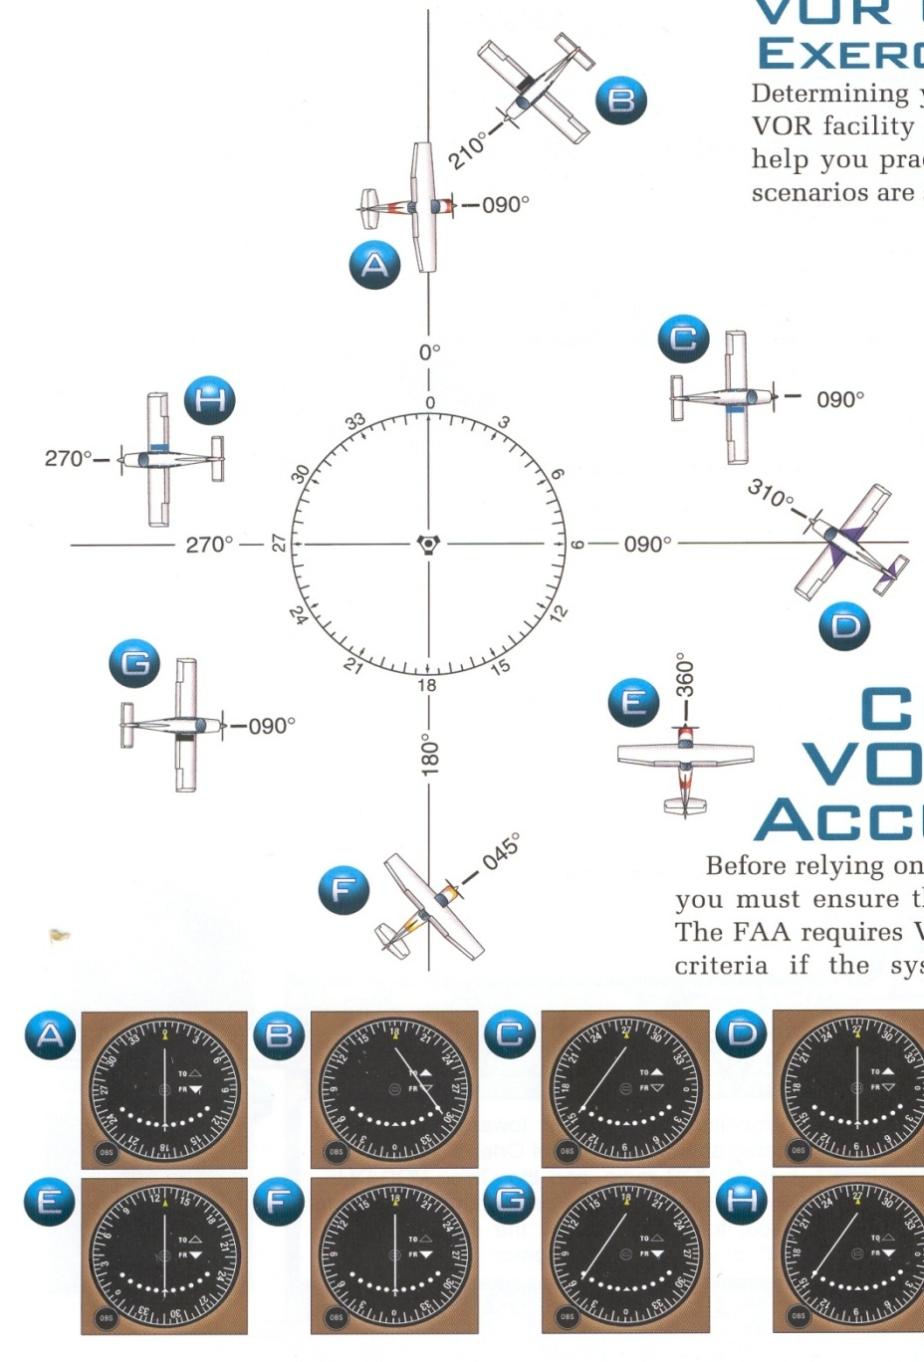
VOR Instrument Examples
Notes:
Note that aircraft orientation does not affect the VOR instrument indication.

Slide 29
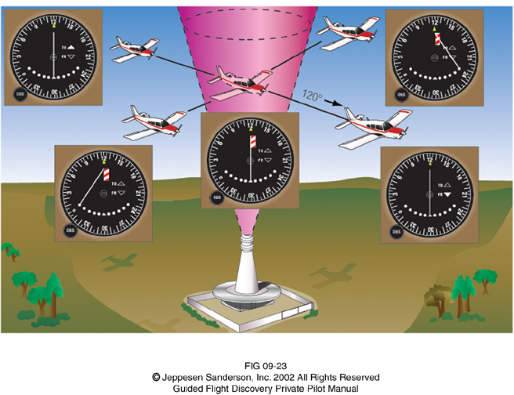
VOR Instrument Examples

Slide 30
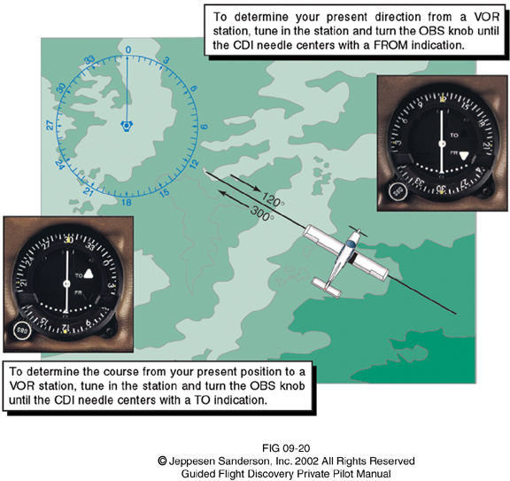
VOR Instrument Examples

Slide 31
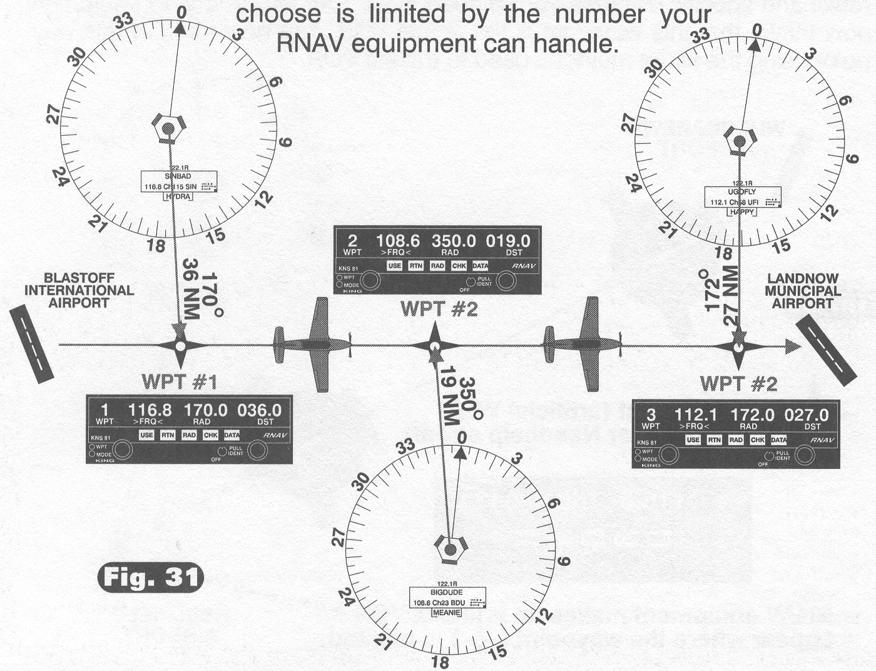
VOR Instrument Usage

Slide 32
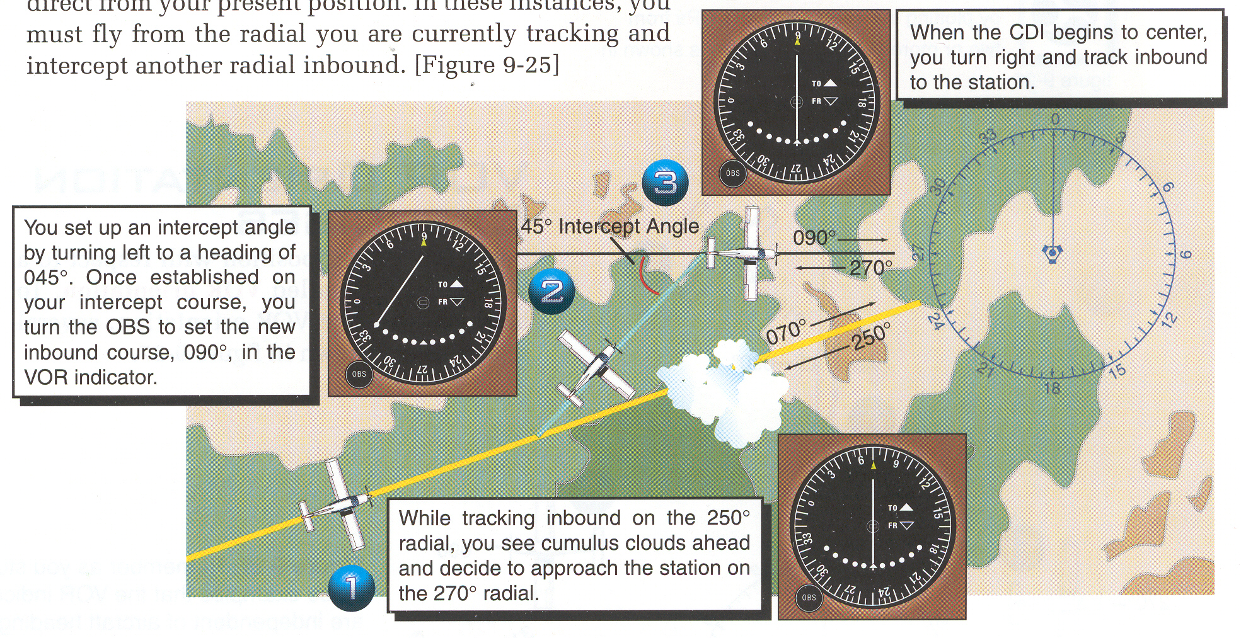
VOR Instrument Usage

Slide 33
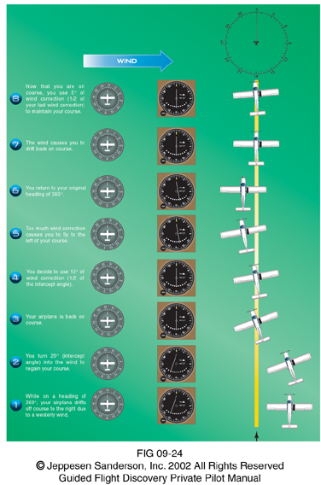
VOR Instrument Usage

Slide 34
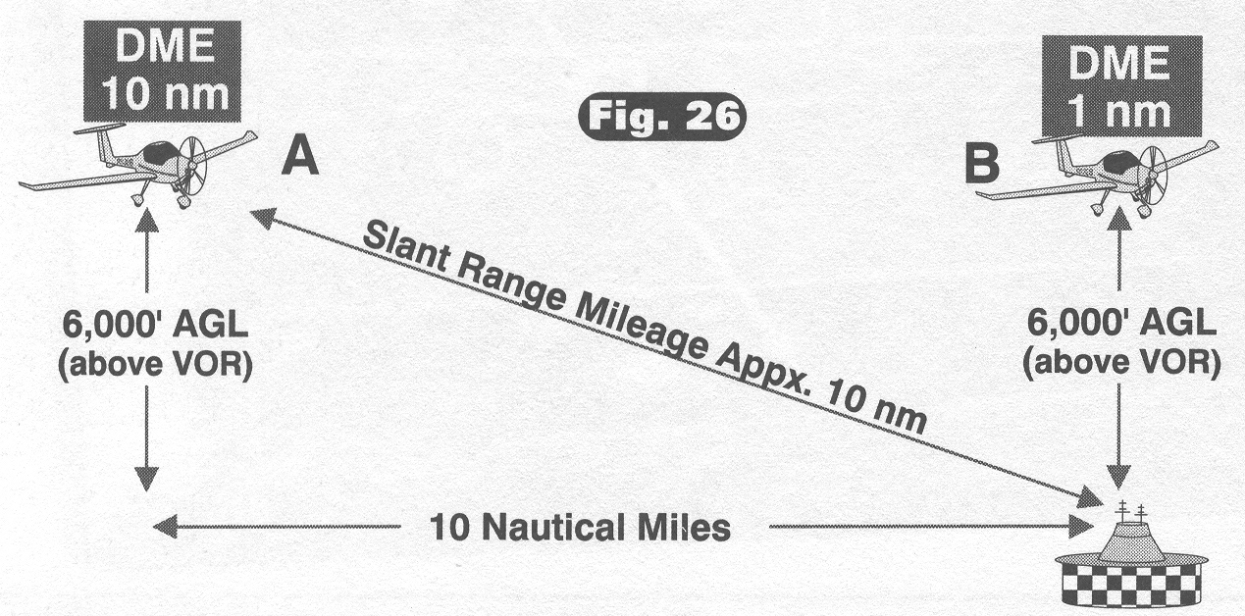
DME (Distance Measuring Equipment)
Measures Slant Range
Error increases as approach DME

Slide 35
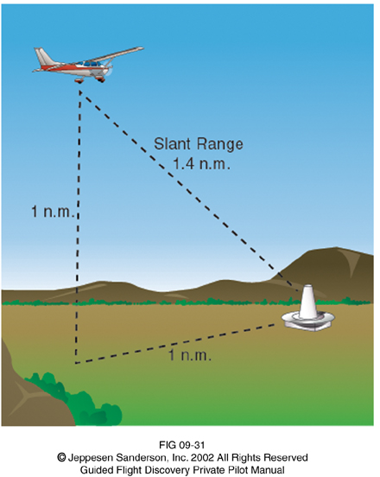
DME Slant Range Example
Notes:
Students should sketch this example and show that the slant range is 1.4 nm (nautical miles).

Slide 36
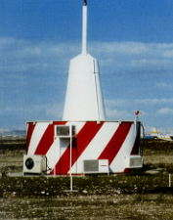
DME Ground Equipment

Slide 37
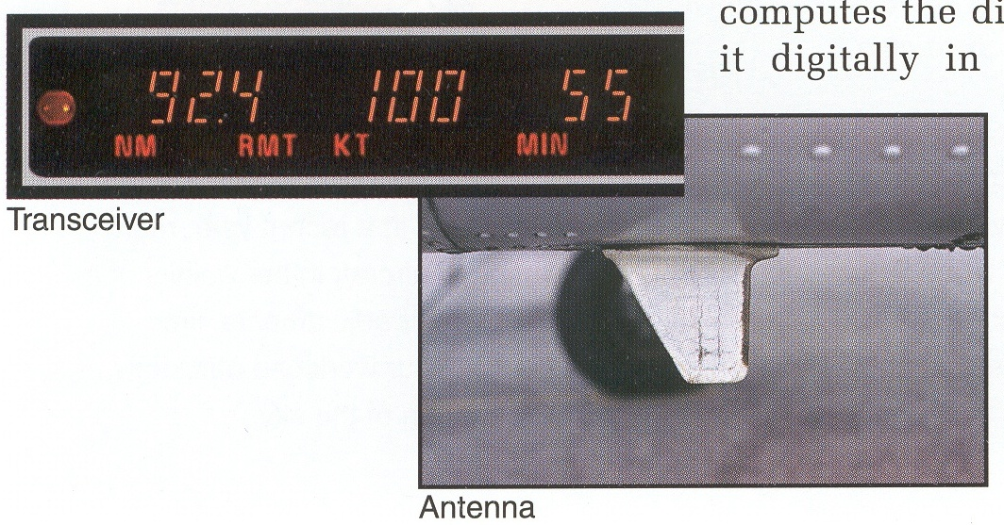
DME Airborne Equipment

Slide 38
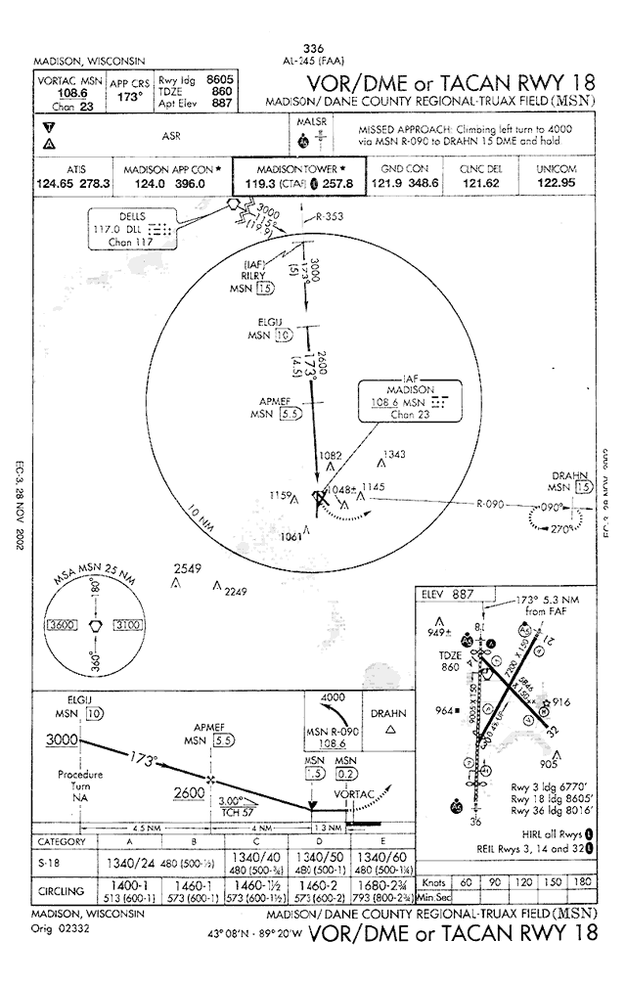
VOR

Slide 39
DME Usage

Slide 40
References
Crouch, T. (2004). Wings. New York: W.W. Norton & Company.
Dalton, S. (1999). The Miracle of flight. Kingston, Ontario: Bookmakers Press Inc.
Federal Aviation Administration (2009). Retrieved from http://www.faa.gov/
Garber, S. (2007). Sputnik and The Dawn of the Space Age. Retrieved from http://history.nasa.gov/sputnik/
Grant, R.G. (2007). Flight the complete history. New York: DK Publishing.

Slide 41
References
Jeppesen (2007). Guided flight discovery private pilot [CD-ROM]. Englewood, CO: Jeppesen. Retrieved from
http://skyvector.com/
Jeppesen Sanderson, Inc. (2006). Guided flight discovery private pilot images [CD-ROM]. Englewood, CO: Jeppesen Sanderson, Inc.
National Aeronautics and Space Administration (2009). Retrieved from http://www.nasa.gov/
National Executive Committee for Space-Based Positioning, Navigation, and Timing (2009). Retrieved from http://pnt.gov/
SkyVector (2009). Retrieved from www.skyvector.com

