Slide 1
Air Traffic Control
How Air Traffic is Coordinated
Aerospace Engineering
© 2011 Project Lead The Way, Inc.

Slide 2
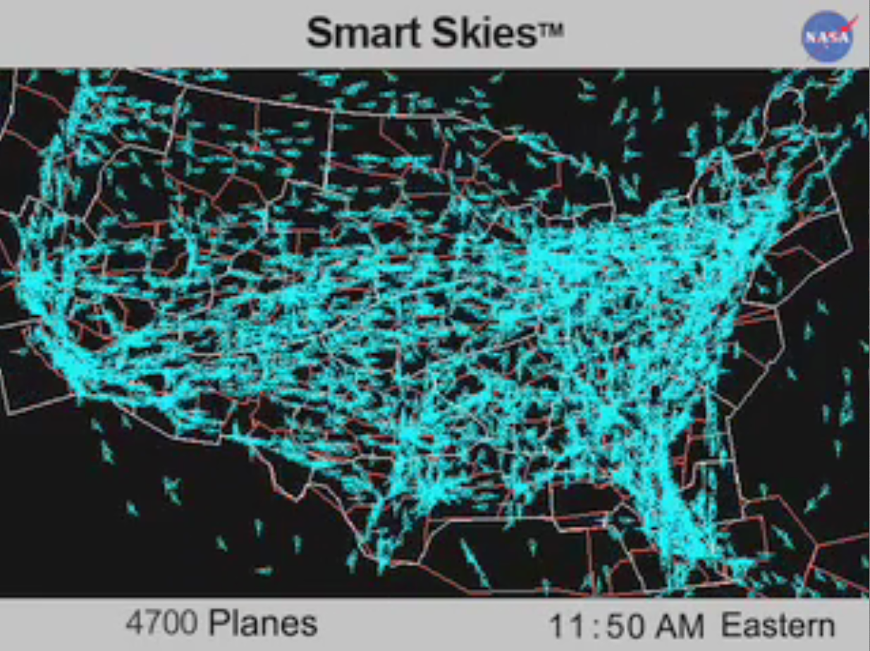
Air Traffic Across the US
Notes:
Show video AirTrafficControl_24hrsofFlight
Presentation Name
Course Name
Unit # – Lesson #.# – Lesson Name
<number>

Slide 3
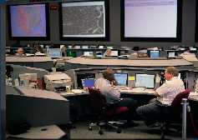
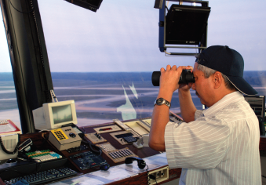
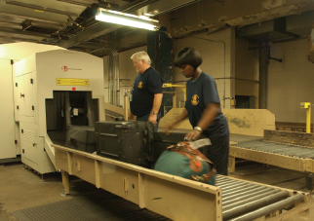
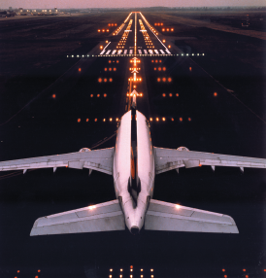
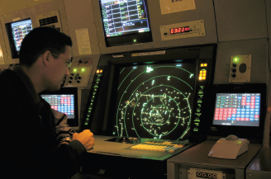
Air Traffic Control (ATC)
ATC system purpose is to prevent collisions between aircraft
Part of US Federal government organization
Federal Aviation Administration (FAA)
Notes:
More information about FAA and ATC available at http://www.faa.gov/air_traffic/briefing/ and http://www.faa.gov/about/history/historical_perspective/
Presentation Name
Course Name
Unit # – Lesson #.# – Lesson Name
<number>

Slide 4
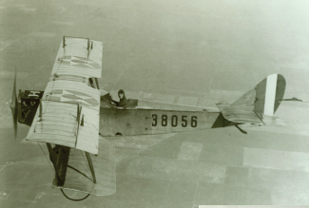
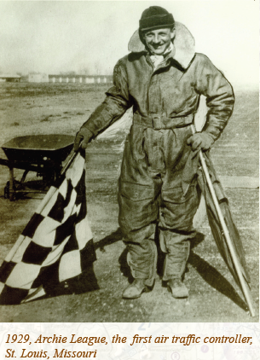
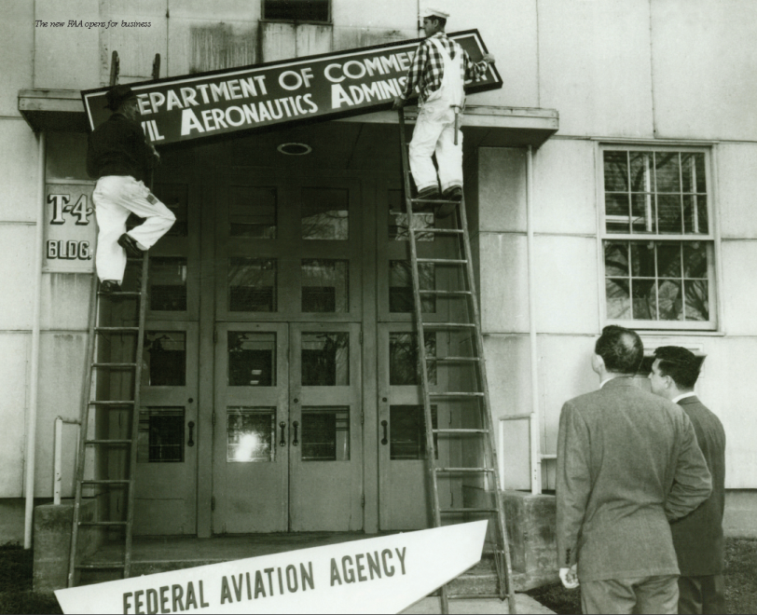
How Did Air Traffic Control Start?
Early aviators depended on visual references
Some airports began using flagmen in 20s
Air Commerce Act in 1926 established US rules
Air Traffic Control began in 1958 after series of midair collisions
Notes:
http://www.faa.gov/air_traffic/publications/atpubs/ATC/atc0201.html
Presentation Name
Course Name
Unit # – Lesson #.# – Lesson Name
<number>

Slide 5
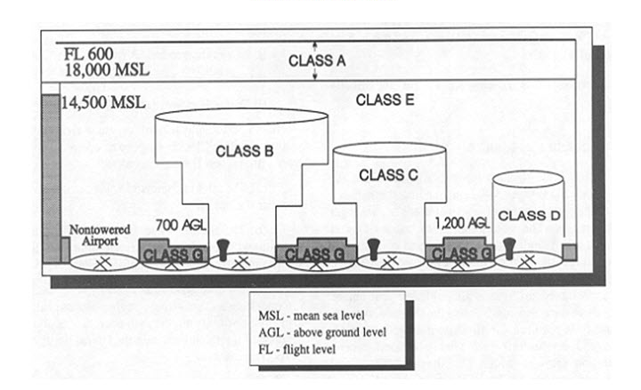
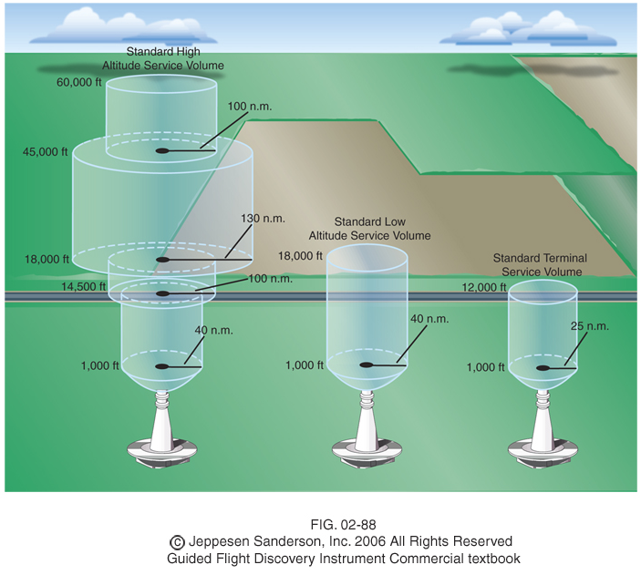
Air Traffic Control System
Air space is divided into three-dimensional areas called classes (A through G)
Airspace close to airport looks like upside down wedding cake
Airports connected by federal airways called Victor airways and jet routes
Notes:
Each airspace class has different rules about use and control. Federal airways are like three dimensional highways in the sky. Victor airways exist at low altitudes of 1200 ft AGL to 18,000 ft. Jet routes exist above 18,000 ft.
Presentation Name
Course Name
Unit # – Lesson #.# – Lesson Name
<number>

Slide 6
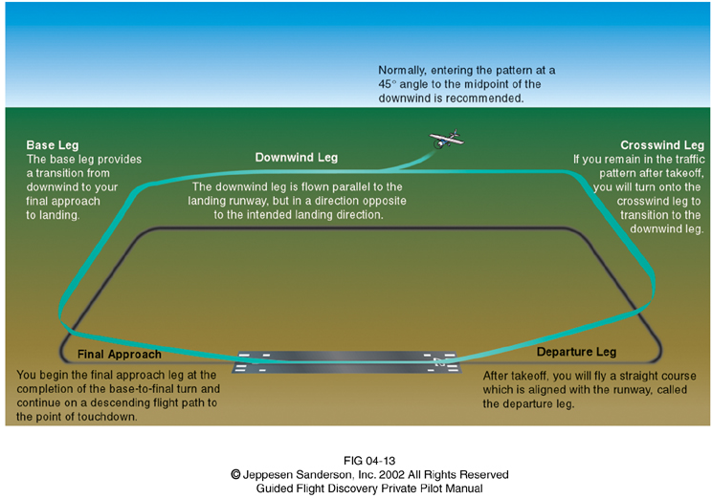
Typical Airport Traffic Pattern
Pattern defines routes to approach and depart from each airport
Pattern based on five main legs to provide consistency
Downwind
Base
Final
Departure
Crosswind
Notes:
The primary airport runways are aligned parallel to the prevailing winds to allow aircraft to land at and depart from the airport while facing the wind. This provides a slower ground speed for all speeds of air flow over the wings. This improves safety by allowing a shorter distance for take off and landing.
Presentation Name
Course Name
Unit # – Lesson #.# – Lesson Name
<number>

Slide 7
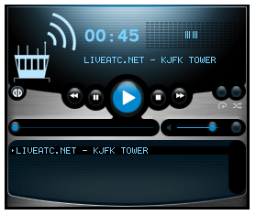
Air Traffic Control Radio
Air traffic controllers have specialized vocabulary
Click the icon to hear live air traffic controller radio transmissions at JFK airport tower in New York
Notes:
Click the icon to hear live air traffic controller radio transmissions at JFK airport tower in New York . More ATC radio channels are available at: http://www.flightradio.com/
Presentation Name
Course Name
Unit # – Lesson #.# – Lesson Name
<number>

Slide 8
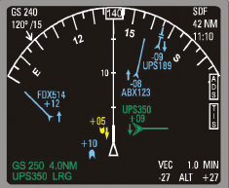
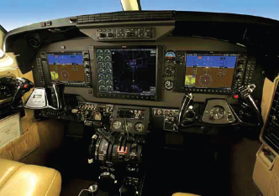
Air Traffic Control System
Pilots and ATC abide by sets of rules
Visual Flight Rules (VFR)
Instrument Flight Rules (IFR)
Standards developed by US used worldwide
Procedures
Equipment
English language
Notes:
Visual Flight Rules are a set of FAA regulations where conditions allow pilots to fly aircraft using visual cues in day or night conditions. This set of regulations is more common in general aviation (GA), which is non-commercial aviation. Instrument Flight Rules are used when conditions prevent use of VFR rules. Instrument Flight Rules are the predominant rules followed in commercial aviation.
Presentation Name
Course Name
Unit # – Lesson #.# – Lesson Name
<number>

Slide 9
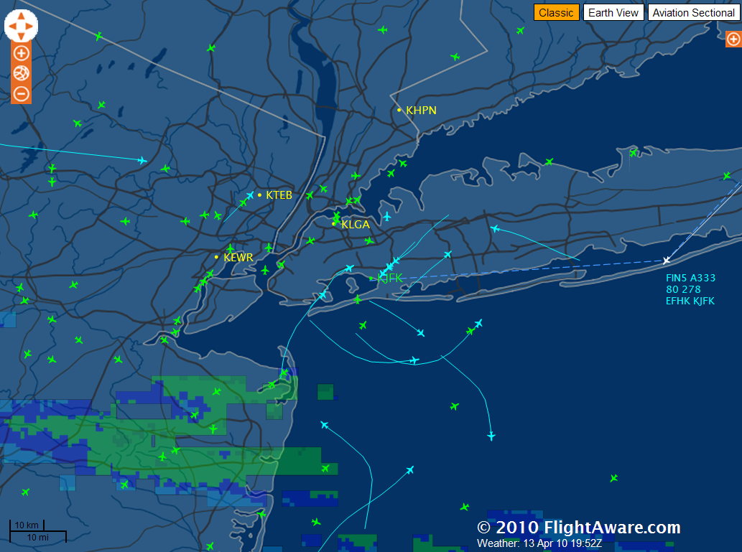
Air Traffic Control System
ATC often do not actually see airplanes
Air Traffic Control System Command Center
Coordinates air traffic for nation
Aircraft directed to speed up or slow down to balance air traffic
Click the icon for live air traffic at JFK Airport in New York
Notes:
ATC often do not actually see airplanes. Instead they rely on radar and other instruments. The distances and atmospheric conditions often prevent reliance on direct visualization.
This is an image of JFK airport in New York from the Flight Aware website: http://flightaware.com/live/airport/KJFK. Air traffic is available from http://flightaware.com
Presentation Name
Course Name
Unit # – Lesson #.# – Lesson Name
<number>

Slide 10
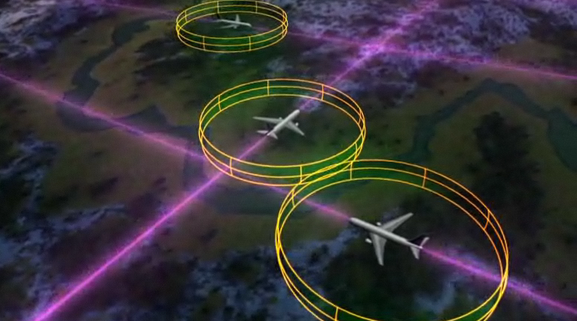
Air Traffic Control (ATC)
ATC system is part of the FAA with the purpose to prevent collisions between aircraft
Long history of development
What’s next?
Play NextGen Video
Notes:
At the “What’s Next?” bullet, stop the presentation and show the NextGen video.
Presentation Name
Course Name
Unit # – Lesson #.# – Lesson Name
<number>

Slide 11
References
Federal Aviation Administration (2010). The Federal Aviation Administration: A historical perspective, 1903-2008. Retrieved from http://www.faa.gov/about/history/historical_perspective/
Federal Aviation Administration (2010). Air traffic administration. Retrieved from http://www.faa.gov/air_traffic/briefing/
Jeppesen Sanderson, Inc. (2006). Guided flight discovery private pilot images [CD-ROM]. Englewood, CO: Jeppesen Sanderson, Inc.

