Slide 1
Multi-View Sketching

Slide 2
Multi-View Drawing
Shows two or more two-dimensional views of a three-dimensional object.
Provides the shape description of an object.
When combined with dimensions, serves as the main form of communication between designers and manufacturers.

Slide 3
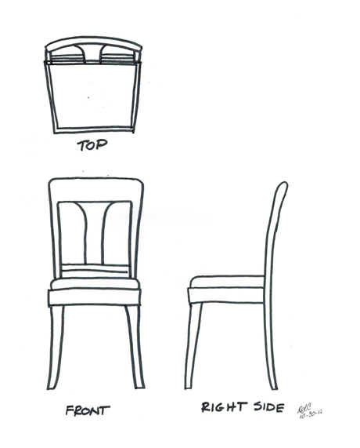
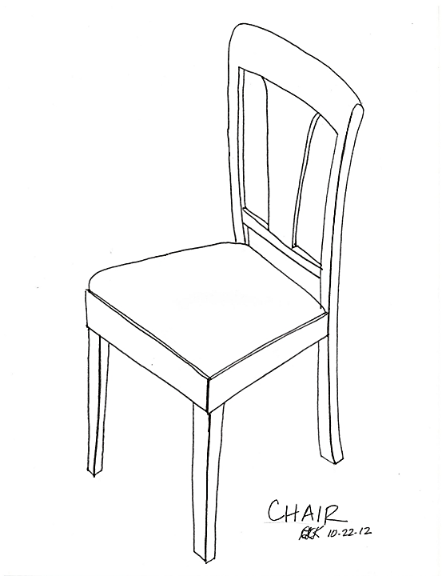
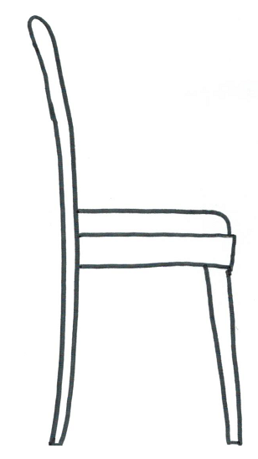
Example of Multi-view Sketch
LEFT SIDE
FRONT
RIGHT SIDE
Dining Chair
Notes:
Note that hidden lines are not shown for simplicity.
Do you think the view chosen for the Front View is the best choice? Why or why not?
Remember the recommendations for how to choose a front view:
Most natural position or use
Shows best shape and characteristic contours
Longest dimensions
Fewest hidden lines
Most stable and natural position
An argument can be made for using what would be the Left Side view <click> for the Front View in that it shows the characteristic shape of the chair, but the Front View shown in the slide provides a better view of the decorative wood work on the back of the chair. Either view would suffice as a front view.

Slide 4
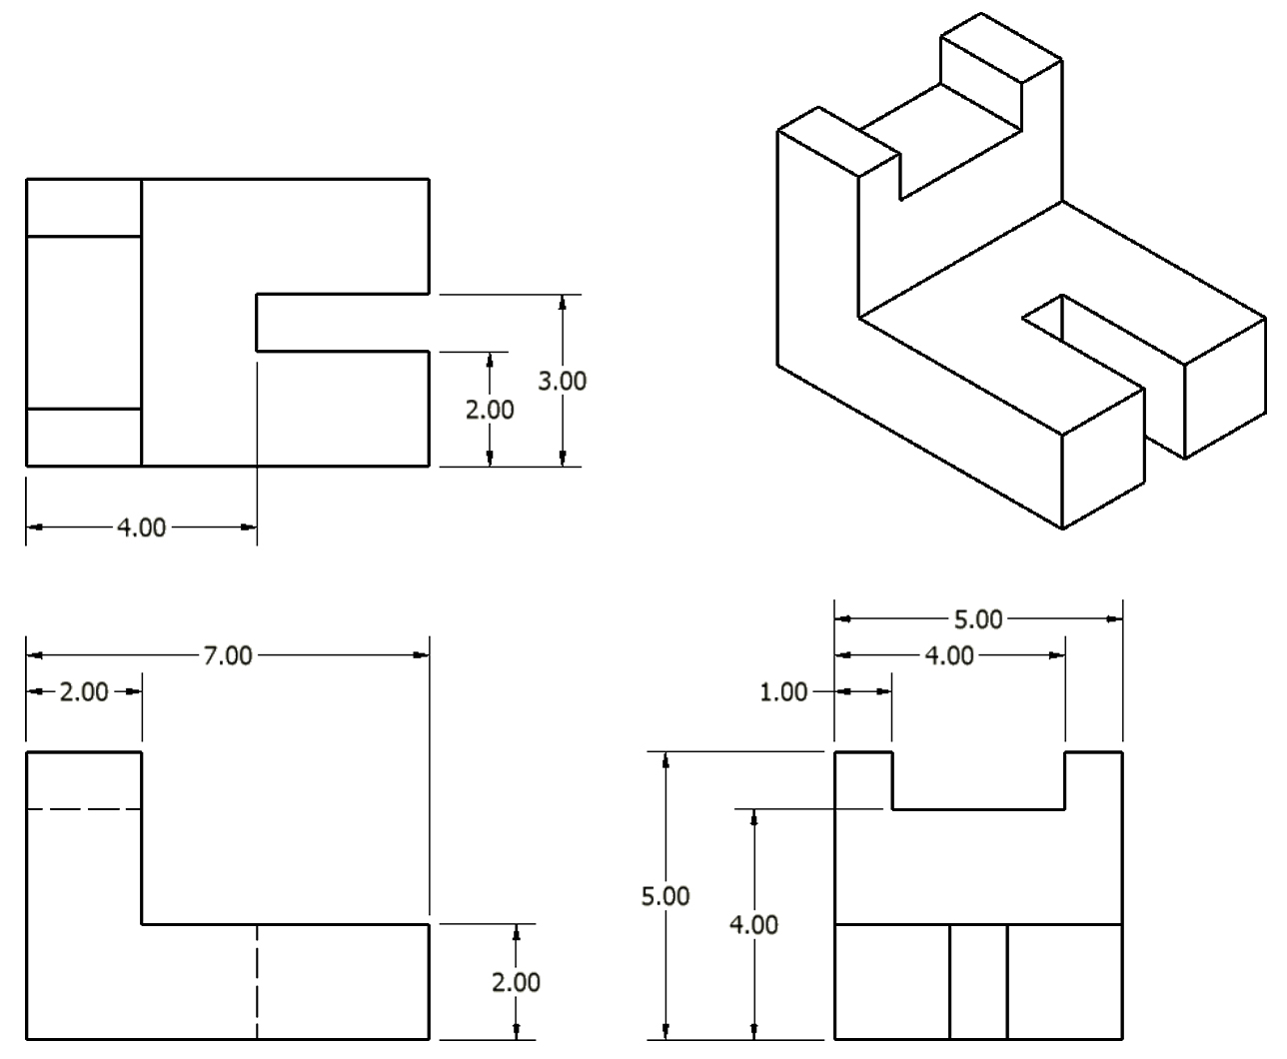
Multi-View Drawing

Slide 5
Multi-View Drawing
All three-dimensional objects have width, height, and depth.
Width is associated with an object’s side-to-side dimension.
Height is associated with an object’s top-to-bottom dimension.
Depth is associated with front-to-back distance.

Slide 6
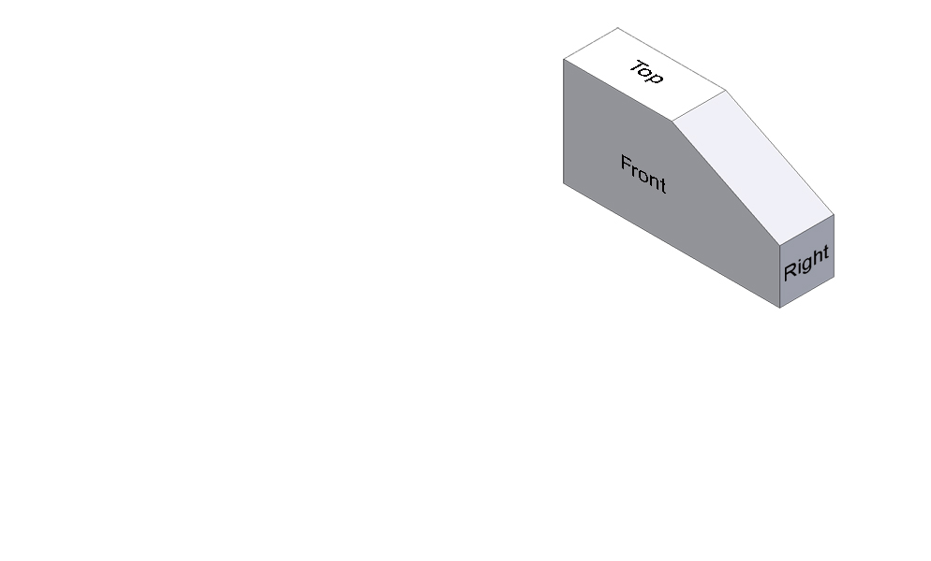
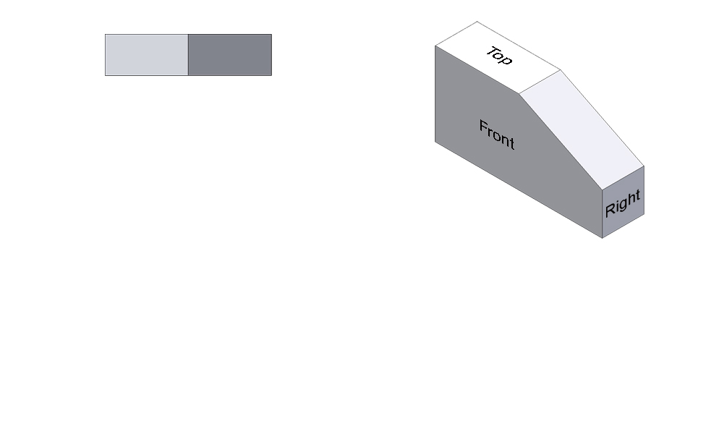
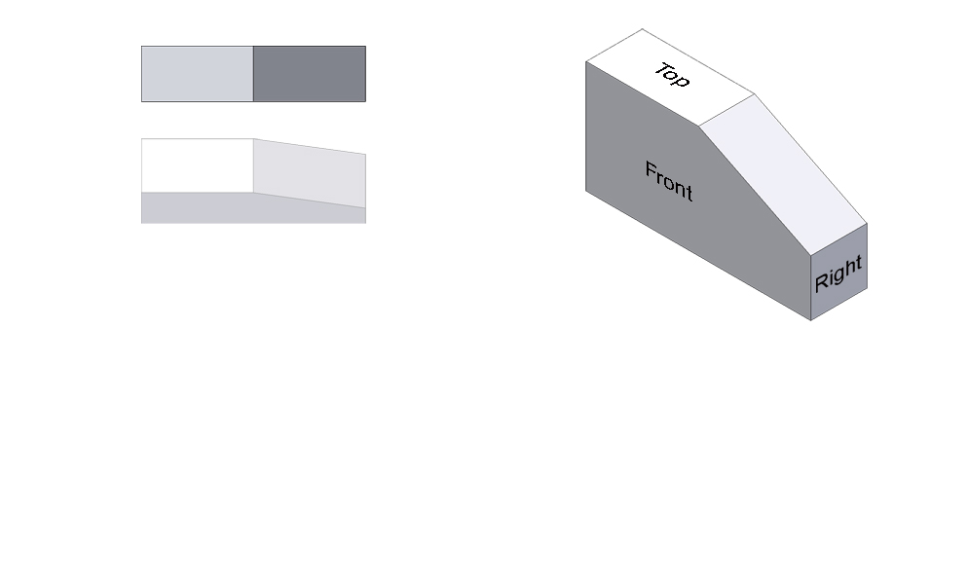
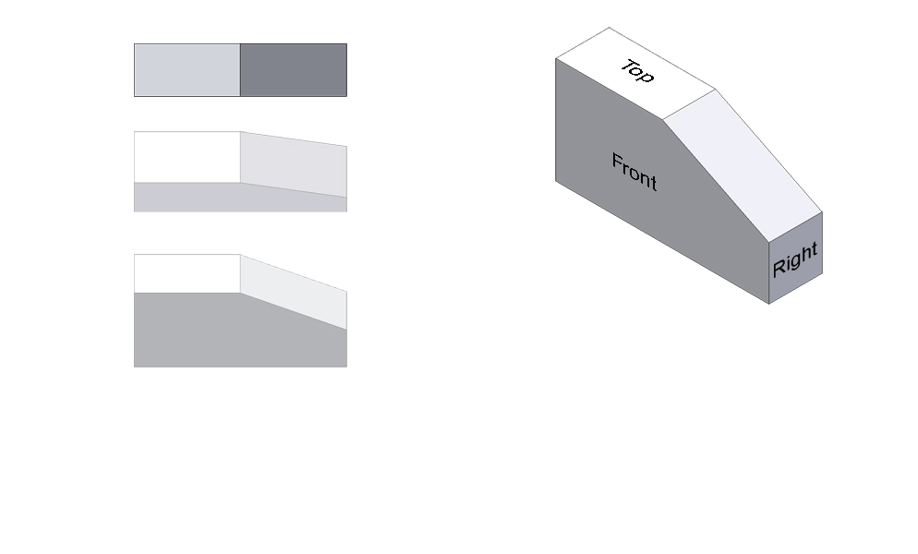
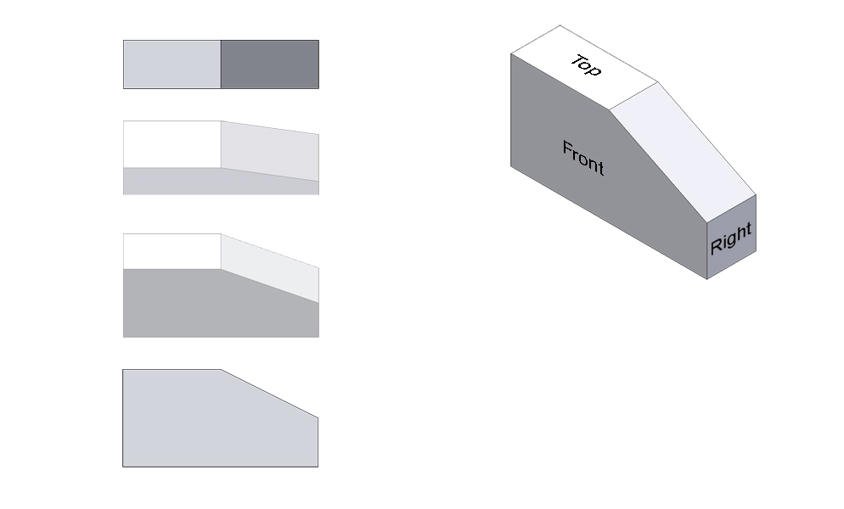
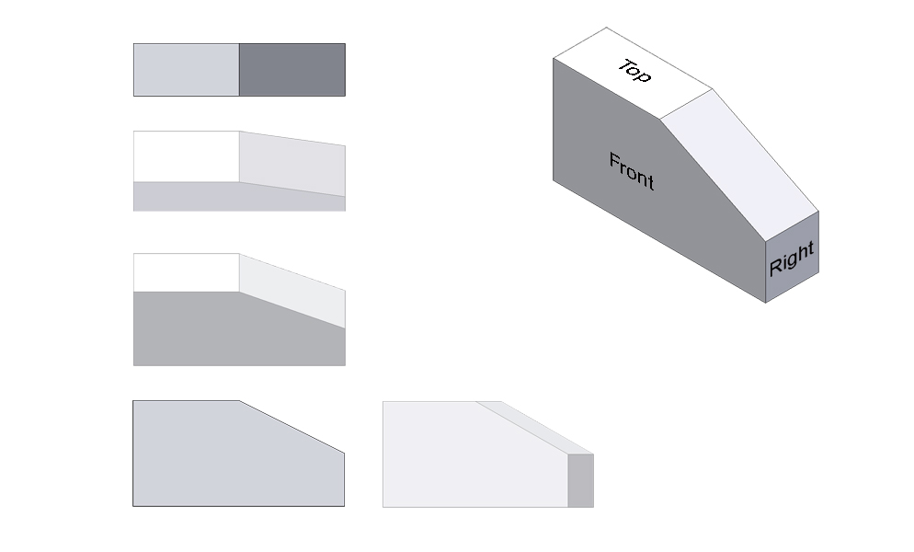
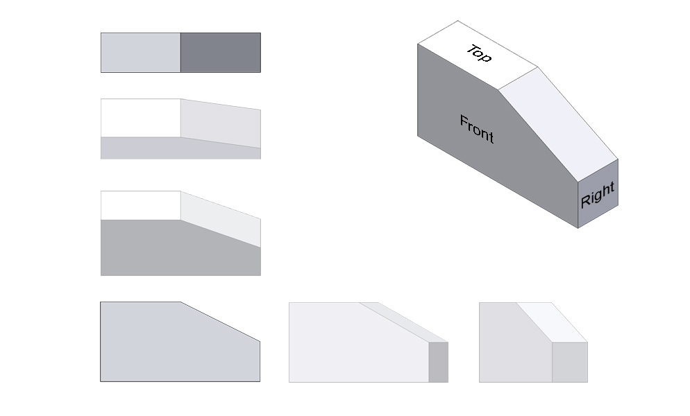
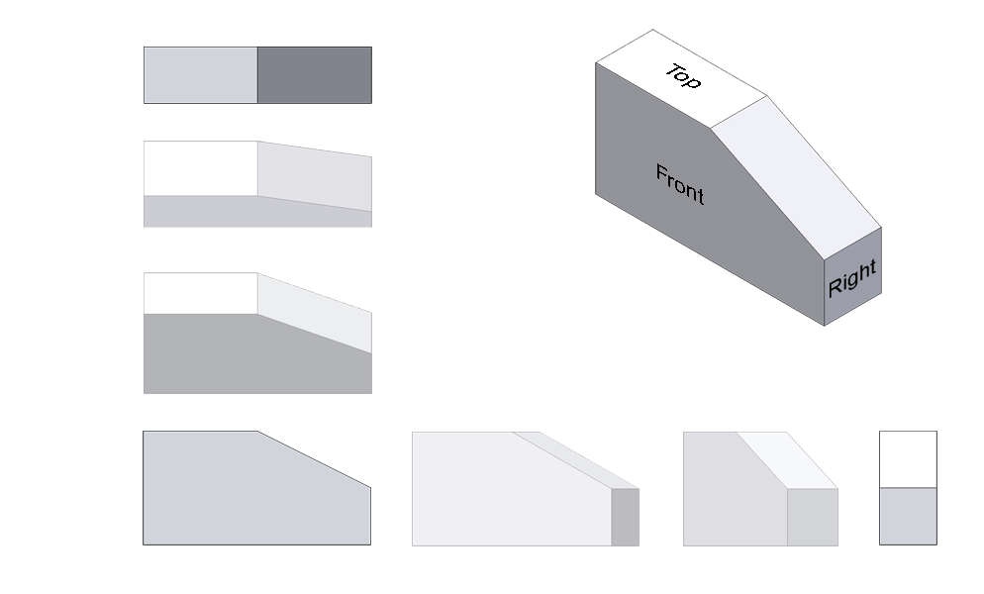
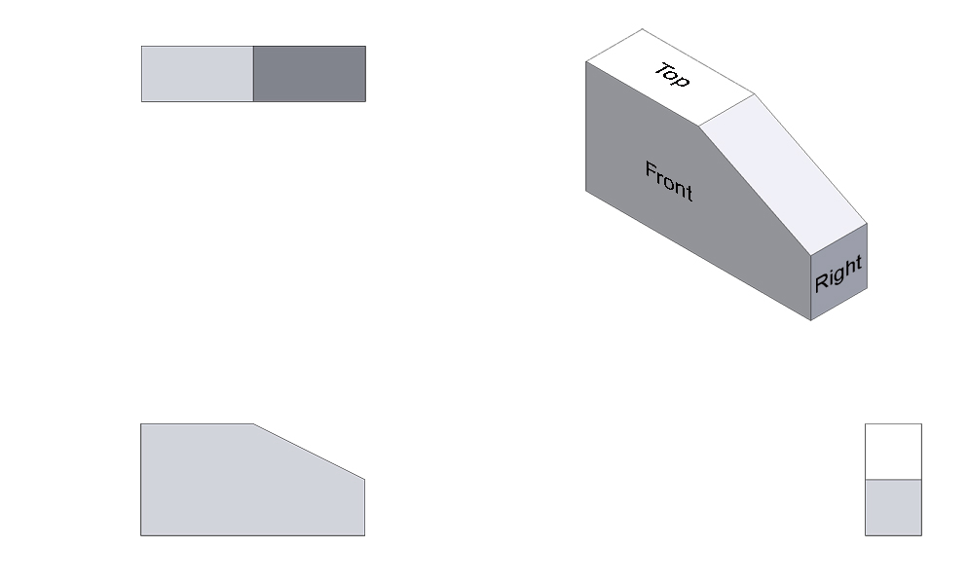
Multi-View Drawing
TOP VIEW
FRONT VIEW
RIGHT SIDE VIEW
Notes:
A typical multi-view drawing includes a top view, a front view and a right side view.

Slide 7
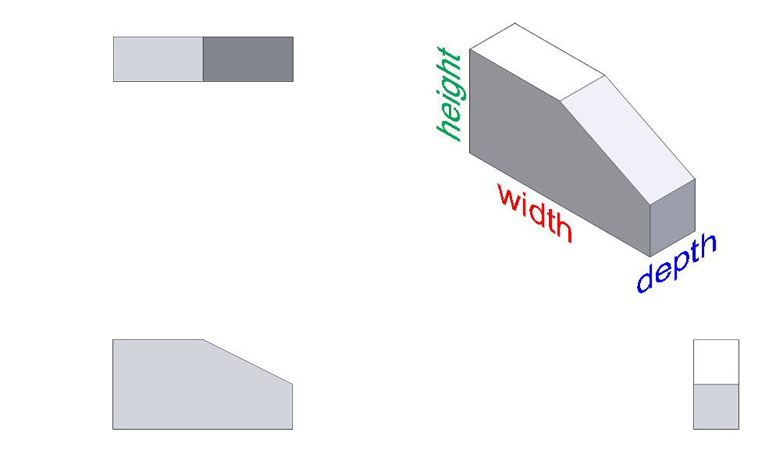
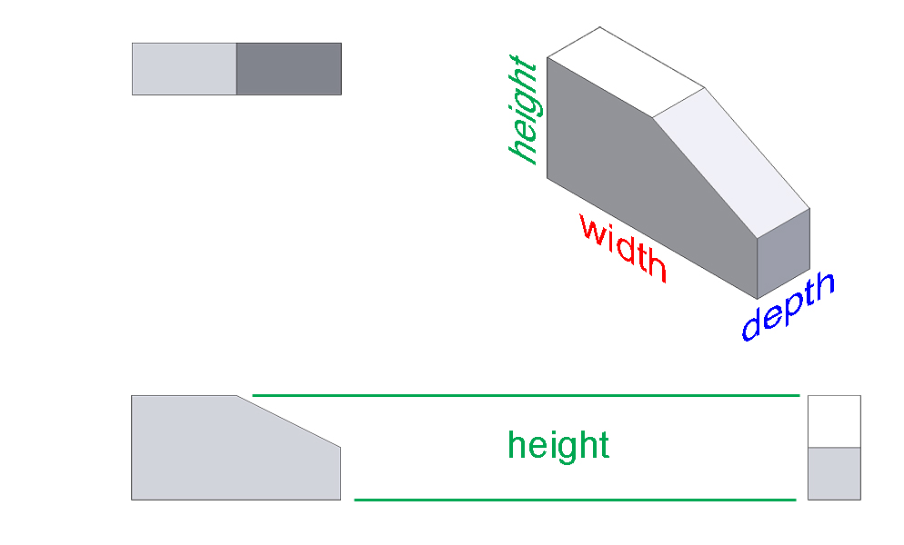
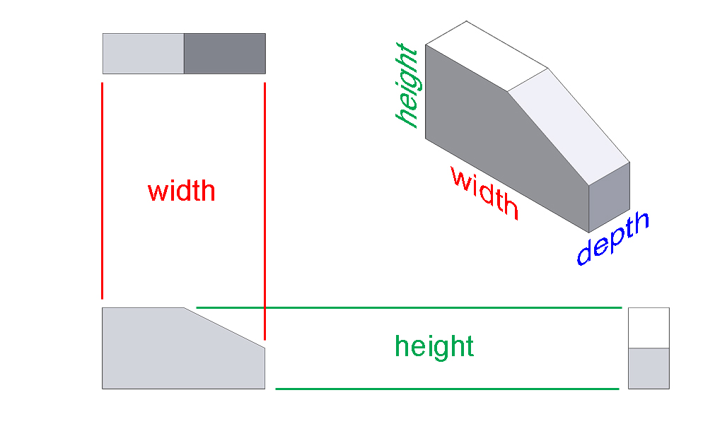
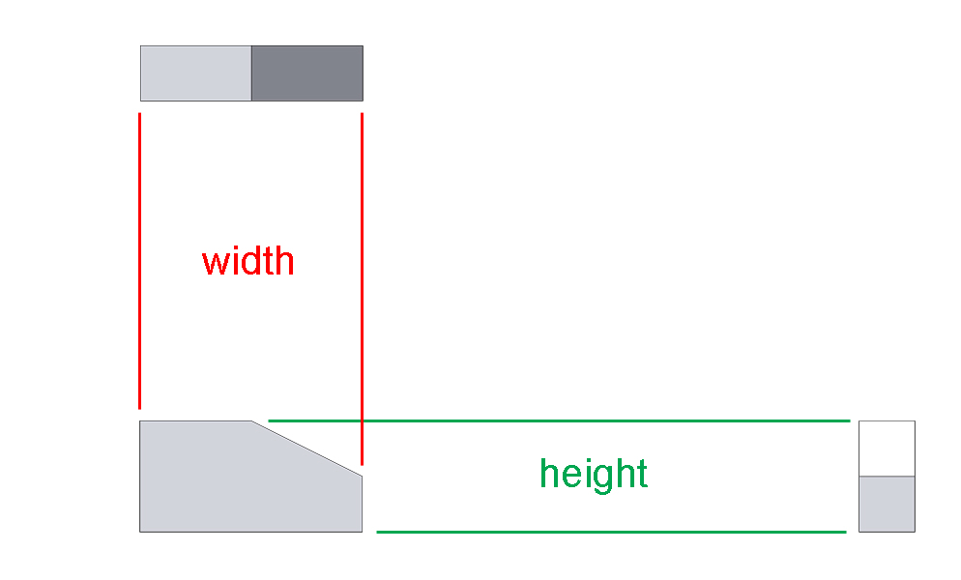
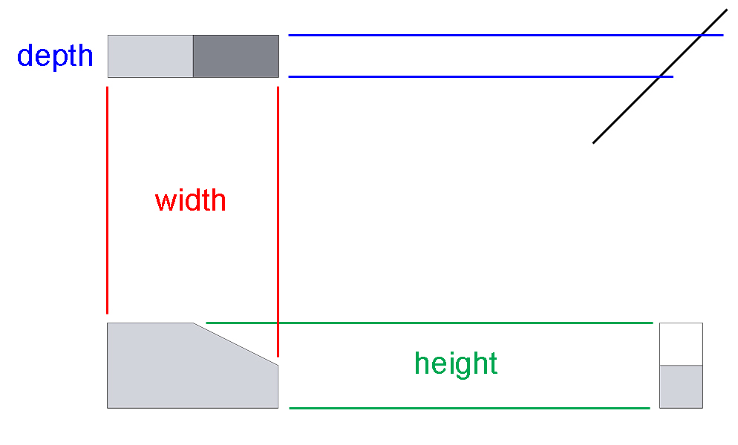
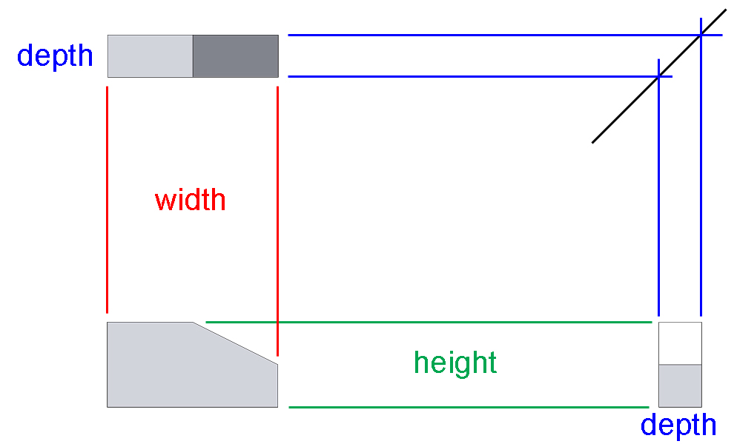
Multi-View Drawing
45°
Notes:
The isometric view shows the width, height and depth of the object. The height of the object is obvious in the front view and the right side view. The width is displayed in the front view and the top view. And the depth is shown in the top and right side. Notice how all views are aligned such that line up and construction lines can be used to help project the views from the first view drawn.

Slide 8
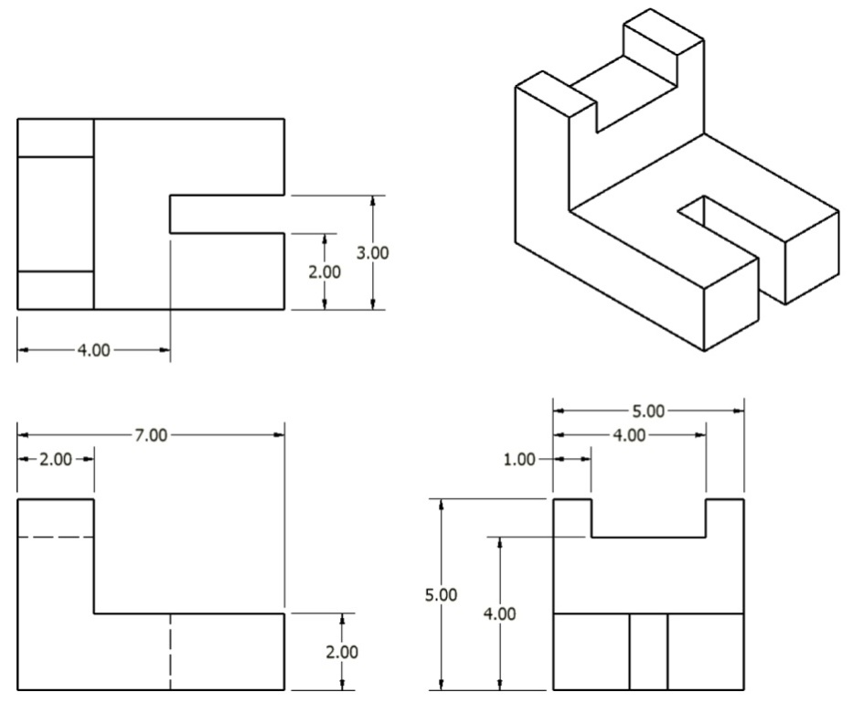
Sketching a Multi-View Drawing
Given the overall dimensions of the object, a pencil, and a sheet of graph paper, a sketching multi-view drawing can be easily done using points, construction lines, and object lines.
Notes:
There are several ways to sketch a multi-view drawing. Feel free to use the best way that make since to you. Teachers may choose to explain from the board or overhead using an example and have students follow along.

Slide 9
Sketching a Multi-View Drawing
Step 1 - Layout the boxes within which the individual views will occur using points and construction lines.
TOP
FRONT
RIGHT SIDE

Slide 10
Sketching a Multi-View Drawing
Step 2 - Use construction lines between the views to indicate the geometry of the views.
Notes:
Three examples of edges that are translated to construction lines are shown here.

Slide 11
Sketching a Multi-View Drawing
Step 3 - Identify the visible edges with Object lines.

Slide 12
Sketching a Multi-View Drawing
Step 4 - Locate hidden lines.

Slide 13
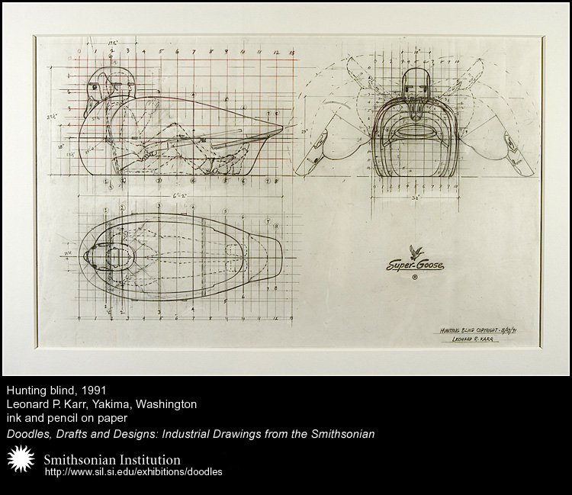
Historical Example
Leonard P. Karr (1913-1995) designed a man-sized hunting blind shaped like a goose called Super Goose, 1991.
How would you label the views presented in the drawing?
Are Mr. Karr’s views properly aligned based on the orientation presented here?
How would you rearrange the views to orient

Slide 14
A Question…
Each of the blocks at right has the same overall dimensions and color. What else do they have in common?
Notes:
You could have students practice sketching the multi-view drawings of these objects individually or in groups to help determine the answer before revealing it.

Slide 15
A Question…
They all have identical top views!
Each of the blocks at right has the same overall dimensions and color. What else do they have in common?

