Slide 1
Inferential Statistics
Introduction to Engineering Design
© 2012 Project Lead The Way, Inc.

Slide 2
Research and Statistics
Often we do not have information on the entire population of interest
Population versus sample
Population = all members of a group
Sample = part of a population
Inferential statistics involves estimating or forecasting an outcome based on an incomplete set of data
use sample statistics
Notes:
Often in research, it is impossible or excessively expensive to collect data on every member of a population of interest. For instance, according to the American Diabetes Association there are 25.8 million children and adults in the United States (8.3% of the population) that had diabetes (January 2011). Collecting data on the effectiveness of a new blood sugar monitoring device can not practically be performed on all 25.8 million diabetics.
Research on the effectiveness of the device will be performed on a much smaller group of people. In this case, the population is all diabetics. But only a SAMPLE of the larger population (perhaps less than 1% of the larger population) would be used to predict the effectiveness on the entire population.
Statistics can be performed to compare the results of the blood sugar levels measured by the new device to the blood sugar levels determined by a traditional blood test on the population of diabetics in the study. However, if you are interested in the effectiveness of the monitoring device on the entire population of diabetics, the measure of variation should include the fact that it is likely that the recorded blood sugar levels recorded by the new device will vary even more widely in the larger population than is demonstrated by the data collected from the small SAMPLE. So, it is probable that the variation (standard deviation) of the SAMPLE will be smaller than the variation (standard deviation) of the larger population. To account for this likely larger variation in the population, when predicting the standard deviation of a population using only data from a smaller population, a slightly different formula is used for sample standard deviation.

Slide 3
Population versus Sample Standard Deviation
Population Standard Deviation
The measure of the spread of data within a population.
Used when you have a data value for every member of the entire population of interest.
Sample Standard Deviation
An estimate of the spread of data within a larger population.
Used when you do not have a data value for every member of the entire population of interest.
Uses a subset (sample) of the data to generalize the results to the larger population.
Notes:
[click] We have just calculated the population standard deviation of a data set. For that calculation, we were calculating the standard deviation of the data set only – the data set was the entire population.
[click] If you are given data for only a portion of the population of interest and would like to estimate the standard deviation for the larger population, you would use the sample standard deviation formula.

Slide 4

A Note about Standard Deviation
Population Standard Deviation | Sample Standard Deviation
$$σ=\sqrt{\frac{\sum{{\left({\text{x}}_{\text{i}} \text{−} \text{μ}\right)}^{\text{2}}}}{\text{N}}}$$
$$\text{s}=\sqrt{\frac{\sum{{\left({\text{x}}_{\text{i}} \text{−} \overline{\text{x}}\right)}^{\text{2}}}}{\text{n} −1}}$$
σ = population standard deviation
x_{i} = individual data value ( x₁, x₂, x₃, …)
μ = population mean
N = size of population
s = sample standard deviation
x_{i} = individual data value ( x₁, x₂, x₃, …)
$\overline{\text{x}}$= samplemean
n = size of sample
Notes:
[click] So, for instance, if you are asked to measure the height of each student in your class, and then are asked to find the standard deviation of those heights, you would use the POPULATION standard deviation. You would have a data value for every member of the population – the students in your class. We call it POPULATION standard deviation because the value is based on the entire population.
[click] However, if you are asked to estimate the height of all of the high school students in your county (and you believed that your class provides a good representation on which to base that estimate) you would use the SAMPLE standard deviation. In this case, you would have only a sample (subset) of the heights of the entire population since your class is a subset of the county high school population. We call this the SAMPLE standard deviation because the value is based on a sample of the entire population.
[click] Notice that the main difference in the two formulas is the denominator. The population uses N, the population size. The sample standard deviation uses n – 1 which is one less than the size of the sample used in the calculation.

Slide 5

Sample Standard Deviation Variation
$$\text{s}=\sqrt{\frac{\sum{{\left({\text{x}}_{\text{i}} \text{−} \overline{\text{x}}\right)}^{\text{2}}}}{\text{n} −1}}$$
Procedure:
Calculate the sample mean,$\overline{ \text{x}}$.
Subtract the mean from each value and then square each difference.
Sum all squared differences.
Divide the summation by the number of data values minus one, n - 1.
Calculate the square root of the result.
Notes:
So, the procedure to find the sample standard deviation is basically the same procedure we used to find the population standard deviation. Notice that here we use the sample mean and the n – 1 denominator.

Slide 6
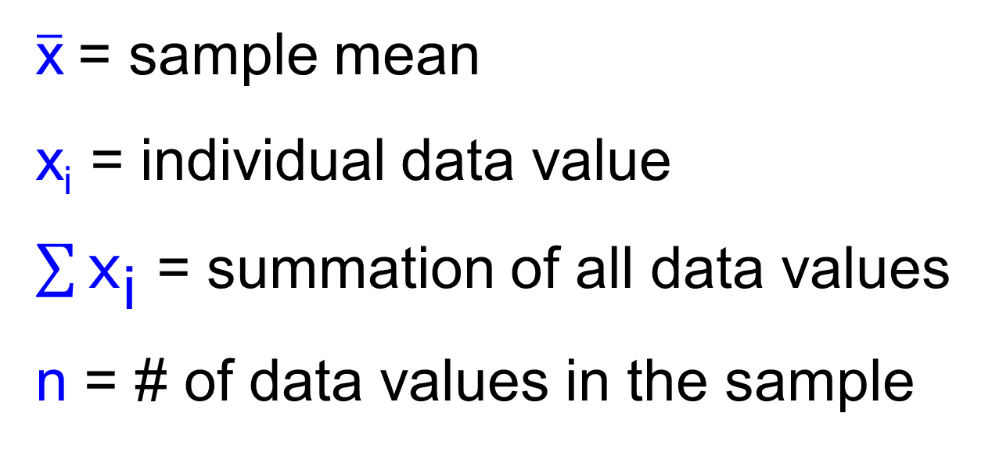
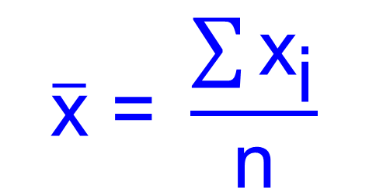
Sample Mean Central Tendency
$$\overline{\text{x}} \text{= }\frac{\sum{{\text{x}}_{\text{i}}}}{\text{n}}$$
Essentially the same calculation as population mean
$\overline{\text{x}}$= sample mean
x_{i}= individual data value
$\sum{{\text{x}}_{\text{i}}}$= summation of all data values
n= # of data values in the sample
Notes:
The sample mean is simply the mean of the data values in the sample. This calculation is essentially no different than the mean calculation presented earlier. We are just using a different variable to represent the number of data values.
[click] Here we use lower case n to represent the number of data values in the sample, as opposed to upper case N which represents the size of the larger population.
The sample is always smaller than the population that the sample represents. But when you have all of the data values for a population (n = N) you are really calculating the population mean.

Slide 7

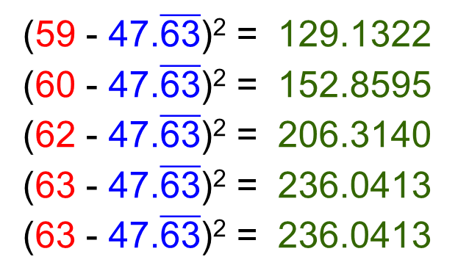
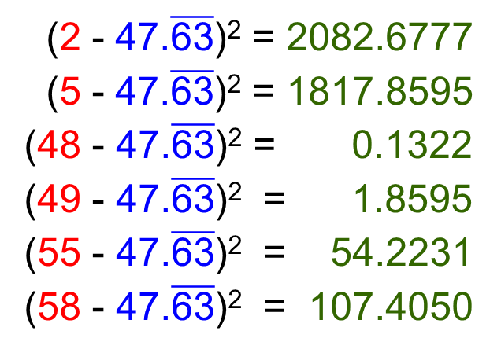

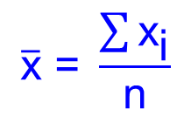
Sample Standard Deviation
$$s=\sqrt{\frac{\sum{{\left({\text{x}}_{\text{i}} \text{−}\overline{\text{x}}\right)}^{\text{2}}}}{\text{n}\text{ − 1}}}$$
Estimate the standard deviation for
a population for which the following data is a sample.
2, 5, 48, 49, 55, 58, 59, 60, 62, 63, 63
1. Calculate the sample mean
$$\overline{\text{x}}\text{ = }\frac{\sum{{\text{x}}_{\text{i}}}}{\text{n}}$$
$$=\text{47.}\overline{\text{63}}$$
2. Subtract the sample mean from each data value and square the difference.
$${\left({\text{x}}_{\text{i}} \text{−} \overline{\text{x}}\right)}^{\text{2}}$$
(2 - $\text{47.}\overline{\text{63}}$)²= 2082.6777
(5 - $\text{47.}\overline{\text{63}}$)² = 1817.8595
(48 - $\text{47.}\overline{\text{63}}$)² = 0.1322
(49 - $\text{47.}\overline{\text{63}}$)² = 1.8595
(55 - $\text{47.}\overline{\text{63}}$)² = 54.2231
(58 - $\text{47.}\overline{\text{63}}$)² = 107.4050
(59 - $\text{47.}\overline{\text{63}}$)² = 129.1322
(60 - $\text{47.}\overline{\text{63}}$)² = 152.8595
(62 - $\text{47.}\overline{\text{63}}$)² = 206.3140
(63 - $\text{47.}\overline{\text{63}}$)² = 236.0413
(63 - $\text{47.}\overline{\text{63}}$)² = 236.0413
Notes:
Since we are given a finite data set, and are not told otherwise, we assume we have a data value for each member of the entire population. We use the POPULATION standard deviation.
Find the mean of the data. [3 clicks] NOTE that if we were asked for the mean, we would report the mean to be 47.6. However, we will use the unrounded value stored in the calculator when calculating the standard deviation.
Find the difference between the mean and each data value and square each difference. [many clicks] Note that these values are calculated using the unrounded mean, but are rounded to two decimal places since it is unwieldy to report to a large number of decimal places. It is preferable to save each UNROUNDED squared difference in your calculator so that we can add them together.
Introduction to Summary Statistics

Slide 8
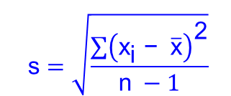
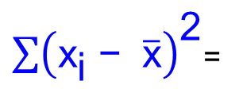
Sample Standard Deviation Variation
3. Sum all squared differences.
$\sum{{\left({\text{x}}_{\text{i}} \text{−} \overline{\text{x}}\right)}^{\text{2}}}$=
2082.6777 + 1817.8595 + 0.1322 + 1.8595 + 54.2231 + 107.4050 + 129.1322 + 152.8595 + 206.3140
+ 236.0413 + 236.0413
= 5,024.5455
4. Divide the summation by the number of sample data values
minus one.
$\frac{\sum{{\left({\text{x}}_{\text{i}} \text{−} \overline{\text{x}}\right)}^{\text{2}}}}{\text{n}\text{ − 1}}$= $\frac{\text{5024.5455}}{\text{10}}$ = 502.4545
5. Calculate the square root of the result.
$$\sqrt{\frac{\sum{{\left({\text{x}}_{\text{i}} \text{−} \overline{\text{x}}\right)}^{\text{2}}}}{\text{n}\text{ − 1}}}\text{=} \sqrt{\text{502.454}\text{5}}\text{ = }\text{22.4}$$
SD of Population = 21.4
Notes:
3. Sum the squared differences. [click] Again, this step yields the same result as the corresponding step in the population standard deviation calculation. Remember that the sum shown reflects the sum of the unrounded squared differences which is slightly different than the sum you would get if you added the rounded values shown.
4. Divide the sum by the number of data values in the sample (the sample size).[click] Here we use n – 1 = 10 in the denominator.
5. Take the square root of the division. [click] So the standard deviation of the larger population predicted by the sample standard deviation formula is 22.4. Slightly different than the population standard deviation of the data set (which was 21.4).

Slide 9
A Note about Rounding in Statistics
General Rule: Don’t round until the final answer
If you are writing intermediate results you may round values, but keep unrounded number in memory
Mean – round to one more decimal place than the original data
Standard Deviation: round to one more decimal place than the original data
Notes:
Ref: Elementary Statistics 7th edition by Bluman, McGraw-Hill 2009.

Slide 10
A Note about Standard Deviation
Population Standard Deviation | Sample Standard Deviation
$$σ=\sqrt{\frac{\sum{{\left({\text{x}}_{\text{i}} \text{−} \text{μ}\right)}^{\text{2}}}}{\text{N}}}$$
$$\text{s}=\sqrt{\frac{\sum{{\left({\text{x}}_{\text{i}} \text{−} \overline{\text{x}}\right)}^{\text{2}}}}{\text{n}\text{ − 1}}}$$
σ = population standard deviation
x_{i} = individual data value ( x₁, x₂, x₃, …)
μ = population mean
N = size of population
s = sample standard deviation
x_{i} = individual data value ( x₁, x₂, x₃, …)
$\overline{\text{x}}$= samplemean
n = size of sample
As n → N, s → σ
Notes:
The two different formulas for standard deviation can be confusing and are often misapplied. However, it is important to note that if you compare the population standard deviation to the estimated standard deviation of that same population provided by a sample standard deviation, the sample standard deviation generally tends to get closer and closer to the population standard deviation as the sample size increases.
[click] In mathematical terms we say, as the sample size approaches the population size (n → N), the sample standard deviation approaches the population standard deviation (s → σ). We use the arrow to represent “approaches”. In other words, the larger the sample, the better the estimate of the population standard deviation.

Slide 11
A Note about Standard Deviation
Population Standard Deviation | Sample Standard Deviation
Given the ACT score of every student in your class, use the population standard deviation formula to find the standard deviation of ACT scores
in the class.
$$σ=\sqrt{\frac{\sum{{\left({\text{x}}_{\text{i}} \text{−} \text{μ}\right)}^{\text{2}}}}{\text{N}}}$$
$$\text{s}=\sqrt{\frac{\sum{{\left({\text{x}}_{\text{i}} \text{−} \overline{\text{x}}\right)}^{\text{2}}}}{\text{n}\text{ − 1}}}$$
σ = population standard deviation
x_{i} = individual data value ( x₁, x₂, x₃, …)
μ = population mean
N = size of population
s = sample standard deviation
x_{i} = individual data value ( x₁, x₂, x₃, …)
$\overline{\text{x}}$= samplemean
n = size of sample
Notes:
So, for example, suppose you are interested in the spread of the ACT scores of the students in your class. If you have the ACT score of every student in your class you would use the population standard deviation formula to determine the standard deviation. [click]

Slide 12
A Note about Standard Deviation
Population Standard Deviation | Sample Standard Deviation
Given the ACT scores of every student in your class, use the sample standard deviation formula to estimate the standard deviation of the ACT scores of all students at your school.
$$σ=\sqrt{\frac{\sum{{\left({\text{x}}_{\text{i}} \text{−} \text{μ}\right)}^{\text{2}}}}{\text{N}}}$$
$$\text{s}=\sqrt{\frac{\sum{{\left({\text{x}}_{\text{i}} \text{−} \overline{\text{x}}\right)}^{\text{2}}}}{\text{n}\text{ − 1}}}$$
σ = population standard deviation
x_{i} = individual data value ( x₁, x₂, x₃, …)
μ = population mean
N = size of population
s = sample standard deviation
x_{i} = individual data value ( x₁, x₂, x₃, …)
$\overline{\text{x}}$= samplemean
n = size of sample
Notes:
However, if you wanted to estimate ACT scores of all of the students in your high school using only the scores of student from your class (and you felt that your class is a good representation of the students that attend your school), you would use the sample standard deviation formula to estimate the standard deviation of the larger population – and you might get fairly close to the actual standard deviation for the entire school. [click]

Slide 13
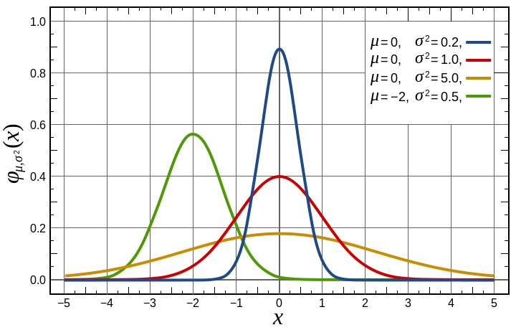
Probability Distribution Distribution
A distribution of all possible values of a variable with an indication of the likelihood that each will occur
A probability distribution can be represented by a probability density function
Normal Distribution – most commonly used probability distribution
http://en.wikipedia.org/wiki/File:Normal_Distribution_PDF.svg
Notes:
We often use probability distributions to represent and help quantify data. [click]
A function (which can be represented by a graph or an equation), called a probability density function, can be used to find the probability that a data value will fall within a specific range of values. [click].
It is not important that you know the equation for a normal probability density function, but you should know that a normal probability density function is represented by a bell shaped graph.

Slide 14
Normal Distribution Distribution
“Is the data distribution normal?”
Translation: Is the histogram/dot plot bell-shaped?
Does the greatest frequency of the data values occur at about the mean value?
Does the curve decrease on both sides away from the mean?
Is the curve symmetric about the mean?
Notes:
A normal distribution has a bell shaped probability density function and is informally known as a bell curve.
This image shows a graph of examples of the density functions for several normal distributions.
To determine whether a data is distributed normally, take a look at the histogram or dot plot of the data. [3 clicks]

Slide 15
Normal Distribution Distribution
Bell shaped curve
Frequency
-6
-5
-4
-3
-2
-1
0
1
2
3
4
5
6
Data Elements
Notes:
Let’s look at an example data set. This dot plot is the same one you saw in a previous presentation.
[click] If you smooth out the dot plot (or histogram) with a continuous curve, the line will appear bell shaped when the data is normally distributed.
In this case, the data does appears to form a bell shaped curve [click] and this data set looks to be normally distributed. But let’s look a little closer.

Slide 16
Normal Distribution Distribution
Does the greatest frequency of the data values occur at about the mean value?
Mean Value
Frequency
-6
-5
-4
-3
-2
-1
0
1
2
3
4
5
6
Data Elements
Notes:
YES. In this example, the highest frequency of values occurs at zero, which is approximately the mean value of the data set.

Slide 17
Normal Distribution Distribution
Does the curve decrease on both sides away from the mean?
Mean Value
Frequency
-6
-5
-4
-3
-2
-1
0
1
2
3
4
5
6
Data Elements
Notes:
YES. In this case, the curve decreases away from the peak (mean) on both sides.

Slide 18
Normal Distribution Distribution
Is the curve symmetric about the mean?
Mean Value
Frequency
-6
-5
-4
-3
-2
-1
0
1
2
3
4
5
6
Data Elements
Notes:
And, YES, in this example the curve is symmetric about the peak (mean).
Again, the data values appear to be normally distributed.

Slide 19
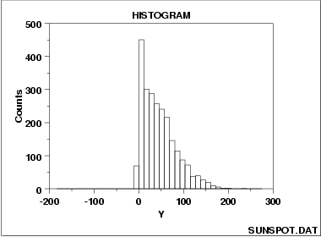
What if the data is not symmetric?
Histogram Interpretation: Skewed (Non-Normal) Right
Notes:
Although a normal distribution is the most common probability distribution in statistics and science, some quantities are not normally distributed. A visual analysis can help you decide if a normal distribution is a good representation for your data (although mathematical tests are usually necessary). If the data is skewed you should not assume a normal distribution of data.
This histogram shows that the data is skewed to the right, that is, there is a longer “tail” to the right.

Slide 20
What if the data is not symmetric?
A normal distribution is a reasonable assumption.
Notes:
In many cases, the histogram will not appear “exactly” symmetric, but a normal distribution can be justified – especially if the number of data values is small.
In this case, it appears that the mean is approximately 4.05. And although the bars of the histogram are not perfectly symmetric about the mean, if a smooth curve is used to approximate the tops of the bars, a bell shaped curve is reasonable. [click]
There are an equal number of data values on either side of the mean, and the curve does drop on both sides away from the mean.

