Slide 1
Engineering Notebook Layout

Slide 2
Cover
Your NAME, COURSE and PERIOD must be written on the cover of your notebook.
Write them LARGE, Clearly and in Permanent Maker.

Slide 3
Example
Mr. Tackett
Introduction to Engineering Design
1st Period

Slide 4
Table of Contents
Leave the first TWO pages (front and back) empty for your TOC.
Write Table of Contents across the top of each page.
Make a header for each Unit
List each activity and what page or pages it is on

Slide 5
Example
Table of contents
Unit 1
Pg 1 - Activity 1.1.1 Classroom & Lab Safety
Pg 2 – Activity 1.1.2 Engineering Notation

Slide 6
Lesson Title
Page #
Warm up:
Lesson Notes:
Activity / Sketches / Etc:
Conclusion Questions:
Your Signature and Date:
Your Witness’s Signature and Date:

Slide 7
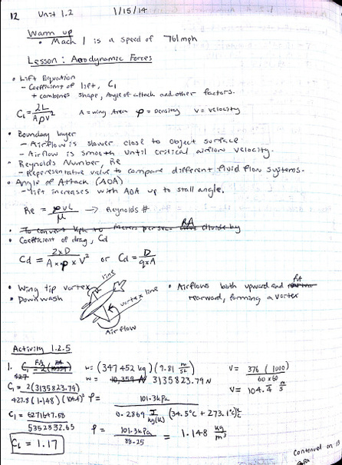
Sample Notebook Entry

