Slide 1
Atmosphere
Aerospace Engineering
© 2011 Project Lead The Way, Inc.

Slide 2
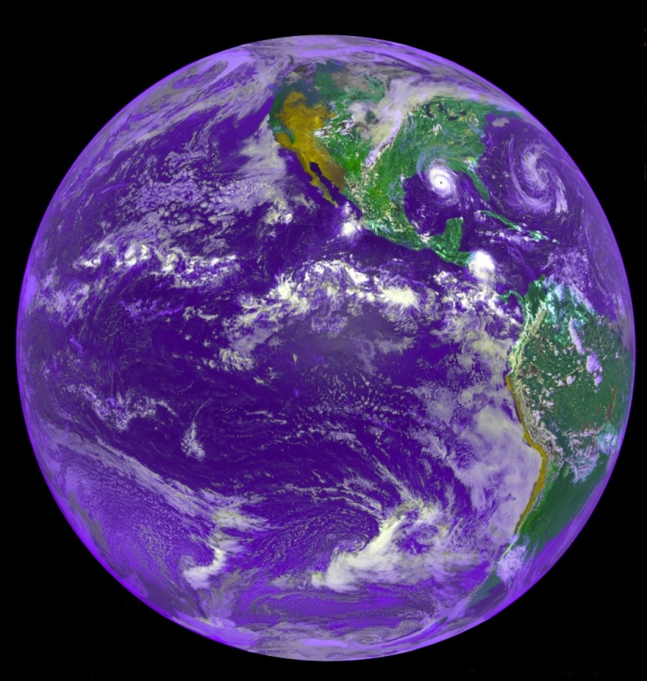
Earth’s Atmosphere
Mixture of gases
78% Nitrogen, 21% Oxygen and other gases
Sustains life
Protects us from solar radiation
Thin sheet of air 60 miles thick
Relative comparison
Basketball wrapped tightly with plastic sheet

Slide 3
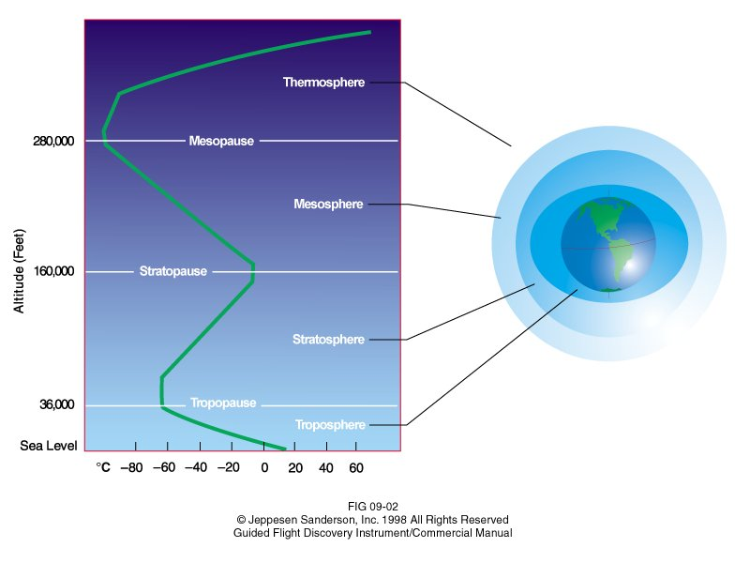
Earth’s Atmosphere Layers
Layers
Troposphere
Tropopause
Stratosphere
Mesosphere
Thermosphere
Notes:
Troposphere comes from the Greek word trope, which means turn or change. The troposphere varies from surface to approximately 36,000 ft. This varies by location and season.
Tropopause is a level rather than a layer. The tropopause acts as a lid for water vapor, which causes weather phenomena.
Stratosphere is the same composition as the troposphere up to 160,000 ft.
The mesosphere and thermosphere are above the stratosphere.

Slide 4
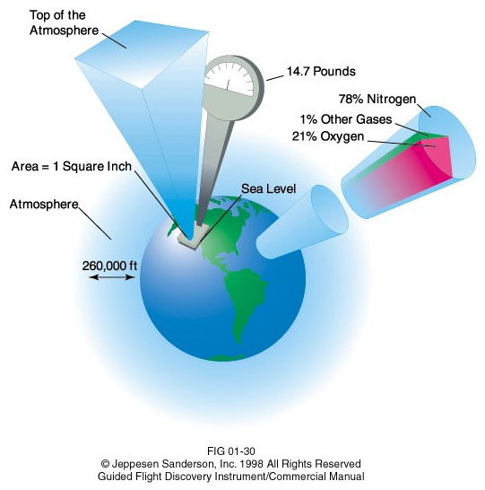
Air Pressure
Air above exerts pressure below
101.3 kPa (14.7 psi) means that column (97 km or 60 miles) of air sitting on two thumbnails is 5.5 kg (14.7 lb)
Density and pressure higher close to ground

Slide 5
Standard Atmospheric Conditions
Aerospace engineers use a standard to compare measurements such as speed
15 ^{O}C and 101.3 kPa (Kilo Pascals)
59 ^{O}F and 14.7 psi
Notes:
Speed of sound changes with air temperature and pressure; therefore, the altitude of the aircraft impacts the speed of sound.

Slide 6
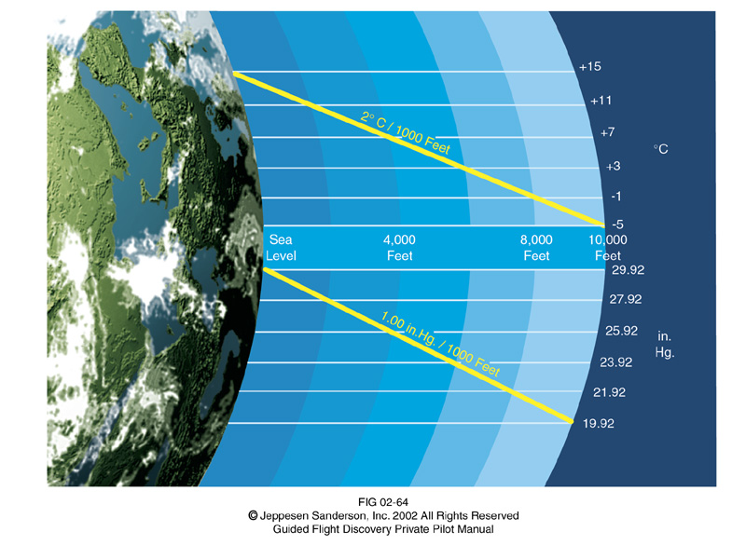
Earth’s Atmosphere Conditions
Notes:
Lapse rate is the decrease in temperature and pressure as altitude increases.

Slide 7
Earth’s Atmosphere Conditions
Lapse rate in troposphere (11 km)
$$T=15.04℃−0.00649\frac{℃}{m}\left(h\right)$$
$$p=101.29 kPa{\left[\frac{\left(T+273.1℃\right)\frac{K}{℃}}{288.08 K}\right]}^{5.256}$$
$$T=Temperature \left(℃\right)$$
$$h=height\left(m\right)$$
$$p=pressure\left(kPa\right)$$
Notes:
Lapse rate is the decrease in temperature and pressure as altitude increases. The standard temperature, T, and pressure, P, at sea level is defined as 15 degC and 101.3 Pa to serve as a common reference point. The temperature and pressure obviously are not always these values in actual existence. From these values the atmosphere decreases in temperature and pressure following these equations as the altitude increases up to the top of the troposphere. Beyond this level the atmosphere does not behave linearly. The lapse rate is particularly important to engineers because aircraft performance is greatly impacted by temperature and pressure. Engines and lift generated by the wing are two examples since both use air as working fluid.
More information available at http://www.grc.nasa.gov/WWW/K-12/airplane/atmosmet.html

Slide 8
Earth’s Atmosphere Conditions
Air density changes based on pressure and temperature
Generally air density lowers as it climbs to higher altitudes
$$ρ= \frac{p}{0.2869 \frac{J}{g\left(K\right)} \left(T+273.1℃\right)\frac{K}{℃}}$$
$$ρ=Density \left(\frac{kg}{m^{3}}\right)$$
$$T=Temperature \left(℃\right)$$
$$h=height\left(m\right)$$
$$p=pressure\left(kPa\right)$$
Notes:
Lapse rate is the decrease in temperature and pressure as altitude increases. The standard temperature, T, and pressure, P, at sea level is defined as 15 degf and 101.3 Pa to serve as a common reference point. The temperature and pressure obviously are not always these values in actual existence. From these values the atmosphere decreases in temperature and pressure following these equations as the altitude increases up to the top of the troposphere. Beyond this level the atmosphere does not behave linearly. The lapse rate is particularly important to engineers because aircraft performance is greatly impacted by temperature and pressure. Engines and lift generated by the wing are two examples since both use air as working fluid.

Slide 9
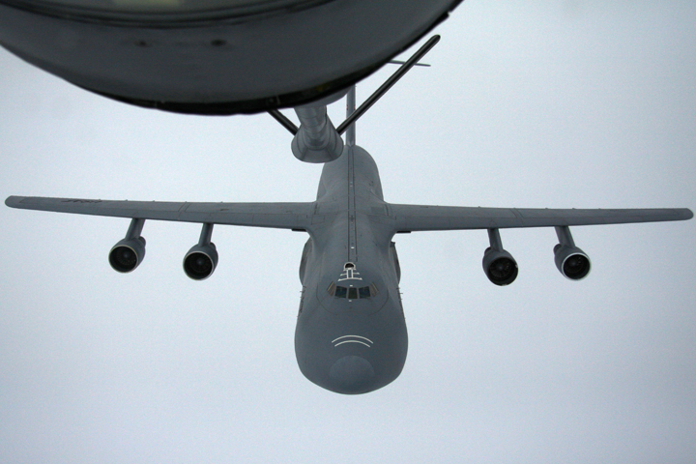
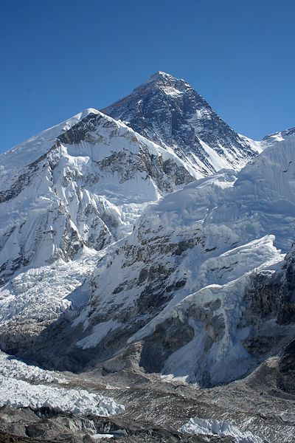
Earth’s Atmosphere Conditions
Mount Everest is 8,848 m (29,029 ft) tall
Similar altitude of jet aircraft
Climbers acclimatize over long period of time or breathe supplemental oxygen
Pilots must react quickly to receive supplemental oxygen if cabin loses pressure
Causes of pressure loss
Fuselage integrity failure (leak)
Window failure
Notes:
Acclimatization is the process where the body adapts to a new environment. Each person has different physiology and lives at different elevations. The process is dependent upon the change in elevation ranging from days to months.

Slide 10
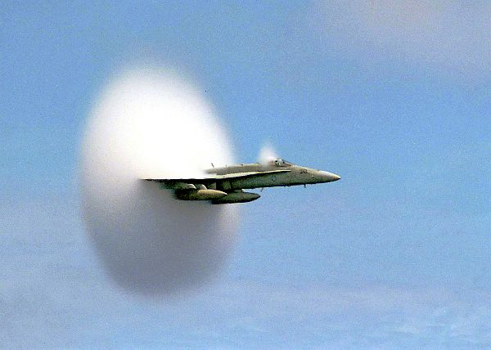
Aircraft Speed
Notes:
This photo was taken off the coast of Pusan, South Korea, July 7, 1999. An F/A-18 Hornet assigned to Strike Fighter Squadron One Five One (VFA-151) breaks the sound barrier in the skies over the Pacific Ocean. VFA-151 is deployed aboard USS Constellation (CVN 64). U.S. Navy photo by Ensign John Gay.

Slide 11
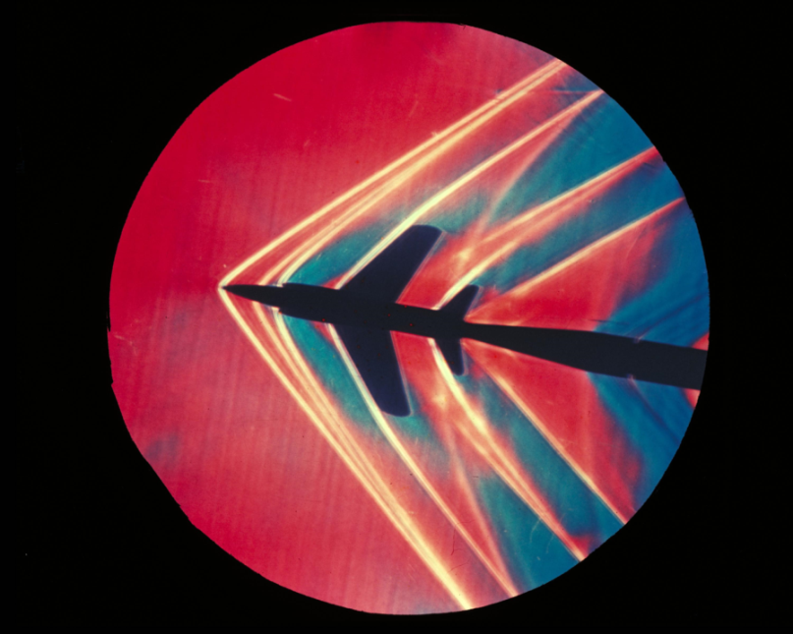
Aircraft Speed
Air molecules must move as aircraft passes through atmosphere
Air compressed at speeds beyond ~ 400 kph (250 mph)
Air resistance is significant when close to speed of sound
Transition to beyond
speed of sound
creates shock waves
and sonic booms
Notes:
As an aircraft moves through the air, the air molecules near the aircraft are disturbed and move around the aircraft. If the aircraft passes at a low speed, typically less than 250 mph, the density of the air remains constant. But for higher speeds, some of the energy of the aircraft goes into compressing the air and locally changing the density of the air. This compressibility effect alters the amount of resulting force on the aircraft. The effect becomes more important as speed increases. Near and beyond the speed of sound, about 330 m/s or 760 mph, small disturbances in the flow are transmitted to other locations isentropically or with constant entropy. But a sharp disturbance generates a shock wave that affects both the lift and drag of an aircraft. Read more at http://www.grc.nasa.gov/WWW/K-12/airplane/mach.html
NASA provides a shock wave simulator to model the effect of the sharpness of the body and Mach number. The simulator is available at: http://www.grc.nasa.gov/WWW/K-12/airplane/shock.html

Slide 12
Aircraft Speed
Mach (M)
Decimal number representing the true airspeed relationship to the local speed of sound: 1,225 kph or 761 mph at sea level and standard conditions
Subsonic: < Mach 1
Supersonic: Mach 1 and 5
Hypersonic: Mach 5 and 10
High-Hypersonic: Mach 10 and 25
Speed of sound changes with temperature
Higher altitudes are cooler, so Mach threshold is lower
Notes:
Speed of sound changes with air temperature and pressure; therefore, the altitude of the aircraft impacts the speed of sound.

Slide 13
References
Basic weather theory. In Jeppesen Private pilot: Guided flight discovery (pp. 6-2 – 6-7). (2007). Englewood, CO: Jeppesen
Jeppesen Sanderson, Inc. (2006). Guided flight discovery commercial pilot images [CD-ROM]. Englewood, CO: Jeppesen Sanderson, Inc.
National Aeronautics and Space Administration (2010). Atmosphere. Retrieved from http://www.grc.nasa.gov/WWW/K-12/airplane/atmosmet.html
US Navy. (1999). F/A-18 hornet breaks the sound barrier. Retrieved from http://www.navy.mil/view_single.asp?id=1445

Slide 14
References
Wikipedia. (2011). Mount Everest from Kalapatthar. Retrieved from http://commons.wikimedia.org/wiki/File:Everest_kalapatthar.jpg

