Slide 1
Aerodynamic Forces
Lift and Drag
Aerospace Engineering
© 2011 Project Lead The Way, Inc.

Slide 2
Lift Equation
Lift
Coefficient of Lift, C_{l}
Determined experimentally
Combines several factors
Shape
Angle of attack
Direction of Flight
$$C_{l}=Coefficient of Lift$$
$$C_{l}=\frac{2L}{Aρv^{2}}$$
$$C_{l}=\frac{L}{qA}$$
$$D=Drag \left(N\right)$$
$$A=Wing Area \left(m^{2}\right)$$
$$ρ=Density \left(\frac{kg}{m^{3}}\right)$$
Alternate format
$$v=Velocity \left(\frac{m}{s}\right)$$
$$q=Dynamic Pressure\left(Pa\right)$$
Notes:
Rearranging the coefficient of lift equation shows that lift is increased by wing area, air density, and velocity. Velocity is a squared function, giving it a more significant impact on lift.

Slide 3
Applying the Lift Equation
The Cessna 172 from Activity 1.2.2 step #2 takes off successfully from Denver, CO during an average day in May (22 ^{O}C) with a standard pressure (101.3 kPa). Assume that the take-off speed is 55 knots (102 kph). What is the minimum coefficient of lift needed at the point where the aircraft just lifts off the ground? The Cessna wing area is 18.2 m² and weight is 2,328 lb (1,056 kg).
Notes:
Average temperature source = http://www.weather.com/outlook/health/fitness/wxclimatology/monthly/graph/USCO0105

Slide 4
Applying the Lift Equation
Convert mass into weight
Convert velocity
$$w=mg$$
$$w=(1,056 kg)\left(9.81 \frac{m}{s^{2}}\right)$$
$$w=10,359 N$$
$$V=\frac{102 kph \left(1000 \frac{m}{km}\right)}{60 \frac{min}{hr} \left(60 \frac{s}{min}\right)}$$
$$V=28.3 \frac{m}{s}$$

Slide 5
Applying the Lift Equation
Calculate Air Density
$$ρ= \frac{p}{0.2869\frac{J}{kg\left(K\right)}\left(T+273.1℃\right)\frac{K}{℃}}$$
$$ρ= \frac{101.29 kPa}{0.2869\frac{J}{kg\left(K\right)}\left(22 ℃+273.1℃\right)\frac{K}{℃}}$$
$$ρ=1.196\frac{kg}{m^{3}}$$

Slide 6
Applying the Lift Equation
Calculate coefficient of lift assuming that lift equals weight
$$C_{l}=\frac{2L}{Aρv^{2}}$$
$$C_{l}=\frac{2(10,359 N)}{18.2{ m}^{2}\left(1.196\frac{kg}{m^{3}}\right){\left(28.3 \frac{m}{s}\right)}^{2}}$$
$$C_{l}= 1.19$$

Slide 7
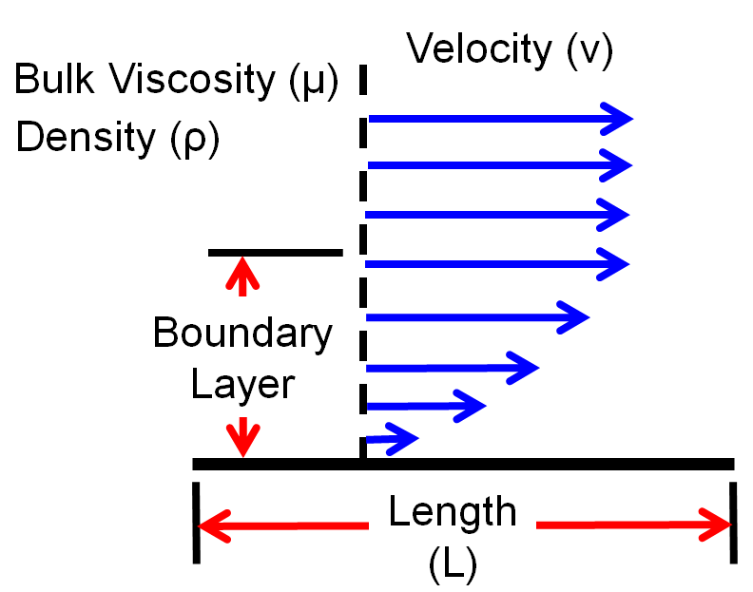
Boundary Layer
Fluid molecules stick to object’s surface
Creates boundary layer of slower moving fluid
Boundary layer is crucial to wing performance
Notes:
More information is available through the NASA Reynolds Number webpage: http://www.grc.nasa.gov/WWW/BGH/reynolds.html.

Slide 8
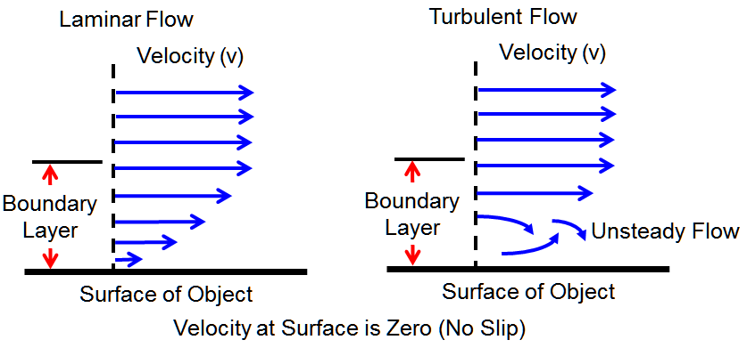
Boundary Layer and Lift
Airflow over object is slower close to object surface
Air flow remains smooth until critical airflow velocity
Airflow close to object becomes turbulent

Slide 9
Reynolds Number, Re
Representative value to compare different fluid flow systems
Object moving through fluid disturbs molecules
Motion generates aerodynamic forces
Airfoil₁
Airfoil₂
Comparable
to
when
Re₁
=
Re₂
Notes:
More information is available through the NASA Reynolds Number webpage: http://www.grc.nasa.gov/WWW/BGH/reynolds.html.

Slide 10
Angle of Attack (AOA) Affects Lift
Lift increases with AOA up to stall angle
Airflow
Lift
Lift
Airflow
Direction of Flight
Direction of Flight
Stall
Lift
Angle of Attack
Notes:
Airflow becomes turbulent at the critical angle of attack. Airflow separates from airfoil, and lift decreases dramatically. NASA developed an applet to show how the angle of attack impacts lift. It can be accessed through this link: http://www.grc.nasa.gov/WWW/K-12/airplane/incline.html

Slide 11
Reynolds Number
Ratio of inertial (resistant to change) forces to viscous (sticky) forces
Dimensionless number
$$R_{e}=\frac{ρvl}{μ}$$
$$R_{e}=\frac{vl}{ν}$$
$$ν=\frac{μ}{ρ}$$
or
$$R_{e}=Reynolds Number$$
$$l=Length of$$
$$Fluid Travel \left(m\right)$$
$$ρ=Fluid Density \left(\frac{kg}{m^{3}}\right)$$
$$μ=Fluid Viscosity \left(\frac{Ns}{m^{2}}\right)$$
$$v=Velocity\left(\frac{m}{s}\right)$$
$$ν=Kinematic Viscosity \left(\frac{m^{2}}{s}\right)$$
Notes:
More information is available through the NASA Reynolds Number webpage: http://www.grc.nasa.gov/WWW/BGH/reynolds.html.

Slide 12
Applying Reynolds Number
A P-3 Orion is cruising at 820 kph (509 mph) at an altitude of 4,023 m (13,198 ft). Assume a fluid viscosity coefficient of 1.65x10⁻⁵ N(s)/m³. What is the average Reynolds Number along a wing cross section measuring 1.1 m (3.6 ft) from leading edge to trailing edge?
Need components to calculate R_{e}
$$R_{e}=\frac{ρvl}{μ}$$

Slide 13
Applying Reynolds Number
Calculate Air Temperature
Calculate Air Pressure
$$T=15.04℃−0.00649\frac{℃}{m}\left(h\right)$$
$$T=15.04℃−0.00649\frac{℃}{m}(4,023 m)$$
$T=−11.1℃$
$$p=101.29kPa{\left[\frac{\left(−11.1℃+273.1℃\right)\frac{K}{℃}}{288.08 K}\right]}^{5.256}$$
$$p=61.5 kPa$$

Slide 14
Applying Reynolds Number
Calculate Air Density
$$ρ= \frac{p}{0.2869\frac{J}{kg\left(K\right)}\left(T+273.1\right)}$$
$$ρ= \frac{61. 5 kPa}{0.2869\frac{J}{kg\left(K\right)}\left(−11.1 ℃+273.1\right)\frac{K}{℃}}$$
$$ρ=0.818\frac{kg}{m^{3}}$$

Slide 15
Applying Reynolds Number
Convert Velocity
$$V=\frac{820 kph\left(1000 \frac{m}{km}\right)}{60 \frac{min}{hr}\left(60 \frac{s}{min}\right)}$$
$$V=227.8 \frac{m}{s}$$

Slide 16
Applying Reynolds Number
Calculate R_{e}
$$R_{e}=\frac{ρvl}{μ}$$
$$R_{e}=\frac{0.817\frac{kg}{m^{3}}\left(227.8 \frac{m}{s}\right)(1.1 m)}{1.65×{10}^{−5}\frac{Ns}{m^{2}}}$$
$$R_{e}=12,408,000$$

Slide 17
Drag Equation
Drag
Coefficient of drag, C_{d}
Determined experimentally
Combines several factors
Shape
Angle of attack
Direction of Flight
$$C_{d}=Coefficient of Drag$$
$$D=Drag \left(N\right)$$
$$C_{d}=\frac{2×D}{A×ρ×v^{2}}$$
$$C_{d}=\frac{D}{q ×A}$$
$$A=Wing Area \left(m^{2}\right)$$
$$ρ=Density \left(\frac{kg}{m^{3}}\right)$$
Alternate format
$$v=Velocity \left(\frac{m}{s}\right)$$
$$q=Dynamic Pressure\left(Pa\right)$$
Notes:
The area referenced with the coefficient of drag varies depending on what C_{d} is compared with. Drag typically refers to total surface area, frontal area, or wing area – all of these are proportional to each other. Our equation refers to wing area to more directly compare C_{d} to C_{l}. More information about reference area is available through NASA at http://www.grc.nasa.gov/WWW/K-12/airplane/sized.html

Slide 18
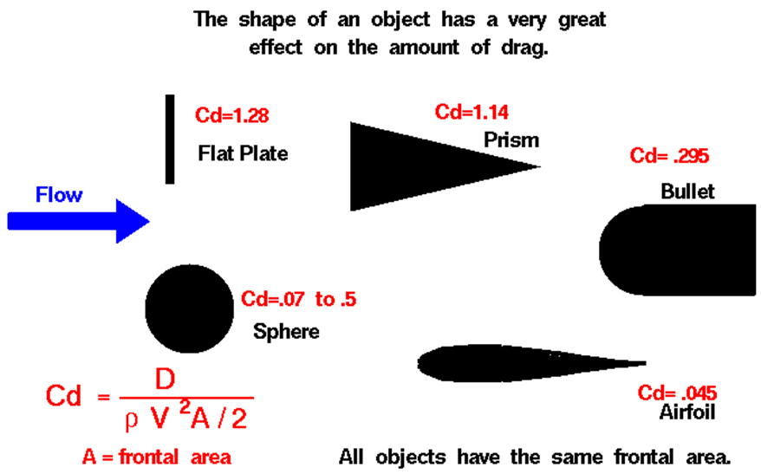
Coefficient of Drag (C_{d})
Object shape affects C_{d}

Slide 19
Applying the Drag Equation
The same Cessna 172 from Activity 1.2.2 step #2 takes off under the same conditions as described earlier in this presentation. How much drag is produced when the wing is configured such that the coefficient of drag is 0.05?
Notes:
Average temperature source = http://www.weather.com/outlook/health/fitness/wxclimatology/monthly/graph/USCO0105

Slide 20
Applying the Drag Equation
Calculate drag
$$C_{d}=\frac{2D}{Aρv^{2}}$$
$$D=\frac{C_{d}Aρv^{2}}{2}$$
$$D=\frac{0.05\left(18.2{ m}^{2}\right)\left(1.196\frac{kg}{m^{3}}\right){\left(28.3 \frac{m}{s}\right)}^{2}}{2}$$
$$D=436 N$$

Slide 21
Downwash and Wingtip Vortices
Pressure difference at wing tips
Air to spill over wingtip perpendicular to main airflow
Air flows both upward and rearward, forming a vortex
Decreases lift
Increases drag
Notes:
The pressure difference above and below the wing causes air flow that is perpendicular to the main airflow over the wing. This causes a flow that is both upward and rearward, causing the air to form a vortex. This can be seen on some aircraft at slow airspeeds in high humidity conditions (e.g., take off and landing).

Slide 22
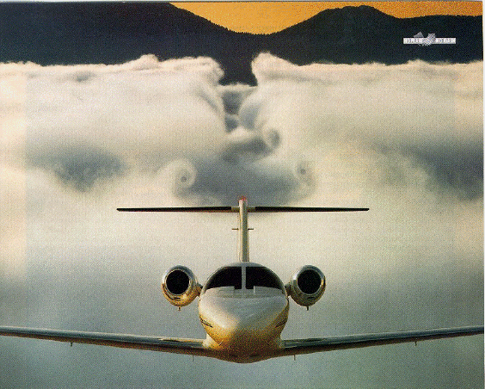
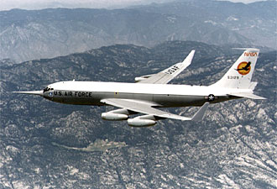
Wingtip Vortices
Air flows both upward and rearward, forming a vortex
Winglets are vertical airfoils that limit vortices and improve fuel efficiency
Notes:
More information about winglets is available from NASA at http://www.nasa.gov/centers/dryden/about/Organizations/Technology/Facts/TF-2004-15-DFRC.html
The aspect ratio is the square of the span, s, divided by the wing area, A. AR = s² / A
For a rectangular wing, this reduces to the ratio of the span to the chord, c. AR = s / c
Long, slender, high aspect ratio wings have lower induced drag than short, thick, low aspect ratio wings. Induced drag is a three dimensional effect related to the wing tips. The longer the wing, the farther the tips are from the main portion of the wing, and the lower the induced drag. Lifting line theory shows that the optimum (lowest) induced drag occurs for an elliptic distribution of lift from tip to tip. The efficiency factor, e, is equal to 1.0 for an elliptic distribution and is some value less than 1.0 for any other lift distribution.
The outstanding aerodynamic performance of the British Spitfire of World War II is partially attributable to its elliptical wing, which gave the aircraft a very low amount of induced drag. A more typical value of e = .7 exists for a rectangular wing. The total drag coefficient C_{d} is equal to the base drag coefficient at zero lift C_{d0} plus the induced drag coefficient C_{di}.

Slide 23
Reference
National Aeronautics and Space Administration (2011). Aerodynamic forces. Retrieved from http://www.grc.nasa.gov/WWW/K-12/airplane/presar.html
National Aeronautics and Space Administration (2011). Reynolds number. Retrieved from http://www.grc.nasa.gov/WWW/BGH/reynolds.html
National Aeronautics and Space Administration (2011). Winglets. Retrieved from http://www.nasa.gov/centers/dryden/about/Organizations/Technology/Facts/TF-2004-15-DFRC.html
Raymer, P. (2006). Aircraft design: A conceptual approach. Reston, VA: American Institute of Aeronautics and Astronautics.

