Slide 1
The Engineering Notebook
Principles Of Engineering
© 2012 Project Lead The Way, Inc.

Slide 2
What is an Engineering Notebook?
An engineering notebook is a book in which an engineer will formally document, in chronological order, all of his or her work that is associated with a specific design project.
Each engineer maintains an engineering notebook. All necessary project work is recorded by hand.
Notes:
The engineering notebook is a tool used by engineers and should be brought to class daily.

Slide 3
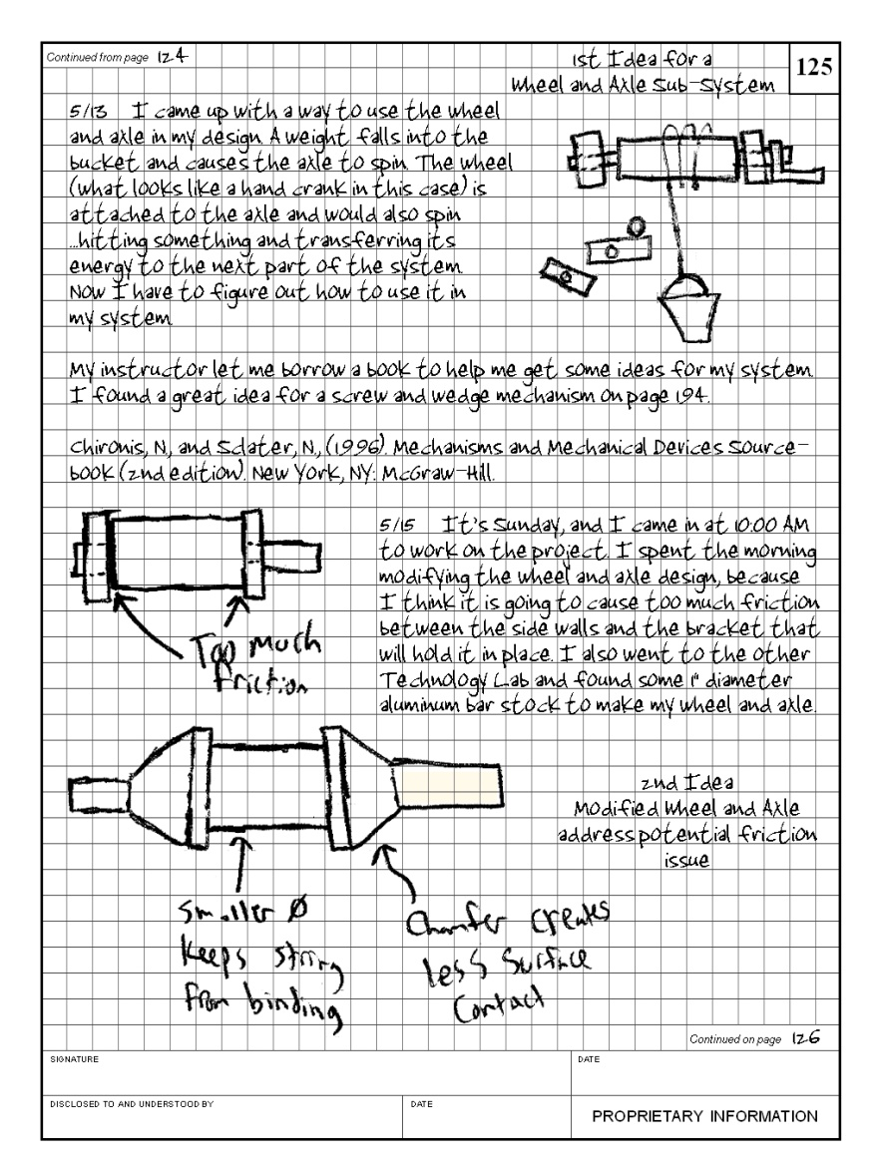
An Engineering Notebook Records
Written ideas
Sketches (preferably annotated)
Work session summaries
Research findings
Interview information: who was contacted, when, and what was discussed or learned
Notes:
We are not looking for artists when sketching, just proper detail of the thought or idea.

Slide 4
Standard Page Layout
Bound quadrille-lined (grid) pages
Individually labeled page numbers
Location for designer’s signature and date
Location for witness signature and date
Locations for identifying contents as continued from and to another page
Statement of the proprietary nature of the notebook
Notes:
Note: Explain to the students where the information will go based on the notebook you are using.

Slide 5
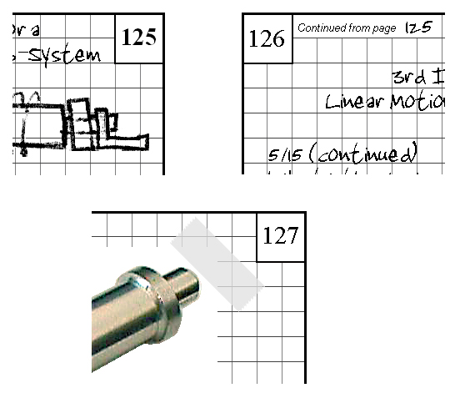
Engineering Notebook Standards
1. Sequentially number pages in ink on the top outside edge of the page.
2. Bind notebooks.
Cannot add pages
Cannot remove pages without disrupting the binding
http://www.dontaylorbookbinder.com/Restoration%20&%20Rebinding.htm
accessed 3/1/06
3. Do not remove pages from the engineering notebook for any reason.

Slide 6
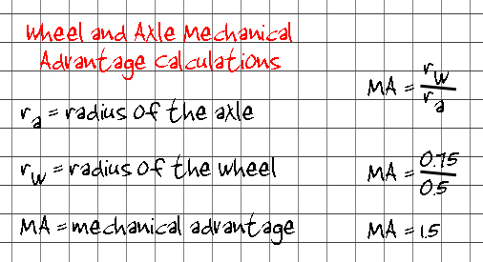
Engineering Notebook Standards
4. Store the notebook in a safe location.
5. When the notebook is full, begin a new notebook and archive the old one.
http://www.ikea.com
accessed 3/2/06
6. Clearly label all figures and calculations.

Slide 7
Engineering Notebook Standards
7. Begin entries at the start of the page. Work left-to-right and top-to-bottom.
8. Do not use markers that will bleed through the paper.
http://powayusd.sdcoe.k12.ca.us/pusdmbms/ASB/ASB/student%20store.htm
accessed 3/1/06
http://www.elmers.com/products/product/product_page.asp?pCode=E379
http://www.shadesdirect.com/adhesives_prods_details_ita/photomount_tapei.htm
accessed 3/1/06
9. Permanently attach inserted items (glue is preferred). Loose leaf items do not belong in the notebook.

Slide 8
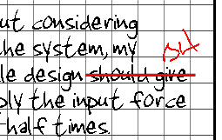
Engineering Notebook Standards
10. Clearly indicate the date for each entry.
11. Do not erase or remove information. Cross out, initial, and correct any mistakes.
12. Use consistent recording methods for ideas, references, test results, etc.

Slide 9
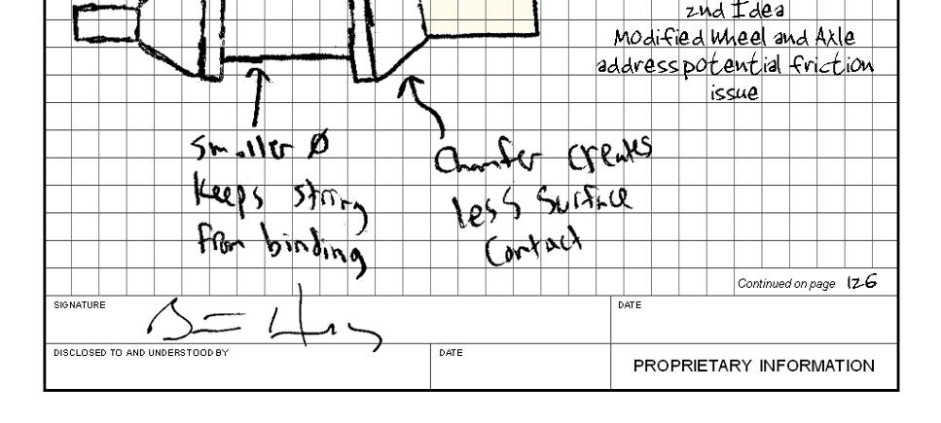
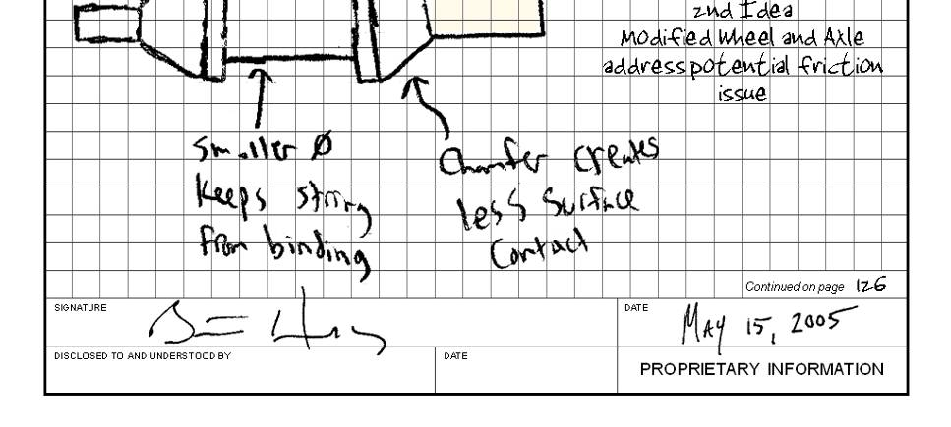
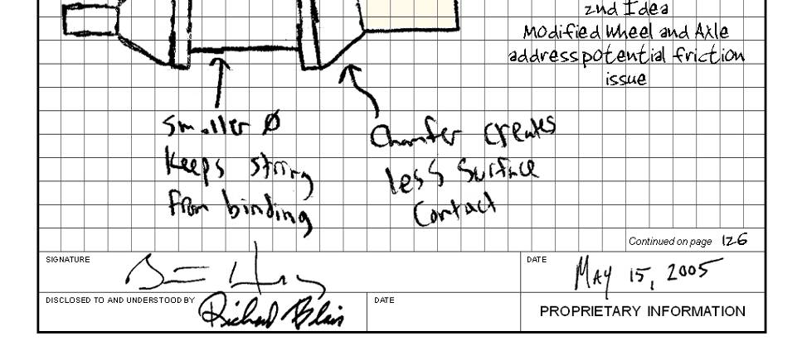
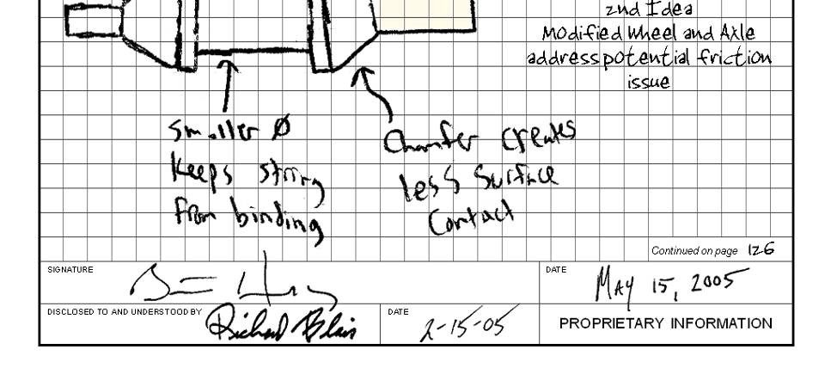
Engineering Notebook Standards
13. Each page is signed and dated before the next page is begun.
14. A colleague or mentor should corroborate the events and facts on each page and sign off as a witness in the appropriate location.

Slide 10
Engineering Notebook Layout

Slide 11
Cover
Your NAME, COURSE and PERIOD must be written on the cover of your notebook.
Write them LARGE, Clearly and in Permanent Maker.

Slide 12
Example
Mr. Tackett
Introduction to Engineering Design
1st Period

Slide 13
Table of Contents
Leave the first TWO pages (front and back) empty for your TOC. This allows for FOUR blank sheets for the TOC.
Write Table of Contents across the top of each page.
Make a header for each Unit
List each activity and what page or pages it is on

Slide 14
Example
Table of contents
Unit 1
Pg 1 - Activity 1.1.1 Classroom & Lab Safety
Pg 2 – Activity 1.1.2 Engineering Notation

Slide 15
Lesson Title
Page #
Warm up:
Lesson Notes:
Activity / Sketches / Etc:
Conclusion Questions:
Your Signature and Date:
Your Witness’s Signature and Date:

Slide 16
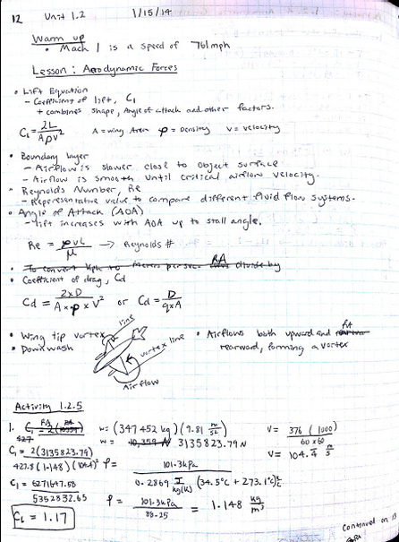
Sample Notebook Entry

