Slide 1
Newton’s Law
Aircraft Action and Reaction
Aerospace Engineering
© 2011 Project Lead The Way, Inc.

Slide 2


Newton’s Laws of Motion
Review of Newton’s Laws
Law of inertia: Object in state of rest or uniform motion will continue unless acted upon by another force
Acceleration of an object is proportional to net force acting on object and inversely proportional to object’s mass (F = ma)
For every action force, there is an equal and opposite reaction force
Notes:
Students should be able to state Newton’s three laws based upon prior exposure to the Principles of Engineering statics lesson.

Slide 3
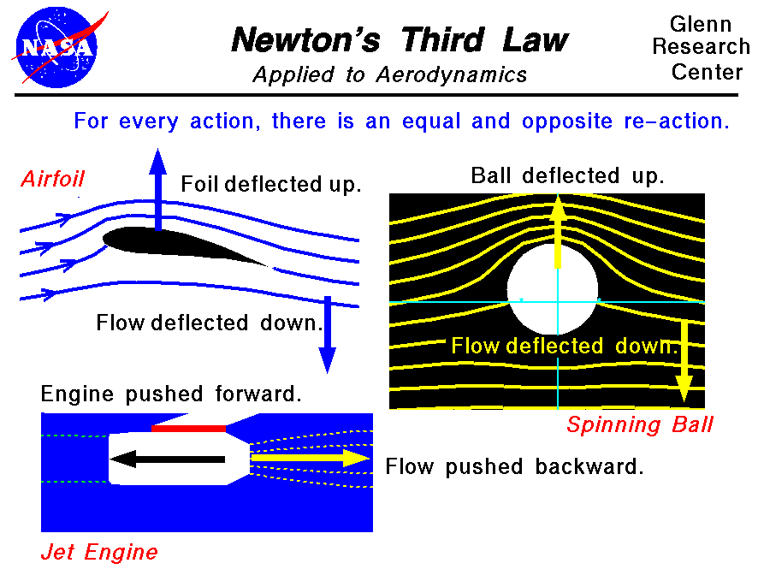
Newton’s Third Law
In Principles of Engineering you learned that forces act and react within structures
Aircraft are acted upon by forces
  Thrust and lift forces shown below

Slide 4
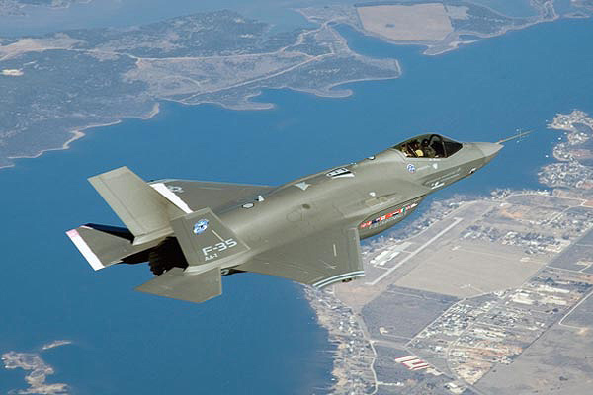
Newton’s Third Law
Lift
Four forces on airplane
  Weight
  Lift
  Drag
  Thrust
Aircraft is in steady flight when all forces are balanced
Aircraft accelerates in direction of strongest force when not balanced
Thrust
Drag
Weight
Notes:
More information available at http://www.grc.nasa.gov/WWW/K-12/airplane/forces.html

Slide 5
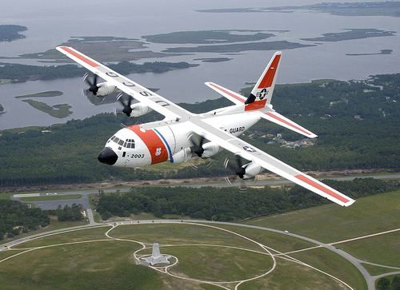
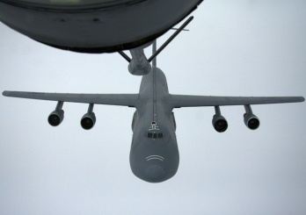
Weight
All mass of aircraft act toward center of Earth
  Aircraft frame
  Fuel: Decreases during flight
  Payload: Passengers and cargo
Weight must be counteracted and balanced
Weight
Notes:
Pose these questions to students:
When will fuel weight decrease during a flight? Mid-air refueling.
When will the payload decrease during a flight? Parachutists exiting the aircraft and airdrops such as food and supply drops.

Slide 6

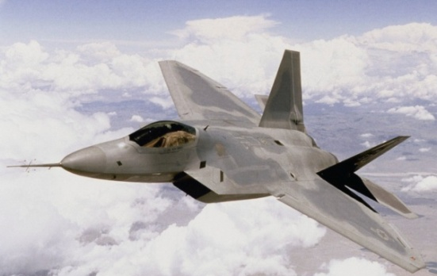
Lift
    Opposes weight
Lift must equal weight for straight and level flight
Unbalanced lift and weight cause a body to ascend or descend
Lift is generated by air movement over wings
Lift
Lift

Slide 7
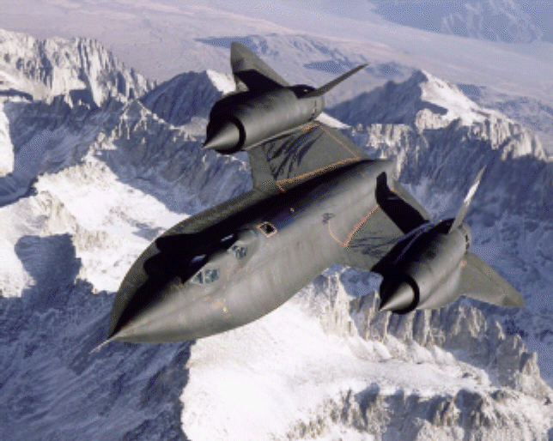
Drag
    Force that resists aircraft motion
Acts opposite of aircraft motion
Drag

Slide 8

Thrust
Must equal drag for straight and level flight
Unbalance of drag and thrust causes slower or faster velocity
Propulsion system produces thrust
Thrust

Slide 9
Newton’s Third Law of Motion
  For every action force, there is an equal and opposite reaction force
  Aircraft is in steady flight when all forces are balanced
  Aircraft accelerates in direction of strongest force

Slide 10
References
Microsoft, Inc. (n.d.). Clip art. Retrieved from http://office.microsoft.com/en-us/clipart/default.aspx
National Aeronautics and Space Administration (2009). Retrieved from http://www.grc.nasa.gov/WWW/K-12/airplane/
Navigation. In Jeppesen Private pilot: Guided flight discovery (pp. 9-20 – 9-46). (2007). Englewood, CO: Jeppesen

