Slide 1
Activity 2.2.1a Action Reaction Construction Guide
Aerospace Engineering
© 2011 Project Lead The Way, Inc.

Slide 2
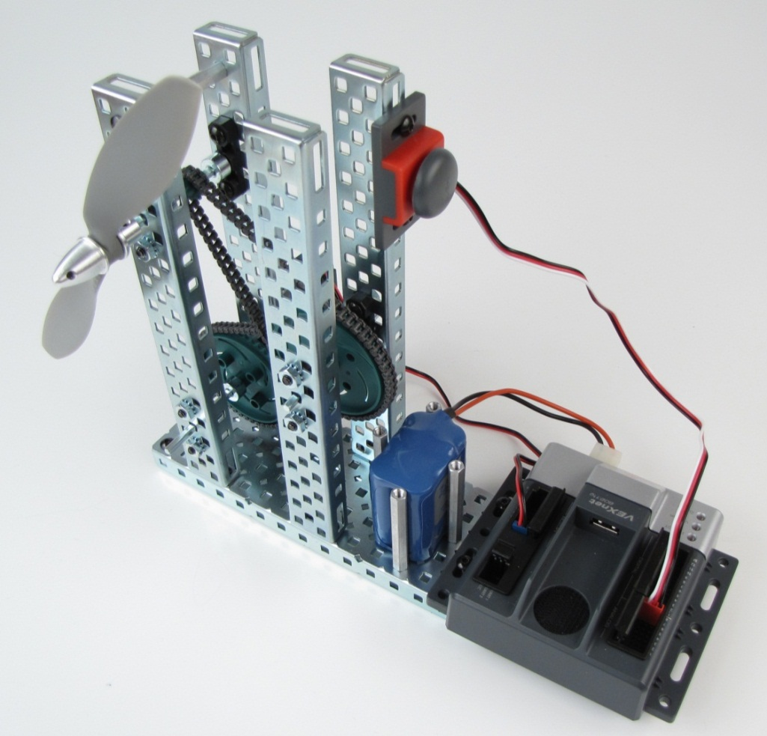
Equipment
AE VEX Kit
Slow Flyer Propeller, 8x3.8SF
Slow Flyer Propeller, 8x6SF
Propeller Adapter with set screw 4mm
12 in. x 12 in. x ½ in. Styrofoam
Vernier Dual-Range Force Sensor
Vernier Go Link Adapter
Small "A" Base
45 cm Stainless Steel Rod
Optional Equipment
6-32 x 1.5 in. Bolt
6-32 Nuts (2)
1 in. Fender washers (2)

Slide 3
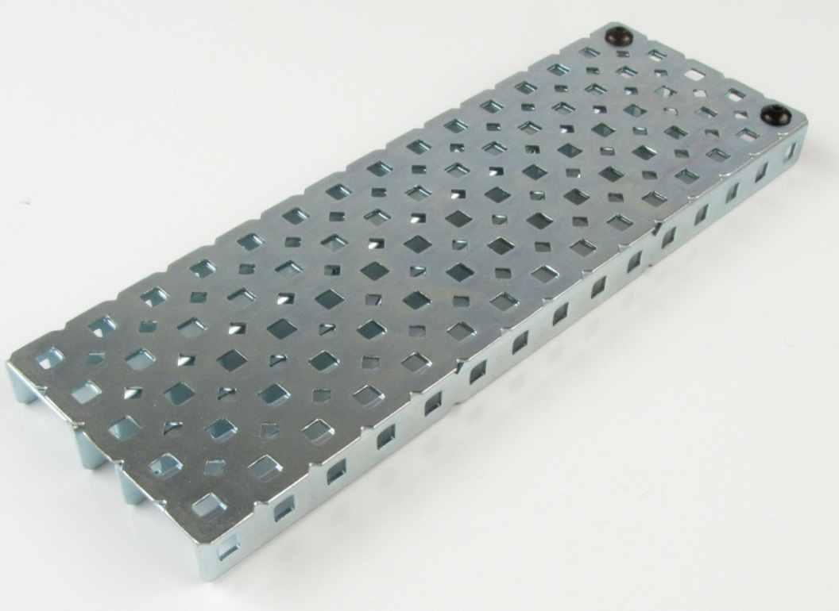
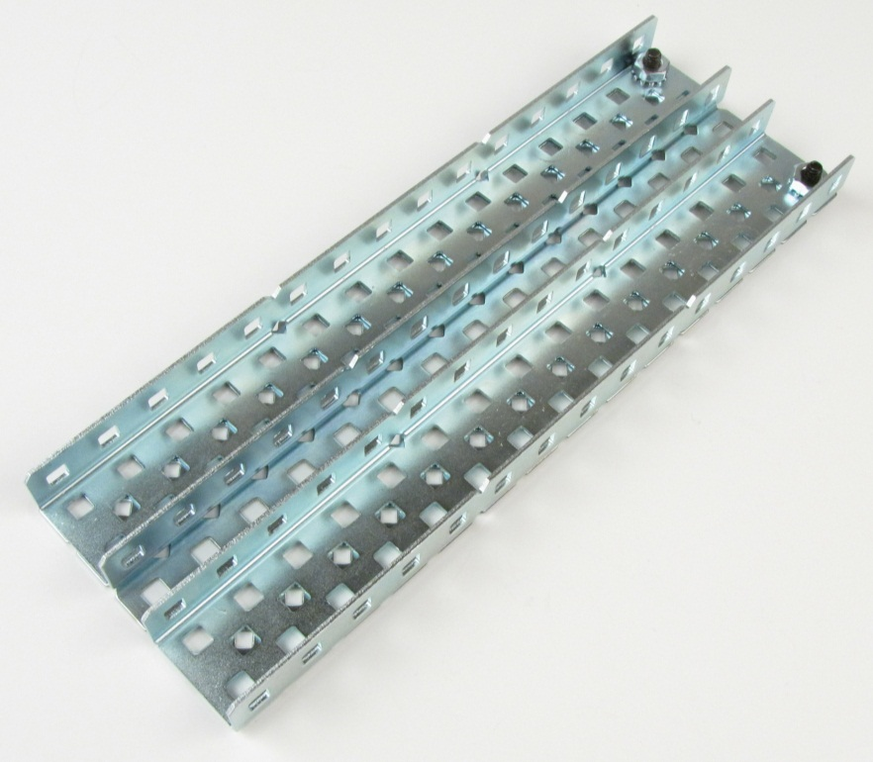
Step 1: Construct Base

Slide 4
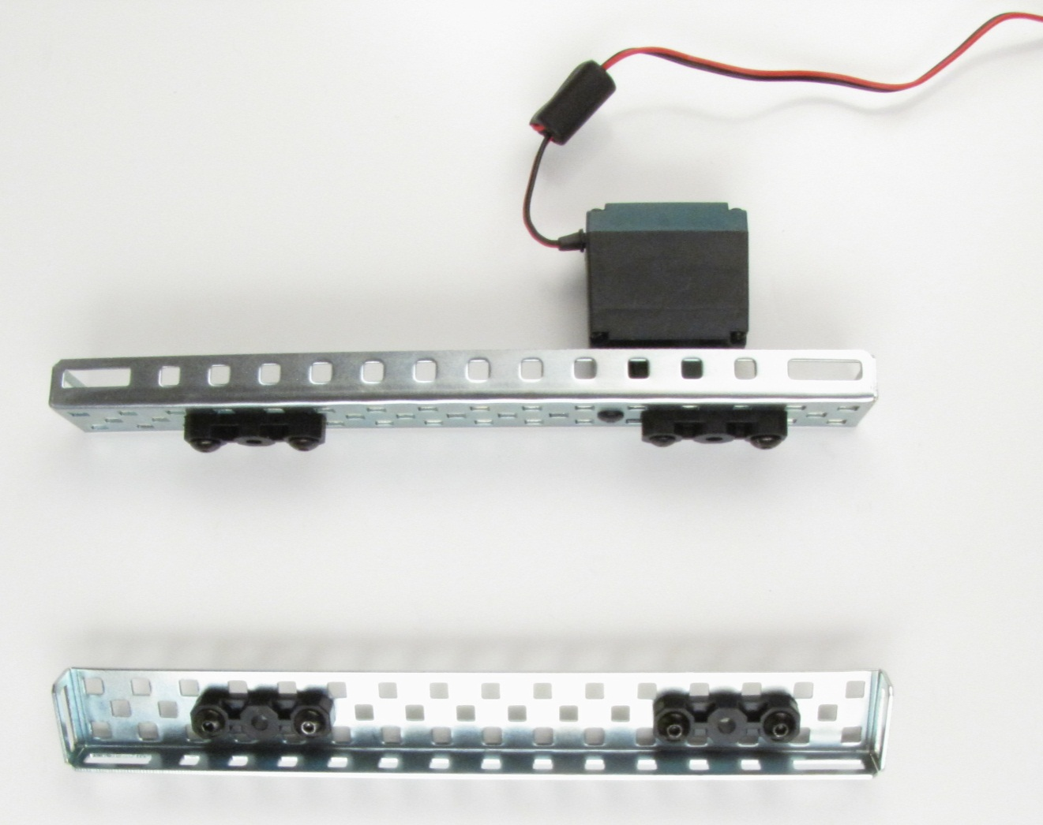
Step 2: Construct Drive Towers

Slide 5
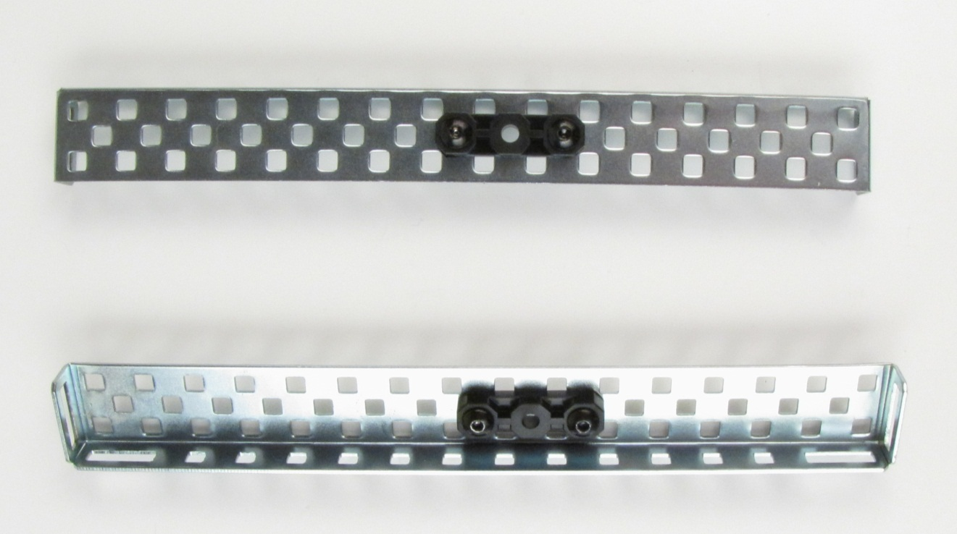
Step 3: Construct Propeller Towers

Slide 6
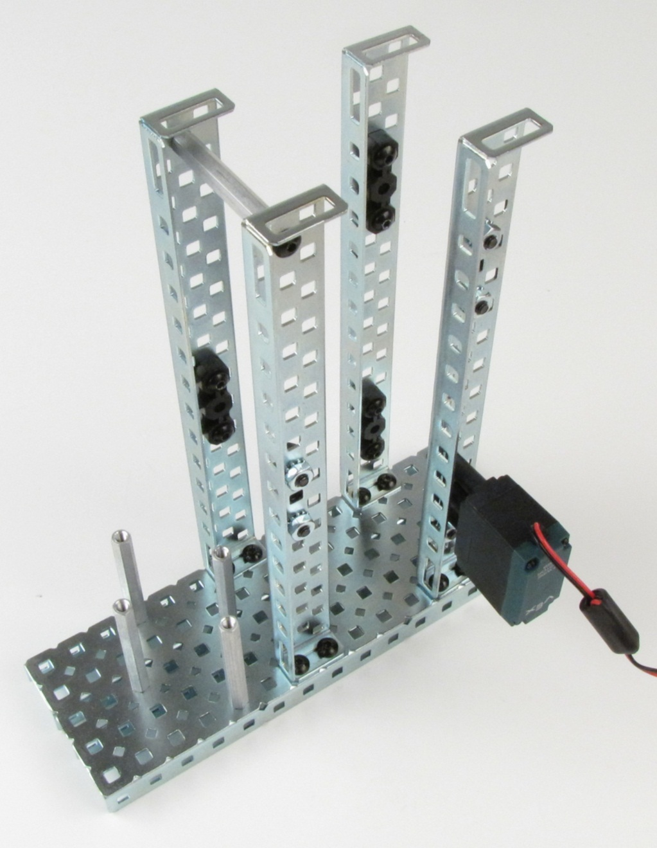
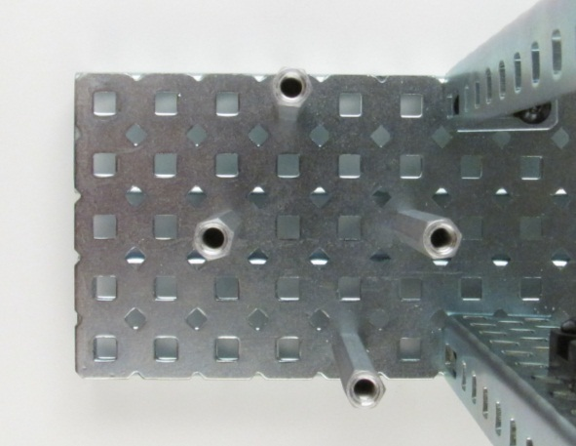
Step 4: Install Towers and Battery Placement
2 in. Spacer
2 in. Spacers
x4

Slide 7
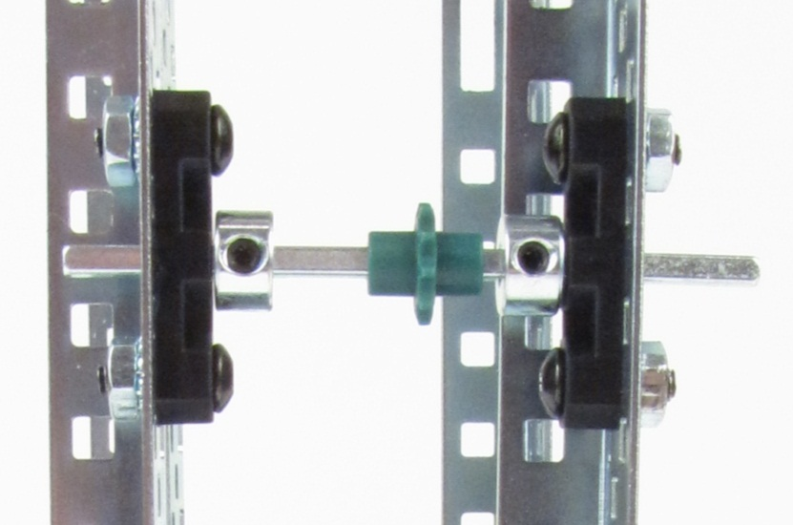
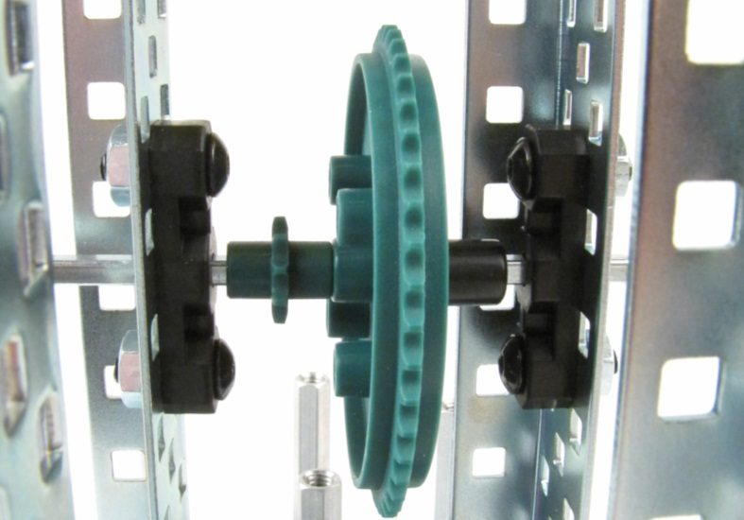
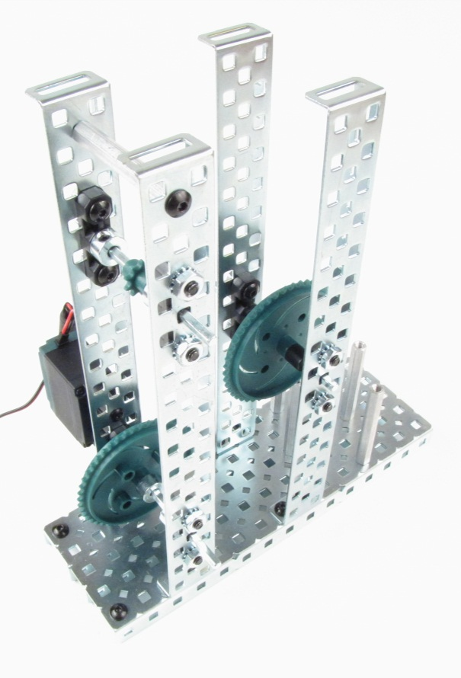
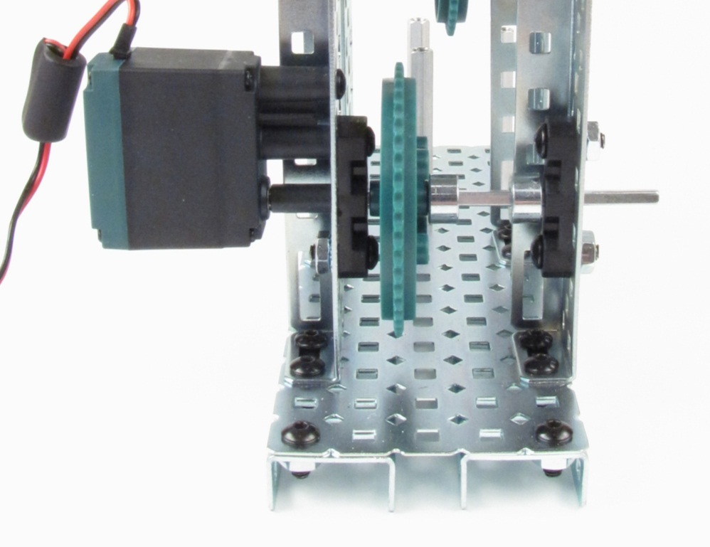
Step 5: Install Sprockets
Small gaps
Small gaps
All detail images shown
from left side

Slide 8
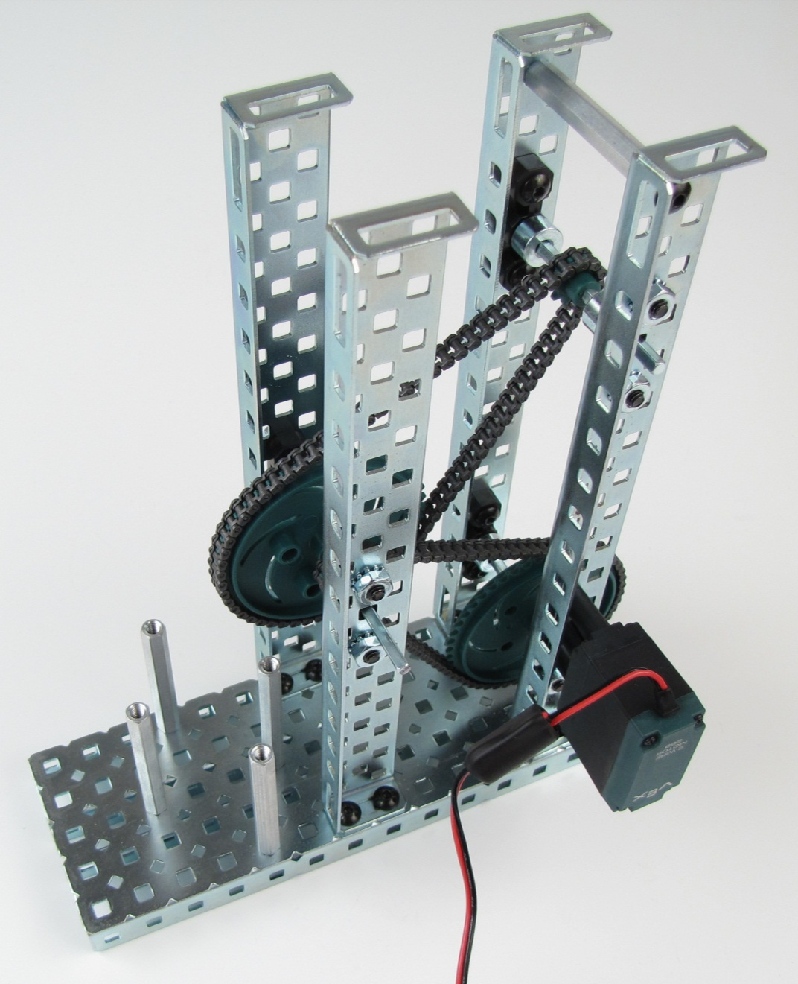
Step 6: Install Chains
11 1/2 in. Chain
10 7/8 in. Chain

Slide 9
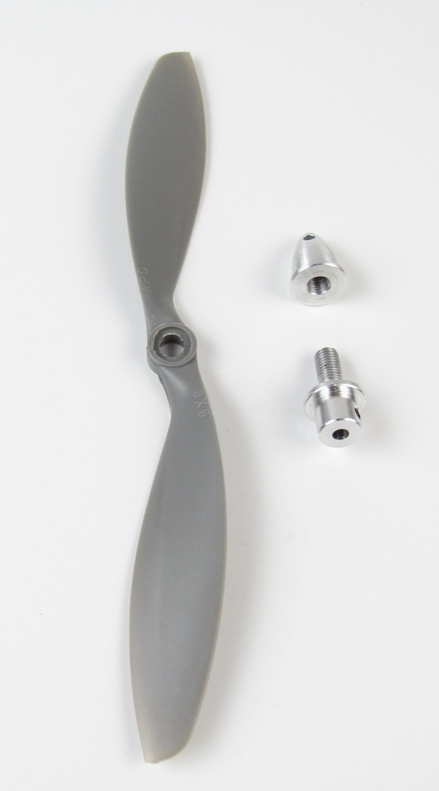
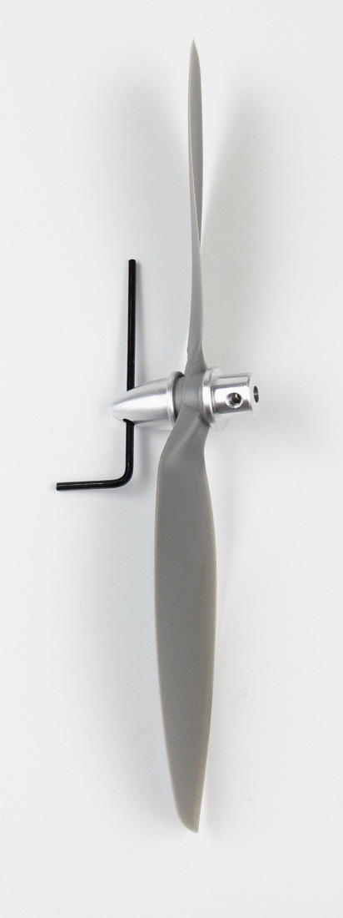
Step 7: Assemble Propeller
Slow flyer propeller,
8x3.8SF
(label side toward nose)
Propeller adapter
with set screw 4mm
Tighten propeller adapter
using hex wrench
(Remove after tightening adapter)

Slide 10
Step 8: Install Inputs and Outputs
Install bump switch
Secure propeller
to shaft with
set screw
Install battery and
connect to CORTEX
Motor into
CORTEX motor 1
Bump switch into
CORTEX digital 1

Slide 11
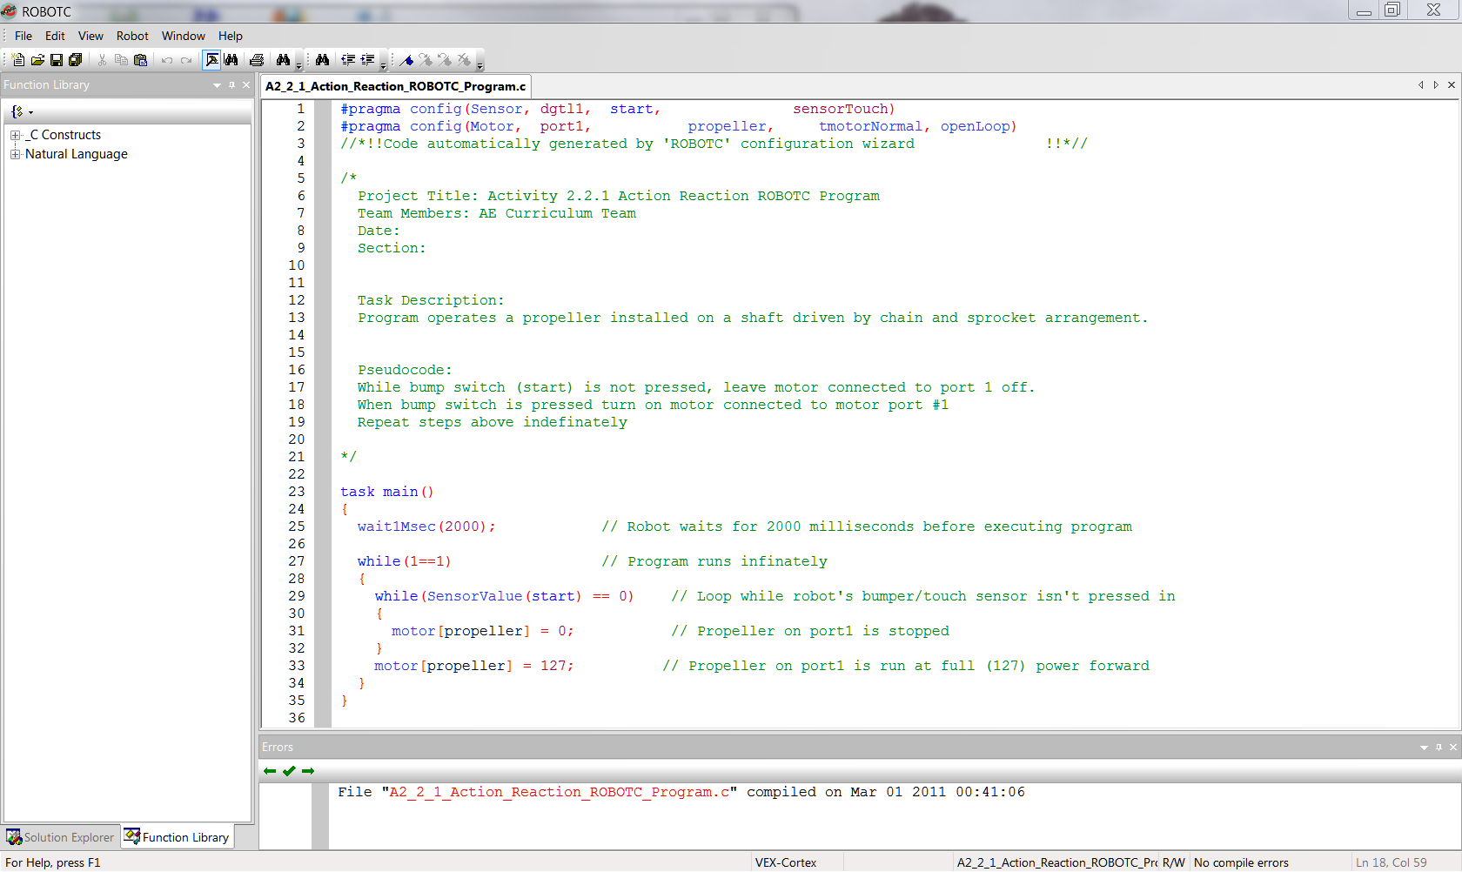
Step 9: Download ROBOTC Program to CORTEX

Slide 12
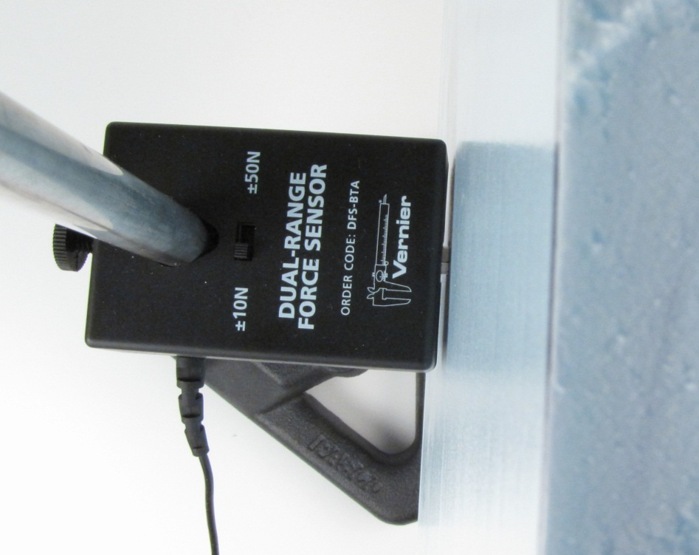
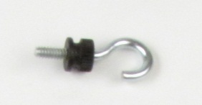
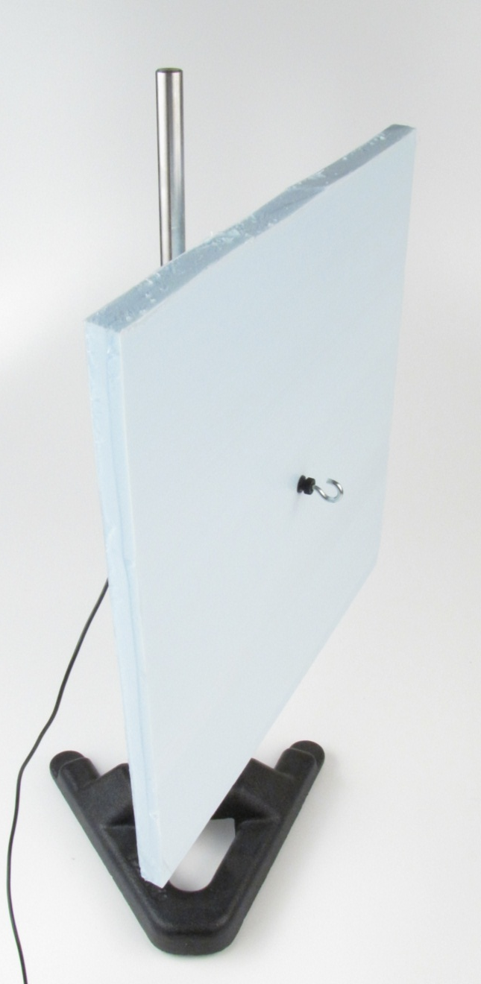
Step 10a: Prepare Styrofoam Target (Method #1)
Step #3
Thread hook through
Styrofoam into
Dual-Range Force
Sensor
12 in. x 12 in. x ½ in.
Styrofoam
Step #1
Select +/- 10 N on
Dual-Range Force Sensor
Step #2
Press Styrofoam onto Dual-Range Force Sensor,
leaving a small gap

Slide 13
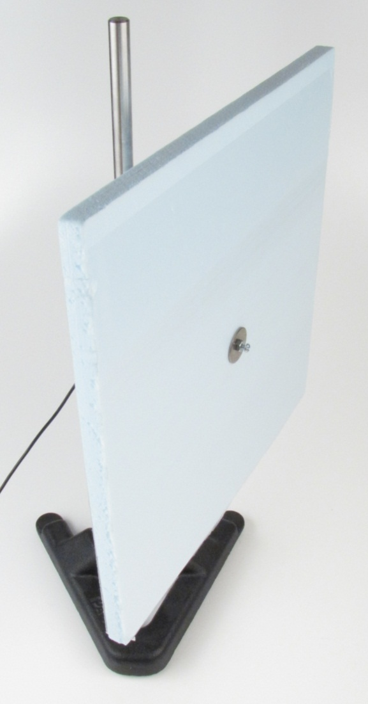
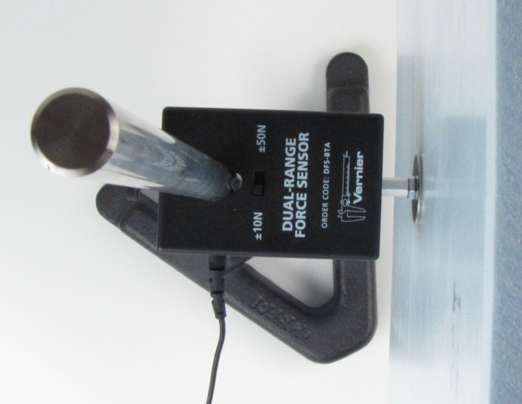
Step 10b: Prepare Styrofoam Target (Method #2)
Step #2
Sandwich Styrofoam between two fender washers each backed by a nut
6-32 x 1.5 in. Bolt
6-32 Nuts (2)
1 in. Fender washers (2)
Step #3
Thread 6-32 bolt onto Dual-Range Force Sensor
12 in. x 12 in. x ½ in.
Styrofoam
Step #1
Select +/- 10 N on
Dual-Range Force Sensor

Slide 14
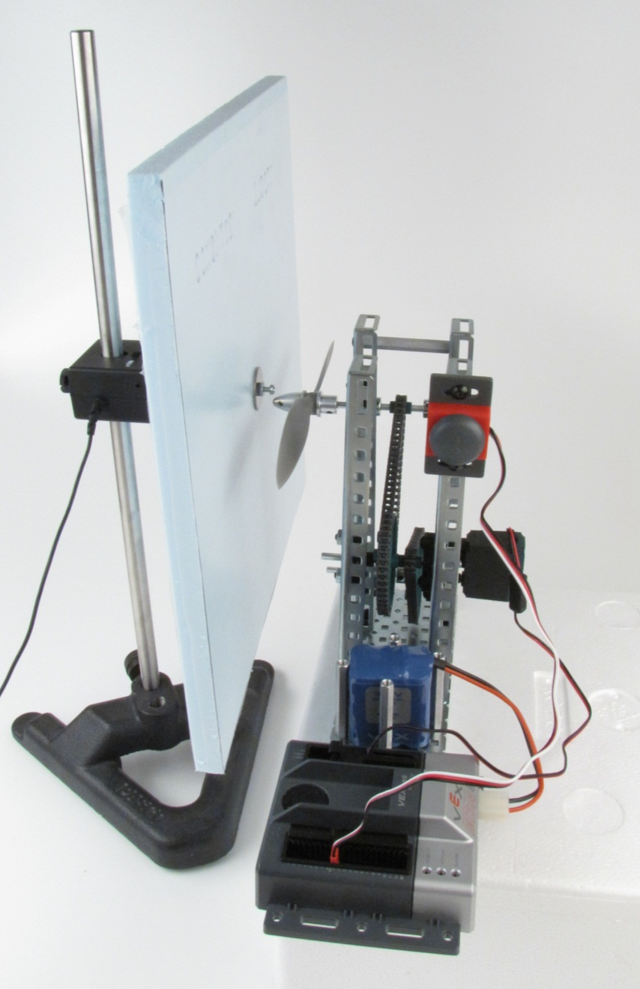
Step 11: Prepare to Test Propeller
Align propeller with center of bolt (avoid contact)

Slide 15
Stop
Complete
Activity 2.1.1 Action and Reaction

