Slide 1
Aircraft Engines
Types and Placement
Aerospace Engineering
© 2011 Project Lead The Way, Inc.

Slide 2
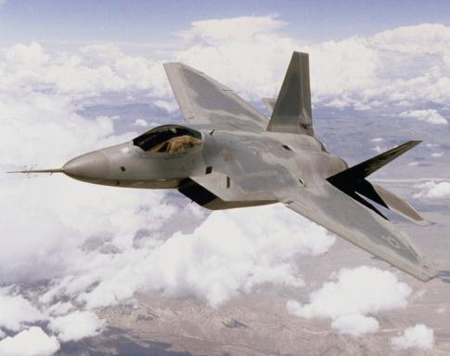
Newton’s Third Law of Motion
For every action force, there is an equal and opposite reaction force
Aircraft drag must be counteracted by thrust
Lift
Drag
Thrust
Weight

Slide 3
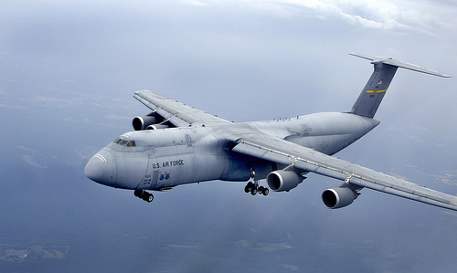
Types of Propulsion Systems
Propeller
Turbine (also called jet)
Ramjet
Aircraft’s velocity compresses air
Newer form is supersonic combustion ramjet (scramjet) for speeds above mach 5
Rocket
Fuel and oxygen burn very rapidly and are exploded and forced through nozzle
Notes:
This lesson will focus on propeller and turbine propulsion systems. The ramjet and rocket are mentioned here for context.
More information available at:
Propeller: http://www.grc.nasa.gov/WWW/K-12/airplane/propeller.html
Turbine: http://www.grc.nasa.gov/WWW/K-12/airplane/turbine.html
Ramjet: http://www.grc.nasa.gov/WWW/K-12/airplane/ramjet.html
Scramjet: http://www.grc.nasa.gov/WWW/K-12/airplane/scramjet.html
Rocket: http://www.grc.nasa.gov/WWW/K-12/airplane/rocket.html

Slide 4
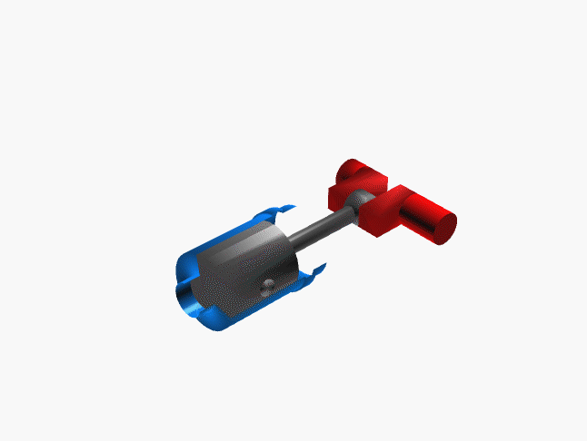
Engine Categories
Reciprocating (contains pistons)
Gasoline-powered
Two stroke
Four stroke
Diesel-powered (not typical in aircraft)
Turbine
Turbojet
Turbofan
Turboprop
Afterburning turbojet

Slide 5
Engine Operations
All engines must perform four basic operations.
Intake: Fuel and air must be brought into the engine
Compression: Fuel-air mixture must be compressed
Power: Fuel-air mixture must be ignited for the gases to provide engine power
Exhaust: Gases must be cleared for the next cycle

Slide 6
Two Stroke Engine
Four operations occur in one revolution
Typically powers smaller engines
Examples include ultralight aircraft, dirt bikes, lawn mowers, and generators
Compared to four stroke engines
Typically more powerful
Higher fuel consumption
More noise

Slide 7
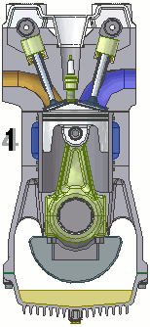
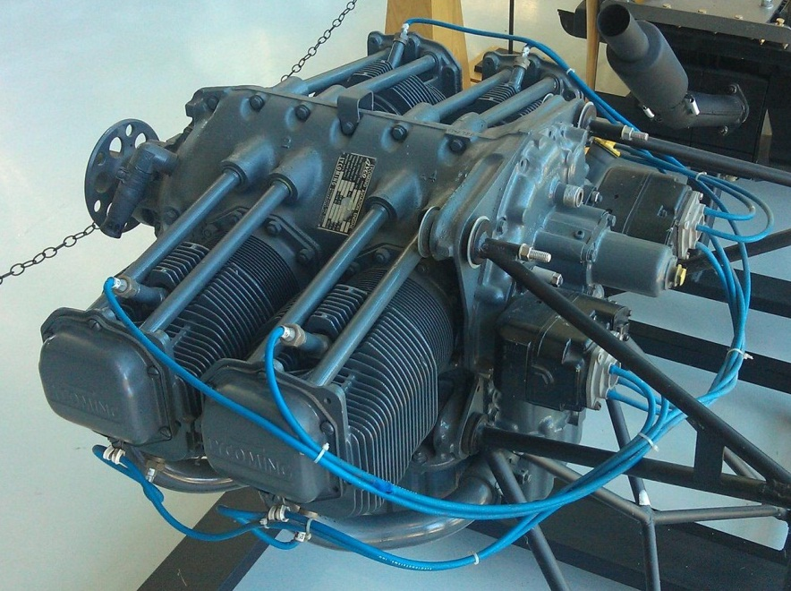
Four Stroke Engine
Four operations occur in two revolutions
Typically found in automobiles and small aircraft
Compared to two stroke engines
More fuel efficient
More quiet
Notes:
More detail about four stroke engines is available at the Animated Engines website: http://www.animatedengines.com/otto.shtml
The physical engine shown is a Lycombing engine, which is a common small general aviation engine.

Slide 8
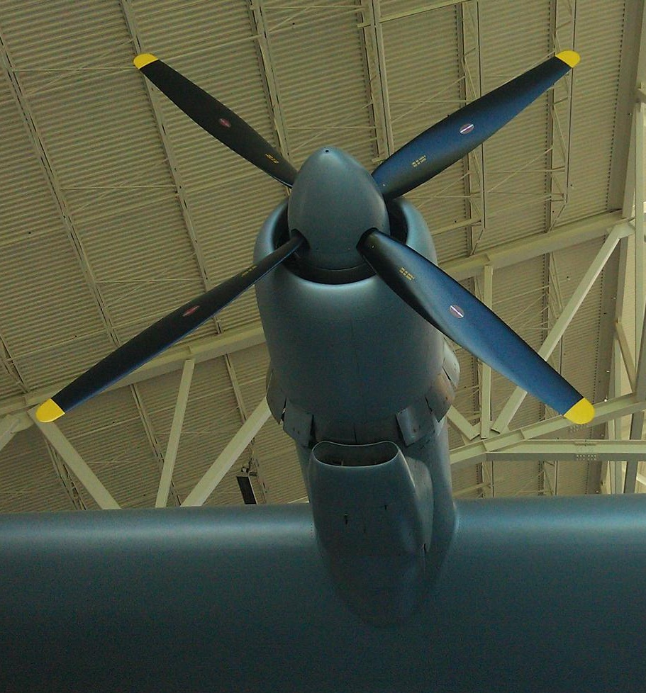
Radial Engine
Notes:
The radian engine shown is from the Spruce Goose on display at the Evergreen Aviation & Space Museum in McMinnville, Oregon. More information about the museum and aircraft is available at http://www.evergreenmuseum.org/

Slide 9
Carburetor
P_{low}
P_{high}
Mixes fuel and air for engine
Carburetor reduces cross-sectional area of air as it passes through
Air velocity increases and pressure lowers at reduction, creating a vacuum
Draws fuel into vacuum to mix with air
Bernoulli’s Law
Also called a Venturi effect
Carburetor only used on gasoline engines (unless fuel injected)
$${\left(P_{s}+\frac{ρv^{2}}{2}\right)}_{1}={\left(P_{s}+\frac{ρv^{2}}{2}\right)}_{2}$$
Notes:
P_{s}= Static pressure; ρ = Density; and V = Velocity.
More information about Bernoulli’s Law is available at: http://www.grc.nasa.gov/WWW/K-12/airplane/bern.html

Slide 10
Carburetor
Icing can be a problem
Water vapor condenses in reduced air pressure
Heated air from engine prevents icing
P_{low}
P_{high}
Notes:
More information about Bernoulli’s Law is available at: http://www.grc.nasa.gov/WWW/K-12/airplane/bern.html

Slide 11
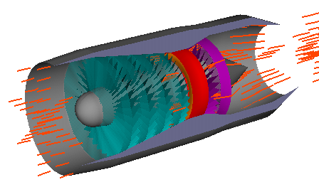
Turbojet
Simplest and earliest gas turbine
Air flows continuously through engine
Intake
Compression
Power (combustion)
Exhaust
Exhaust
Power
Compression
Intake
Notes:
Large amounts of surrounding air are continuously brought into the engine inlet. In England they call this part the intake, which is probably a more accurate description, since the compressor pulls air into the engine. We have shown here a tube-shaped inlet, like one you would see on an airliner. But inlets come in many shapes and sizes depending on the aircraft's mission. At the rear of the inlet, the air enters the compressor. The compressor acts like many rows of airfoils, with each row producing a small jump in pressure. A compressor is like an electric fan; therefore, we must supply energy to turn the compressor. At the exit of the compressor, the air is at a much higher pressure than free stream. In the burner a small amount of fuel is combined with the air and ignited. In a typical jet engine, 100 pounds of air/sec is combined with only 2 pounds of fuel/sec. Most of the hot exhaust has come from the surrounding air. Once the hot exhaust leaves the burner, it is passed through the turbine. The turbine works like a windmill. Instead of needing energy to turn the blades to make the air flow, the turbine extracts energy from a flow of gas by making the blades spin in the flow. In a jet engine we use the energy extracted by the turbine to turn the compressor by linking the compressor and the turbine by the central shaft. The turbine takes some energy out of the hot exhaust, but the flow exiting the turbine is at a higher pressure and temperature than the free stream flow. The flow then passes through the nozzle which is shaped to accelerate the flow. Because the exit velocity is greater than the free stream velocity, thrust is created as described by the thrust equation. For a jet engine, the exit mass flow is nearly equal to the free stream mass flow, since very little fuel is added to the stream. The amount of mass flow is usually set by flow choking in the nozzle throat.

Slide 12
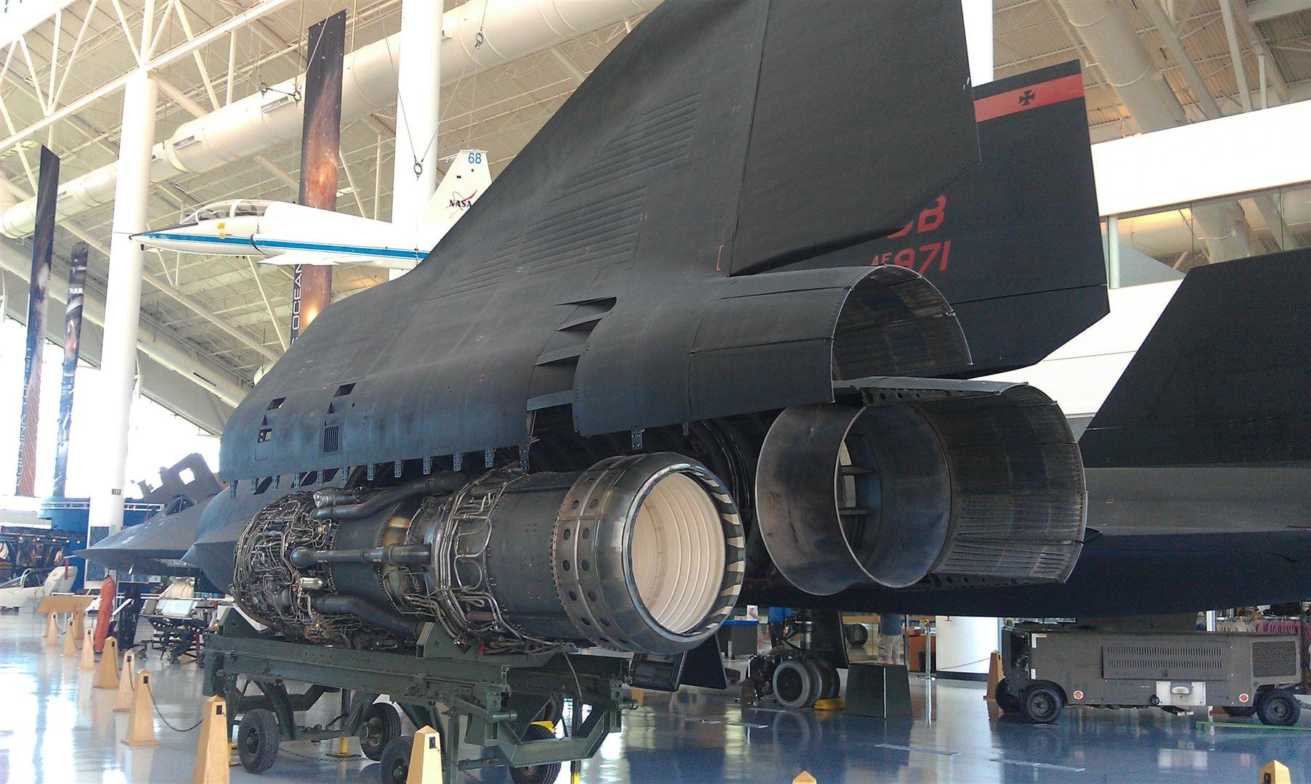
Turbojet Example
SR-71 Engine

Slide 13
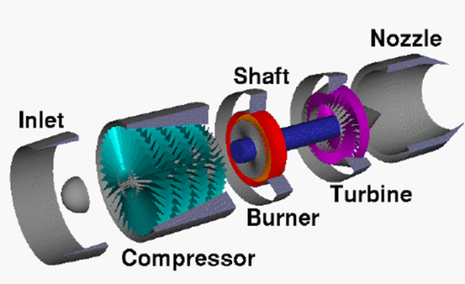
Turbojet Parts and Operation
PRESSURE
Exploded view
showing components
Turbine
Compressor
SPARE
PRESSURE
Shaft work
Large pressure
rise
Small pressure
drop
Cold section
Hot section
Notes:
Throughout any gas turbine there is an interchange of pressure and velocity. In compressor blade passages, air slows down and pressure increases. In turbine blade passages, gas accelerates in response to a reducing pressure.
The fundamental operation of the gas turbine can be explained in two ways. It can be explained as an energy conversion process or more fundamentally in terms of Newton’s Laws of Motion.
The energy explanation states that the energy input in the combustor provides the turbine gas with enough energy to drive the compressor and accelerate a jet or drive a power turbine.
But energy explanations are shorthand. An energy balance does not explain the mechanism that is working.
The mechanistic explanation is that a cold gas is less bulky than a hot gas. At any given flow velocity pressure and massflow a cold gas has a smaller flow area than a hot gas. The braking force on it as it passes through a compressor is low for a given rise in pressure. In contrast, the accelerating force on the hot gas in a turbine is high for a given drop in pressure. Given that the changes in velocity in a matched compressor and turbine have to give a balanced rate of change of momentum and torque, the result is that the turbines drive the compressors for less pressure drop than the compression pressure rise, which leaves spare pressure to be used elsewhere.

Slide 14
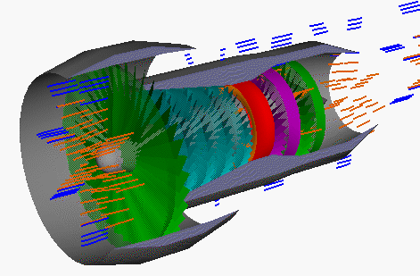
Turbofan
Modern military and commercial aircraft
Combines best of high and low speed and altitude performance
Two airstreams
Center core of air sent through process similar to basic turbojet
Some air passes around this center turbojet
Ratio of two streams is bypass ratio
Notes:
An interactive engine presentation can be found at GE Aviation’s education website: http://www.geae.com/education/index.html . Select Engines 101.
An animated journey through a jet engine can be found at the Rolls Royce education website: http://www.rolls-royce.com/cr/education/resources/how_things_work/index.jsp
Select Take a Journey Through a Jet Engine.
A turbofan engine is the most modern variation of the basic gas turbine engine. As with other gas turbines, there is a core engine. In the turbofan engine, the core engine is surrounded by a fan in the front and an additional turbine at the rear. The fan and fan turbine are composed of many blades, like the core compressor and core turbine, and are connected by an additional shaft also called turbomachinery. As with the core compressor and turbine, some of the fan blades turn with the shaft and some blades remain stationary. The fan shaft passes through the core shaft for mechanical reasons. This type of arrangement is called a two spool engine; one “spool" for the fan, one "spool" for the core. Some advanced engines have additional spools for sections of the compressor which provide for even higher compressor efficiency.
How does a turbofan engine work? The incoming air is captured by the engine inlet. Some of the incoming air, colored blue on the figure, passes through the fan and continues on into the core compressor and then into the burner, where it is mixed with fuel and combustion occurs. The hot exhaust passes through the core and fan turbines and then out the nozzle, as in a basic turbojet.
More information is available at NASA’s website: http://www.grc.nasa.gov/WWW/K-12/airplane/turbfan.html

Slide 15
Turbofan
Notes:
The online flash video can be viewed through the following link: http://www.rolls-royce.com/interactive_games/journey02/flash.html

Slide 16
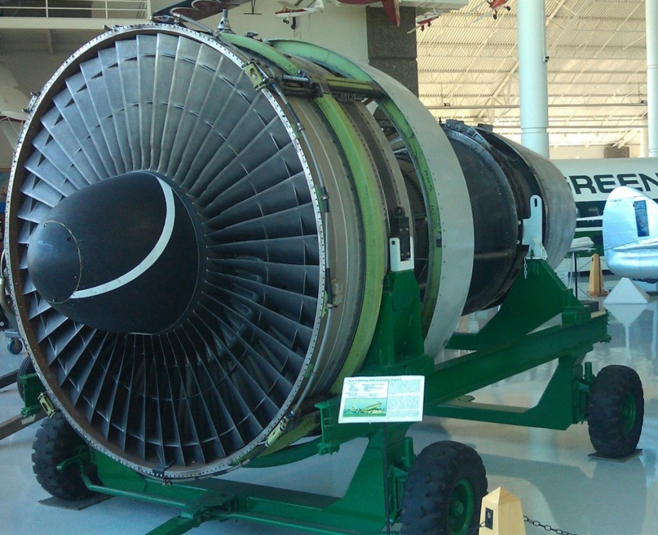
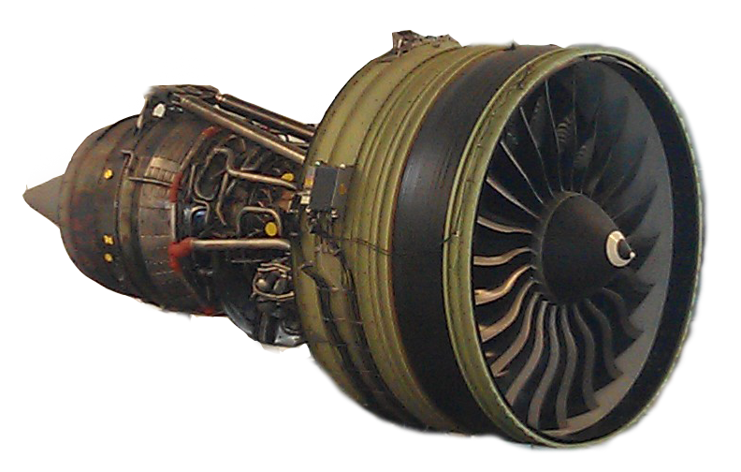
Turbofan
Boeing 777 Engine
Boeing 767 Engine
Notes:
Ask students what the purpose might be for the white stripe on the engine cone. The answer is to indicate to personnel whether the engine is turning or static.

Slide 17
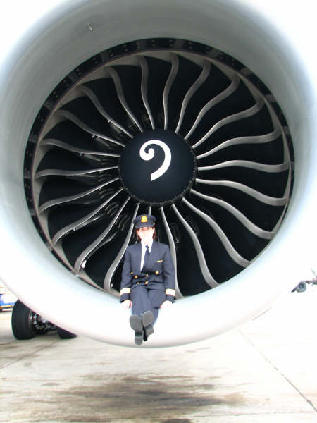
Turbofan Engine Size
Boeing 777 Engine Intake
Notes:
The image shows the scale of a turbofan engine.

Slide 18
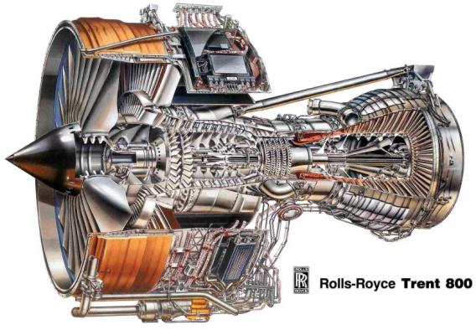
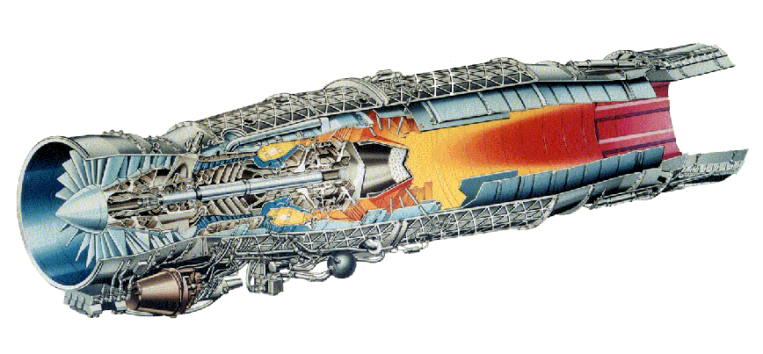
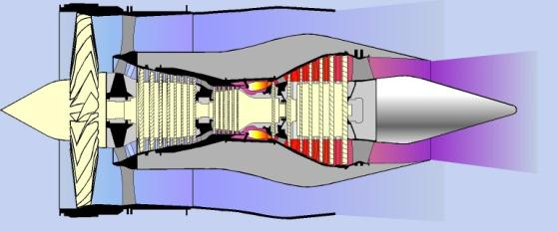
Turbofan Bypass Ratios
High bypass ratio turbofan
for civilian aircraft
Low bypass ratio turbofan
for military aircraft
Notes:
The images on the left are an example of a high bypass ratio turbofan for civilian aircraft. It is a Rolls Royce Trent 800 turbofan engine.
The images on the right are an example of a low bypass ratio turbofan for military aircraft. It is a Rolls Royce EJ200 turbofan engine. The military aircraft’s flight speed and jet velocity are both higher than for a civilian airliner, but jet velocity is still less than a turbojet (V_{flight} < V_{jet} < V_{turbojet}).

Slide 19
Turbofan Operation
Core
compressor
Core turbine
PRESSURE
LPT 1
Bypass
Spare
pressure
Accelerate,
slow down,
accelerate,
slow down,
at each stage
LPT 2
LPT 3
LPT 4
Very fast core jet
Core

Slide 20
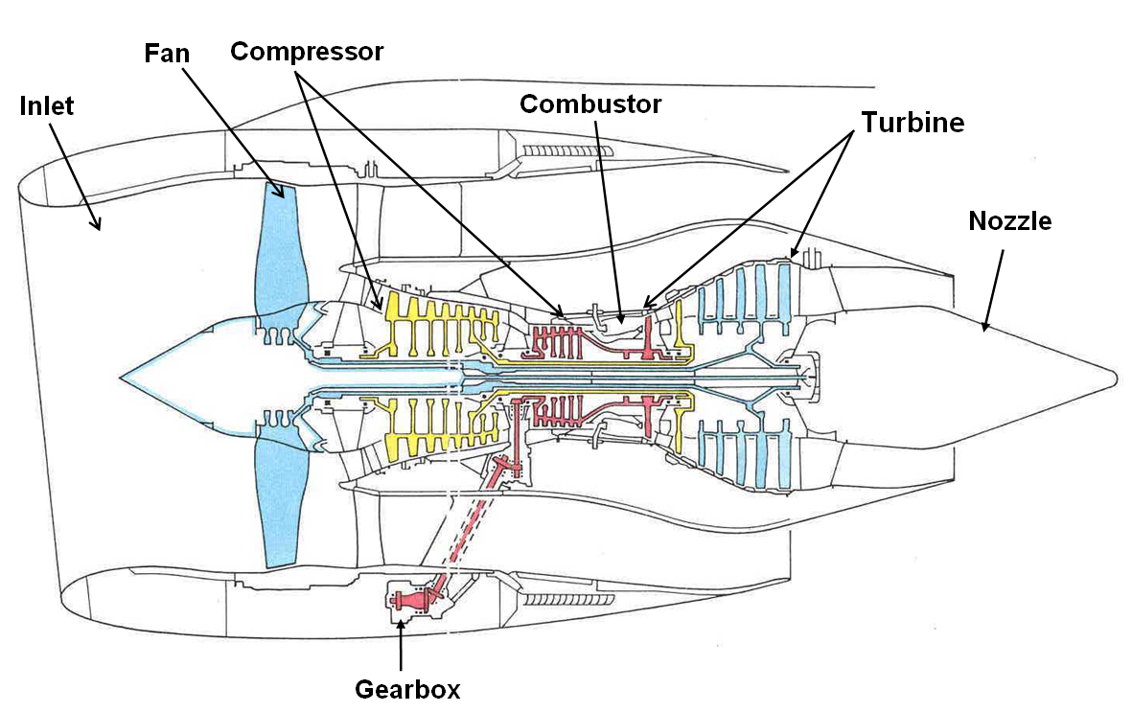
Three-Shaft Turbofan Engine Configuration

Slide 21
Gas Turbine Engine
Thrust Producer
Shaft Power Producer
Compressor supplies high pressure air to the combustor where it is heated by burning fuel
Flow leaving the combustor has a lot of energy
Notes:
• The compressor supplies high pressure air to the combustor where it is heated by burning fuel. The flow leaving the combustor has a lot of energy.
• Some of the energy in the hot, high pressure air leaving the combustor is extracted by a high pressure turbine. The high pressure turbine turns this energy into rotating shaft power to turn the compressor.
• The gas energy left over after enough has been extracted to turn the compressor can be used as thrust or power.

Slide 22
Gas Turbine Engine
Purpose of a gas turbine engine is to generate thrust to propel an aircraft or to generate shaft power
Thrust is a force generated by accelerating air
Thrust is rate of change of momentum
$$W=Air Mass Flow \left(\frac{m}{s}\right)$$
$$F_{N}=W\left(v_{j}−v_{o}\right)$$
$$v_{o}=Flight Velocity$$
$$F_{N}=Net Thrust$$
$$v_{j}=Jet Velocity$$
Notes:
A turbofan engine can generate thrust (F_{N}) by accelerating a large flow to a low velocity. A turbojet engine can generate thrust (F_{N}) by accelerating a small flow to a high velocity.

Slide 23
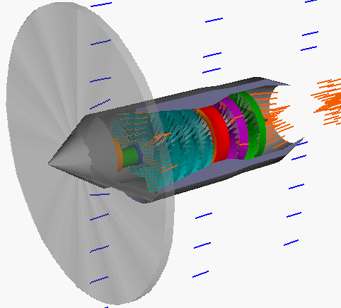
Turboprop
Turbine engine (with power turbine) turns propeller
Propellers develop thrust by moving large mass of air through small change in velocity
Used in low speed transport aircraft and small commuter aircraft
Turbo shaft is similar but drives a rotor for helicopters
Notes:
To move an airplane through the air, thrust is generated with some kind of propulsion system. Many low speed transport aircraft and small commuter aircraft use turboprop propulsion. On this page we will discuss some of the fundamentals of turboprop engines. The turboprop uses a gas turbine core to turn a propeller. Propellers develop thrust by moving a large mass of air through a small change in velocity. Propellers are very efficient and can use nearly any kind of engine to turn the prop. General aviation aircraft use an internal combustion engine to turn the propeller. In the turboprop, a gas turbine core is used. How does a turboprop engine work?
There are two main parts to a turboprop propulsion system, the core engine and the propeller. The core is similar to a basic turbojet, which has a compressor, burner, and turbine. However, at the exit of the main turbine the hot exhaust gas is passed through an additional turbine, shown in green before entering the nozzle. Unlike a basic turbojet, most of the energy of the exhaust is used to turn this additional turbine. The turbine is attached to an additional drive shaft which passes through the core shaft and is connected to a gear box. The gear box is then connected to a propeller that produces most of the thrust. The exhaust velocity of the core is low and contributes little thrust because most of the energy of the core exhaust has gone into turning the drive shaft.
More information available at NASA’s website: http://www.grc.nasa.gov/WWW/K-12/airplane/turbprp.html

Slide 24
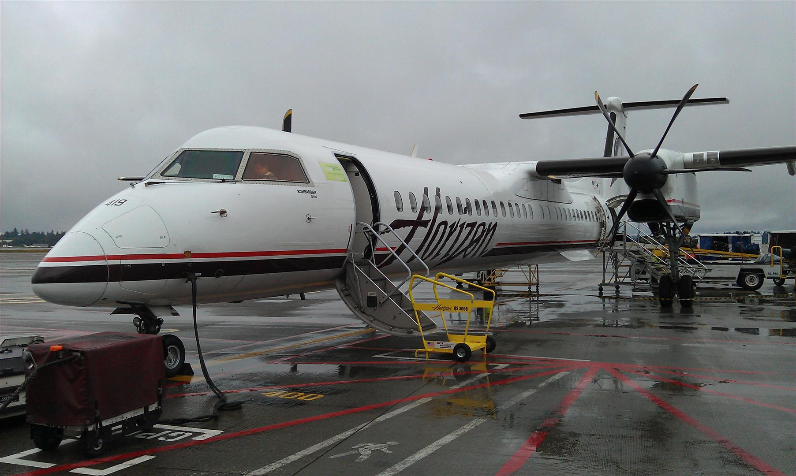
Turboprop Example

Slide 25
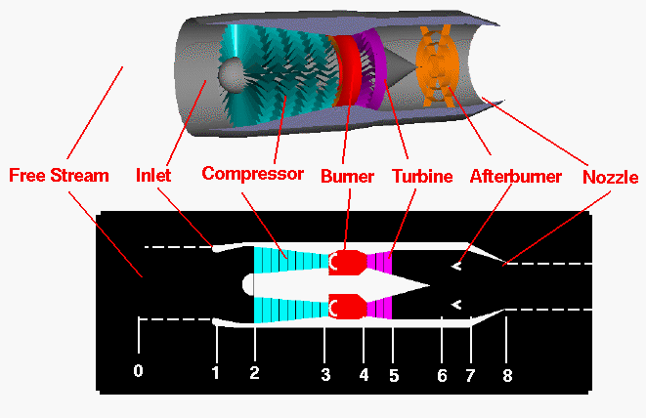
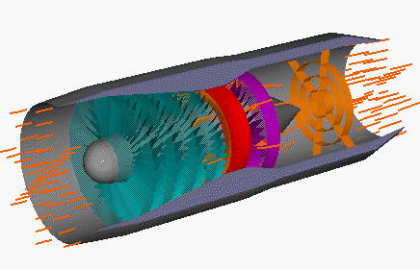
Afterburning Turbojet
Most military fighter jet engines (turbojet and turbofan) use afterburners
Helps exceed drag close to sound barrier
Nozzle extended and fuel injected in hot gases for extra thrust
Inefficient burn uses a lot of fuel
Notes:
Most modern fighter aircraft employ an afterburner on either a low bypass turbofan or a turbojet. In order for fighter planes to fly supersonically, they have to overcome a sharp rise in drag near the speed of sound. A simple way to obtain the necessary thrust is to add an afterburner to a core turbojet. In a basic turbojet, some of the energy of the exhaust from the burner is used to turn the turbine. The afterburner is used to put back some energy by injecting fuel directly into the hot exhaust. Notice that the nozzle of the basic turbojet has been extended and there is now a ring of flame holders, colored yellow, in the nozzle. When the afterburner is turned on, additional fuel is injected through the hoops and into the hot exhaust stream of the turbojet. The fuel burns and produces additional thrust, but it doesn't burn as efficiently as it does in the combustion section of the turbojet. You get more thrust, but you burn much more fuel. With the increased temperature of the exhaust, the flow area of the nozzle must be increased to pass the same mass flow. Therefore, afterburning nozzles must be designed with variable geometry and are heavier and more complex than simple turbojet nozzles. When the afterburner is turned off, the engine performs like a basic turbojet. You can investigate nozzle operation with our interactive nozzle simulator. The nozzle of a turbojet is usually designed to take the exhaust pressure back to free stream pressure.
More information available at NASA’s website: http://www.grc.nasa.gov/WWW/K-12/airplane/turbab.html

Slide 26
Afterburning Turbofan
Variable nozzle geometry
3-stage fan
Afterburner
Single-stage LP turbine
Single stage HP turbine
Note: LP = Low Pressure
HP = High Pressure
Notes:
The image is a Rolls Royce EJ200 turbofan engine. The military aircraft’s flight speed and jet velocity are both higher than for an civilian airliner, but jet velocity is still less than it would be as a turbojet (V_{flight} < V_{jet} < V_{turbojet}).

Slide 27
Gas Turbine Alternate Uses
Also used to power
Racing cars
Ships
Electrical power generators
Natural gas pumping stations

Slide 28
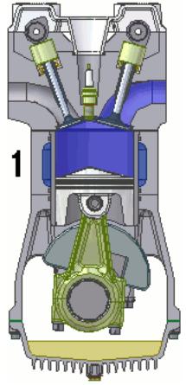
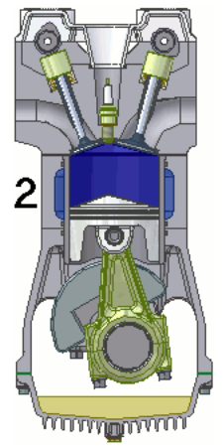
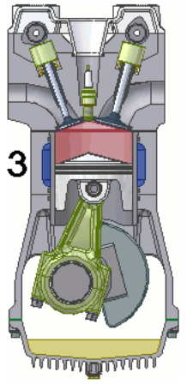
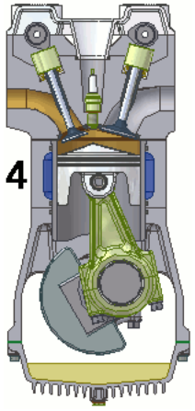
Engine Operation Similarity
Reciprocating and turbine engines have same four operations
Intake
Compression
Ignition
Expansion
Notes:
Each of the stages in a jet engine are similar to the operations of a reciprocating engine.

Slide 29
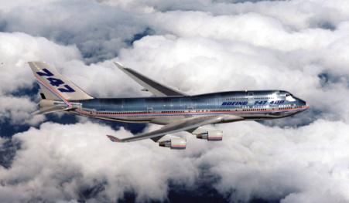
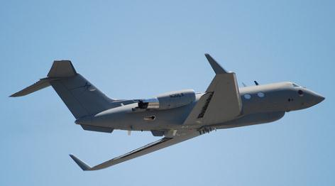
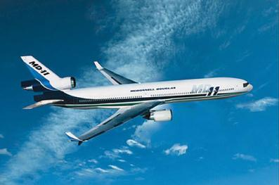
Engine Placement
Engine arrangements
Under wing
Engine weight close to lift generation
Reduces wing structure
Rear-fuselage
Mixed under wing and rear fuselage

Slide 30
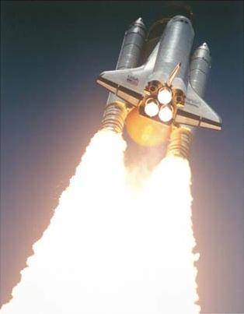
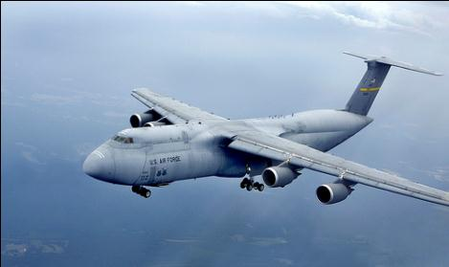
Types of Propulsion Systems
All propulsion systems are driven by an engine
Propeller
Turbine (also called jet)
Ramjet and scramjet
Rocket

Slide 31
References
Federal Aviation Administration . (2007). Airplane flying handbook. New York, NY: Skyhorse Publishing.
Hunecke, K. (1997). Jet engines fundamentals of theory, design and operation (A. Vanags-Baginskis Trans.). Marlborough, England: The Crowood Press. (Original work published 1987).
Lockheed Martin (2010). Retrieved from http://www.flickr.com/photos/lockheedmartin/
National Aeronautics and Space Administration (2010). Retrieved from http://www.nasa.gov/
National Aeronautics and Space Administration (2009). Retrieved from http://oea.larc.nasa.gov/PAIS/Concept2Reality/winglets.html

Slide 32
References
National Aeronautics and Space Administration (2010). Retrieved from http://www.grc.nasa.gov/WWW/K-12/airplane/stroke.html
Rolls-Royce Group plc (2005). Aircraft engines. [Presentation]
The Powerplant and Related Systems. In Jeppesen private pilot: Guided flight discovery (pp. 2-14 – 2-46). (2007). Englewood, CO: Jeppesen
UtzOnBike. (2010). 4 stroke engine. Retrieved from http://en.wikipedia.org/wiki/File:4-Stroke-Engine.gif

