Slide 1
Rocket Components and Design
Aerospace Engineering
© 2011 Project Lead The Way, Inc.

Slide 2
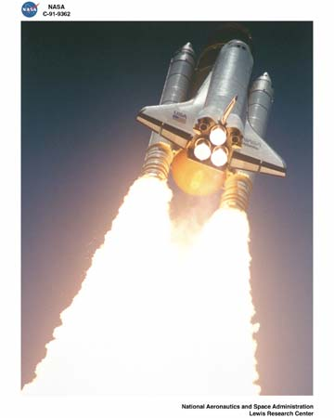
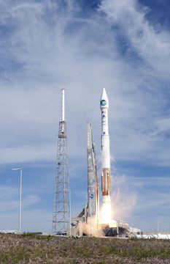
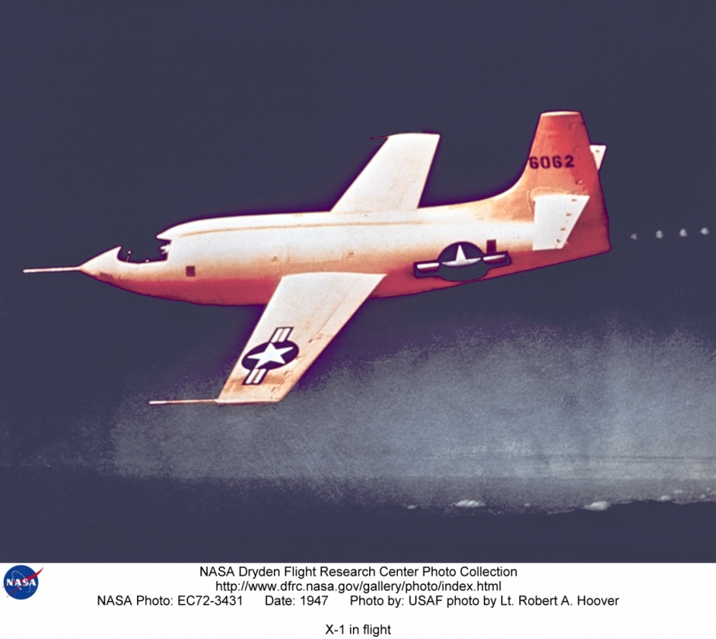
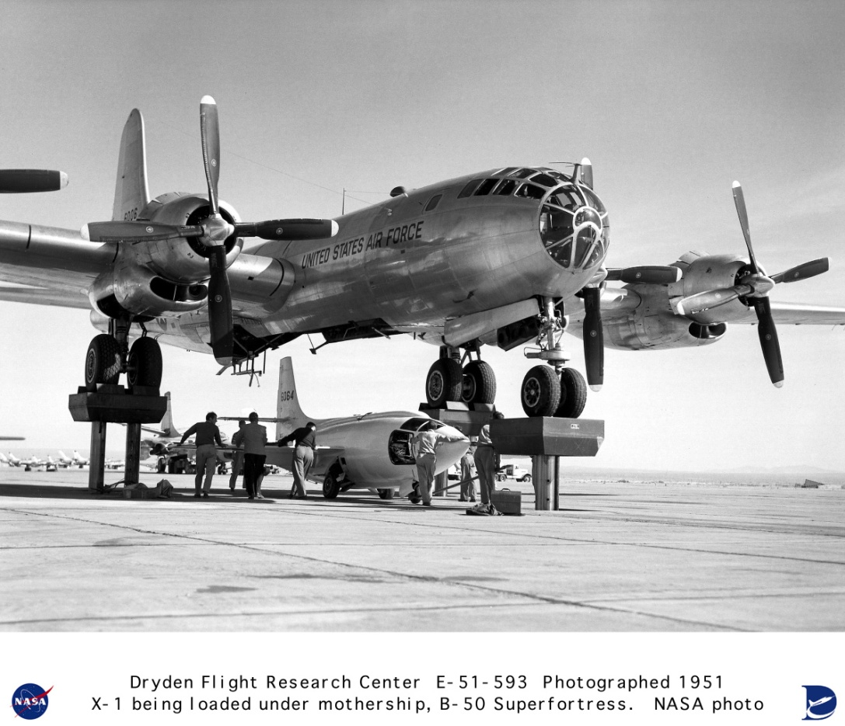
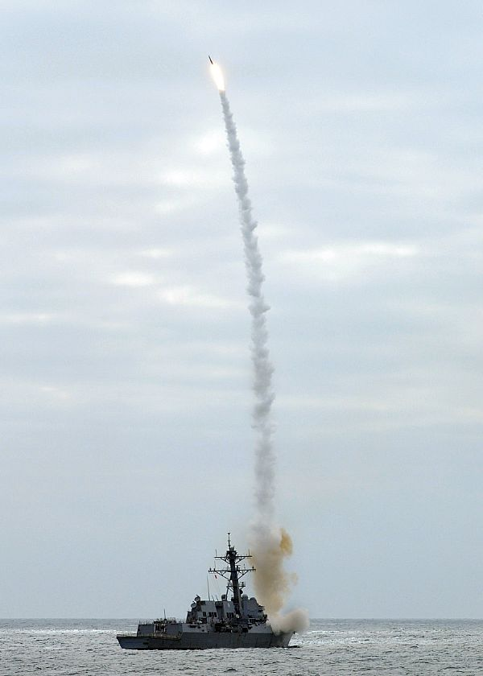
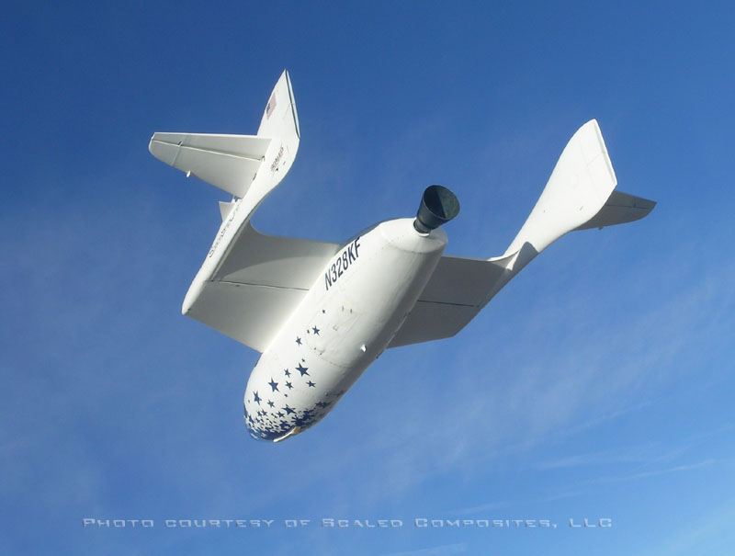
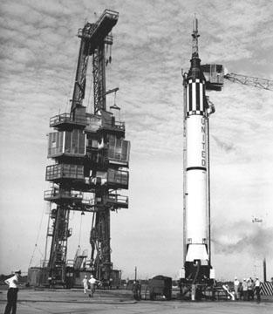
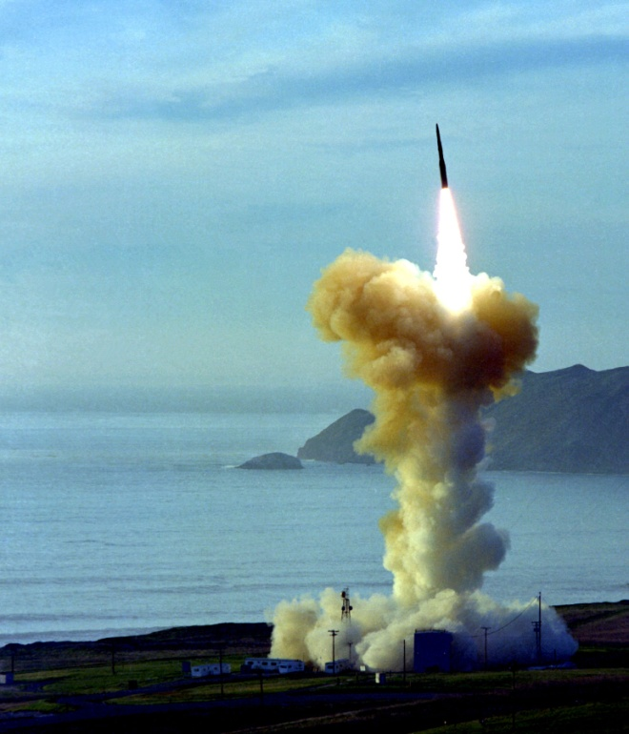
Rocket Applications
Bell X-1 first to exceed sound barrier
Space launch vehicles
Space shuttle
Military missiles
Space tourism
Notes:
Bell X-1 was the first supersonic flight. Chuck Yeager served as the test pilot. The X-1 was dropped from a bomber, the liquid propellants, alcohol, and liquid oxygen were mixed and burned to push the aircraft to reach a speed of mach 1.06.
The space shuttle contains 67 rocket propulsion systems. The most noticeable ones are the two solid rocket boosters, SRB, which straddle the single large liquid oxygen and hydrogen rocket.

Slide 3
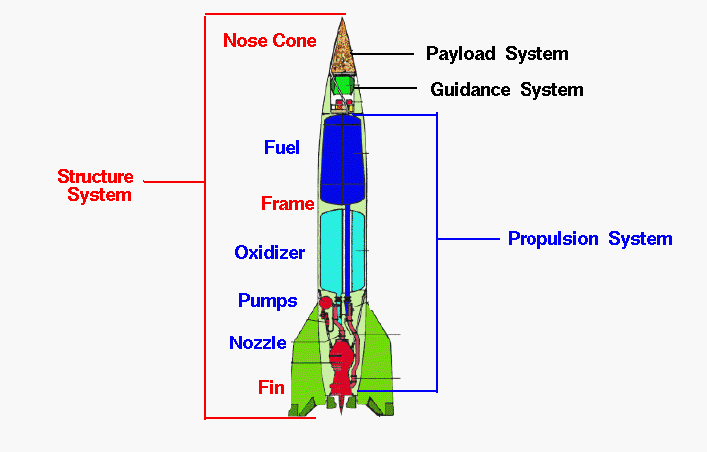
Rocket Components

Slide 4
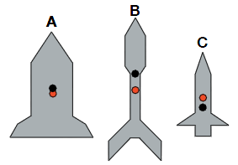
Rocket Stability
Center of gravity ahead of center of pressure with respect to airflow along rocket
In the same way that the weightof all the rocket components acts through the center of gravity cg, the aerodynamic forces act through a single point called the center of pressure cp.
Center of Gravity
Center of Pressure

Slide 5
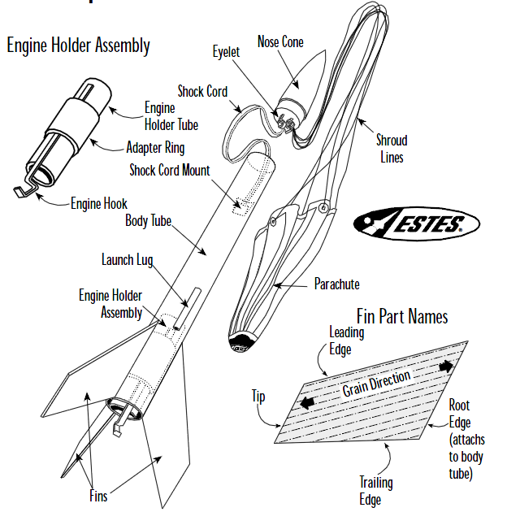
Model Rocket Components
Root
Edge
(attaches
to body
Tube)

Slide 6
Forces on Rocket in Flight
Four Forces
Weight
Thrust
Drag
Lift
Notes:
The study of rockets is an excellent way for students to learn the basics of forces and the response of an object to external forces. The motion of an object in response to an external force was first accurately described over 300 years ago by Sir Isaac Newton, using his three laws of motion. Engineers still use Newton's laws to design and predict the flight of full scale rockets.
Forces are vector quantities having both a magnitude and a direction. When describing the action of forces, one must account for both the magnitude and the direction. In flight, a rocket is subjected to four forces; weight, thrust, and the aerodynamic forces, lift and drag. The magnitude of the weight depends on the mass of all of the parts of the rocket. The weight force is always directed toward the center of the earth and acts through the center of gravity, the yellow dot on the figure. The magnitude of the thrust depends on the mass flow rate through the engine and the velocity and pressure at the exit of the nozzle. The thrust force normally acts along the longitudinal axis of the rocket and therefore acts through the center of gravity. Some full scale rockets can move, or gimbal, their nozzles to produce a force which is not aligned with the center of gravity. The resulting torque about the center of gravity can be used to maneuver the rocket. The magnitude of the aerodynamic forces depends on the shape, size, and velocity of the rocket and on properties of the atmosphere. The aerodynamic forces act through the center of pressure, the black and yellow dot on the figure. Aerodynamic forces are very important for model rockets, but may not be as important for full scale rockets, depending on the mission of the rocket. Full scale boosters usually spend only a short amount of time in the atmosphere.
During flight the magnitude, and sometimes the direction, of the four forces is constantly changing. The response of the rocket depends on the relative magnitude and direction of the forces, much like the motion of the rope in a "tug-of-war" contest. If we add up the forces and carefully account for the direction, we obtain a net external force on the rocket. The resulting motion of the rocket is described by Newton's laws of motion. Although the same four forces act on a rocket as on an airplane, there are some important differences in the application of the forces:
On an airplane, the lift force (the aerodynamic force perpendicular to the flight direction) is used to overcome the weight. On a rocket, thrust is used in opposition to weight. On many rockets, lift is used to stabilize and control the direction of flight.
On an airplane, most of the aerodynamic forces are generated by the wings and the tail surfaces. For a rocket, the aerodynamic forces are generated by the fins, nose cone, and body tube. For both airplane and rocket, the aerodynamic forces act through the center of pressure (the yellow dot with the black center on the figure), while the weight acts through the center of gravity (the yellow dot on the figure).
While most airplanes have a high lift to drag ratio, the drag of a rocket is usually much greater than the lift.
While the magnitude and direction of the forces remain fairly constant for an airplane, the magnitude and direction of the forces acting on a rocket change dramatically during a typical flight.

Slide 7
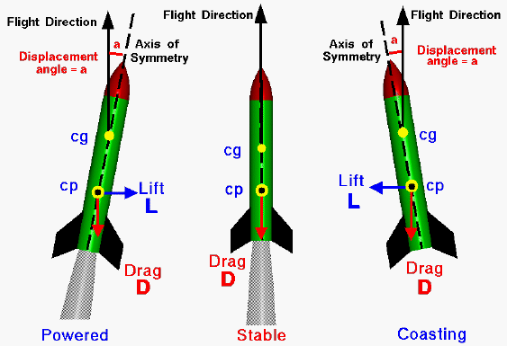
Rocket Stability

Slide 8
Rocket Weight

Slide 9
Rocket Center of Gravity

Slide 10
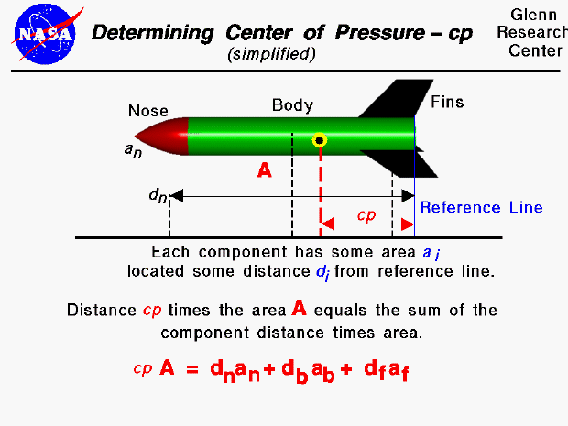
Determining Center of Pressure

Slide 11
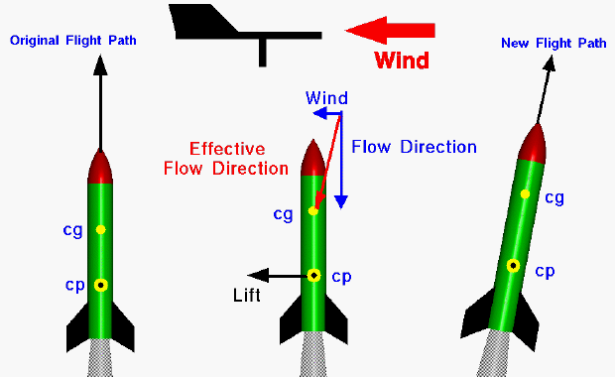
Rocket Flight

Slide 12
Rocket Flight

Slide 13
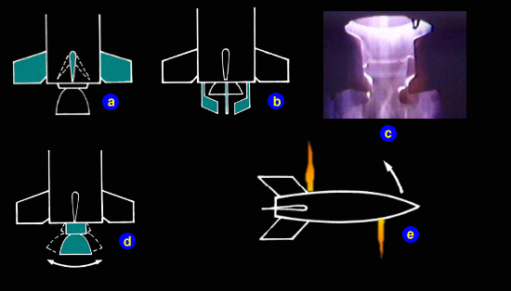
Rocket Attitude Control

Slide 14
References
National Aeronautics and Space Administration (2010). X-1 in flight. Retrieved from http://www.dfrc.nasa.gov/gallery/photo/X-1/index.html
National Aeronautics and Space Administration (2010). Retrieved from http://www.nasa.gov/
National Museum of the USAF (2010). Sentinels of freedom: air force strategic missles. Retrieved from http://www.nationalmuseum.af.mil/factsheets/factsheet.asp?id=14577
Lockheed Martin (2010). Retrieved from http://www.flickr.com/photos/lockheedmartin/

Slide 15
References
Lockheed Martin (2010). Retrieved from http://www.flickr.com/photos/lockheedmartin/
Sutton, G, & Biblarz, O. (2001). Rocket propulsion elements: An introduction to the engineering of rockets. New York, NY: John Wiley & Sons, Inc.
US Navy (2010). Retrieved from http://www.navy.mil/view_single.asp?id=60914

