Slide 1
Activity 4.2.8d Satellite Flight
Path Construction Guide
Aerospace Engineering
© 2011 Project Lead The Way, Inc.

Slide 2
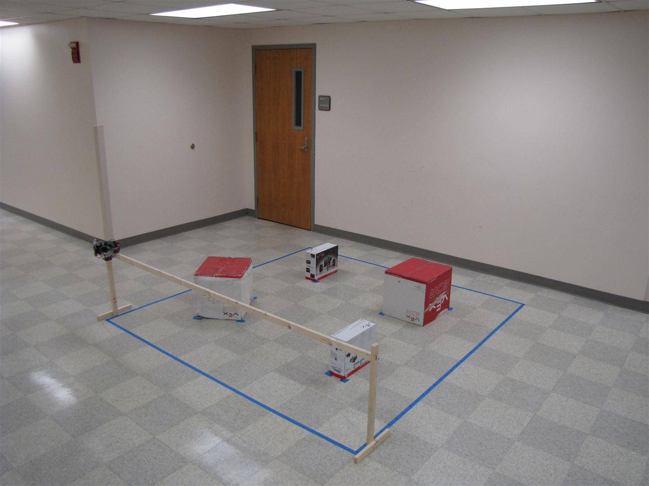
Equipment
1 in. x 2 in. x 8 ft furring strips (2)
1 in. screws (4)
2 in. screws (4)
2 in. L-brackets with screws (2)
Drill
Drill bits
Drill fastener bits

Slide 3
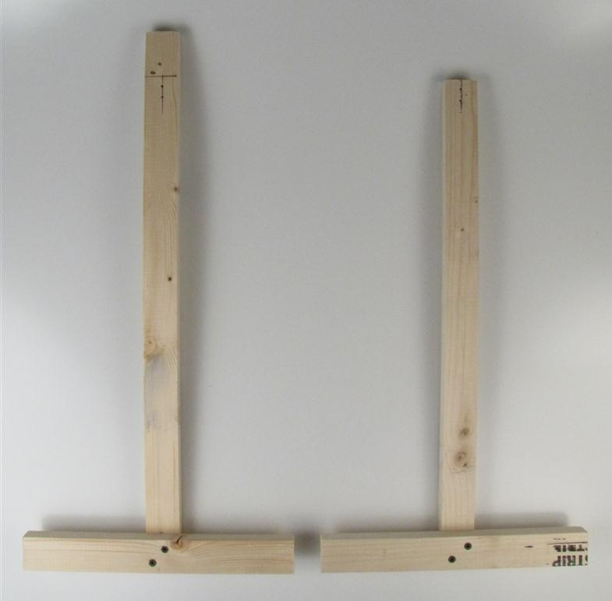
Step 1: Cut and Assemble Path Supports
Step 1:
Mark line 2 in. from end to align top of path
Step 3:
Mark center line
Step 2:
Mark center line
1 in. x 2 in. x 24 in. furring strip
1 in. x 2 in. x 22 in. furring strip
1 in. screws (2)
1 in. screws (2)
Step 4:
Attach both vertical and horizontal
strips with screws
1 in. x 2 in. x 12 in. furring strips x 2 attached with screws

Slide 4
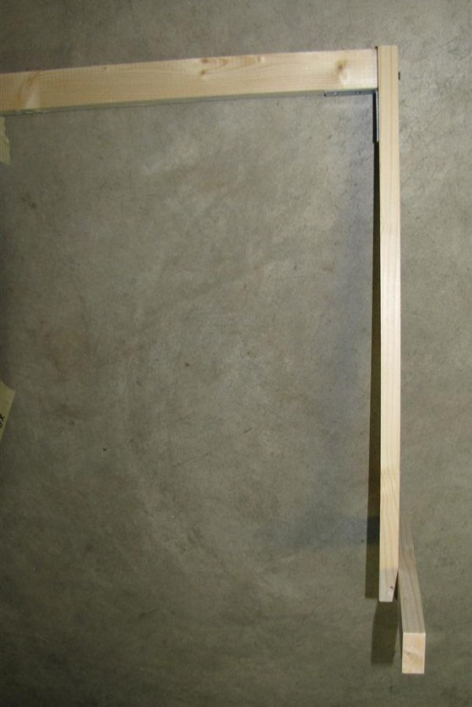
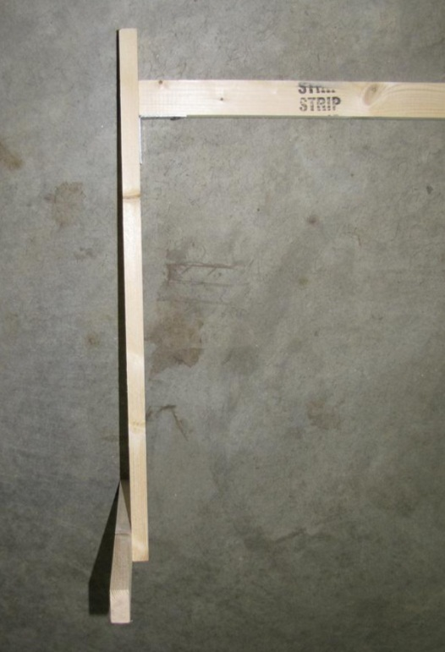
Step 2: Attach Frame Bar
Step 5:
Align top of path with top of support.
Attach path to support with screws.
2 in. screws (2)
Start end
2 in. screws (2)
Stop end
2 in. L-bracket
Step 6:
Align top of path 2 in. below top of support.
Attach path to support with screws.

